Slide 1
welcome

Slide 2
Introduction
Class : 3
Subject : English
Iessons : 1-2
Title : Occupations
Time : 35minute
Page : 38
Date : 12-11-2020
Teacher’s name : Umme Ayman
Designation :Assistant Teacher
School’s name: Pakundia Model Govt. Primary School.

Slide 3
Learning outcome:Students will be able to-
Listening
3.3.1 understand statements.
speaking
6.1.2 say what others are doing.
Reading
1.4.1 read and match words and sentences with pictures.
Writing
8.1.1 write words from the text book.

Slide 4
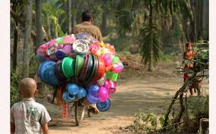
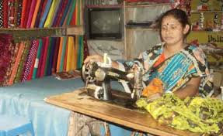
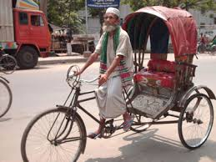
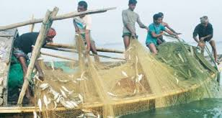
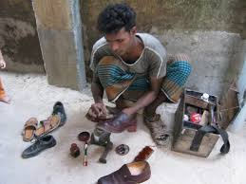
Showing picture

Slide 5
Today our lesson is about Occupations.

Slide 6
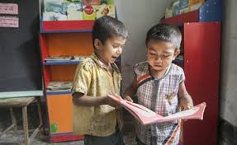
Everybody open your page at 38

Slide 7
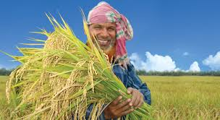
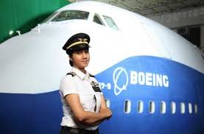
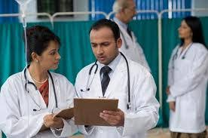
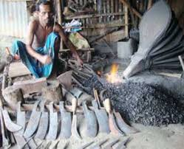
Lets introduce and pronounce some news word
Farmer
Pilot
Doctor
Blacksmith

Slide 8
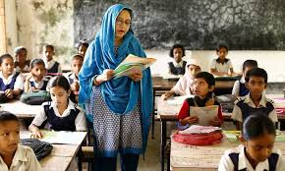
Teachers reading aloud and whole class listen.

Slide 9
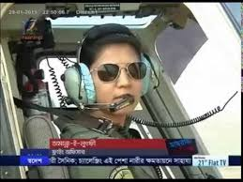
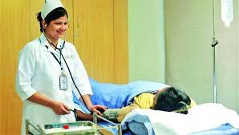
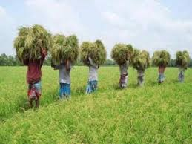
A blacksmith makes metal things
A pilot flies a plane
A doctor helps people
A farmer grows food

Slide 10
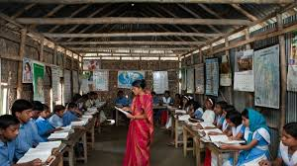
Everybody say with me

Slide 11
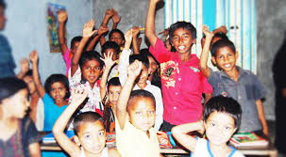
One student will read out and others will repeat.wcw

Slide 12
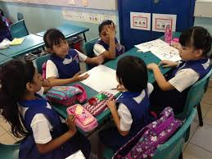
Group work
Every five make a group.
Group 1:write the 4 occupation name
Group 2:Fill in the gaps
1………..grows food.
2………..helps people.
3………..flies a plane.
4……….. Makes metal things.

Slide 13
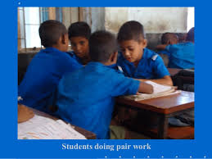
Every 2 make a pair.one will ask another will ans.
Pair work

Slide 14
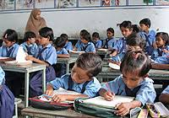
Everybody read the text silently

Slide 15
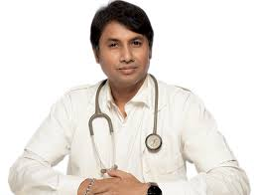
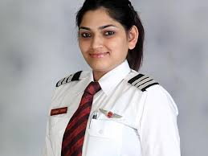
Oral test

Slide 16
Match sentence with the picture.
A doctor helps people.
A farmer grows food
A pilot flies a plane
A blacksmith makes metal things.

Slide 17
Thank you

