Slide 1
Welcome to All

Slide 2
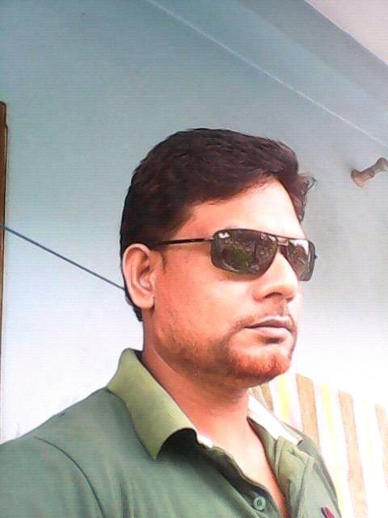
Introduction
Md Shahneoaz
Assistant Teacher (English)
Jalalabad B/L High School,Sylhet.
E-mail: shahneoazmd@yahoo.com
Cell: 01631712091
Class: X
English 1st paper
Unit-9, Lesson-1 (B)
Time- 45 Minutes

Slide 3
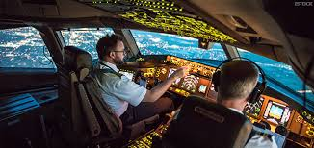
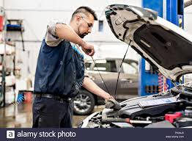
Can you say What the pictures are about?
Different people are doing different jobs

Slide 4
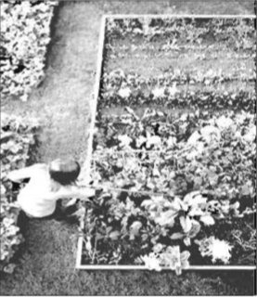
Topic: Jobs That People Do

Slide 5
Learning Outcomes:
After finishing this lesson students will be able to-
write about jobs and situations.
answer the questions.
describe how a person keep his mental satisfaction avoiding the job of a desk clerk.

Slide 6
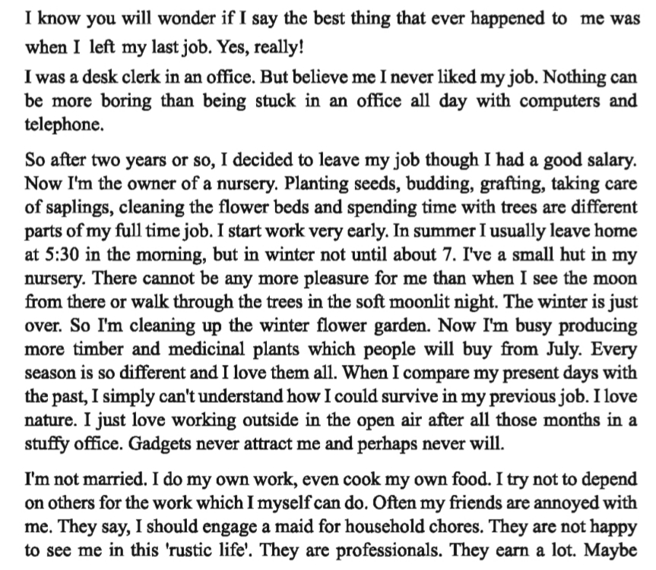
Read the passage in unit-9, lesson-1 (B)
Silent Reading

Slide 7
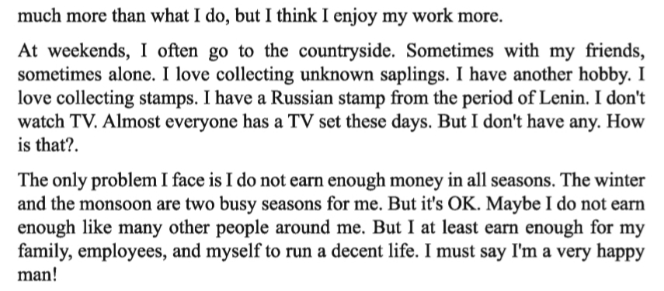
Read the passage in unit-9, lesson-1 (B)
Silent Reading

Slide 8
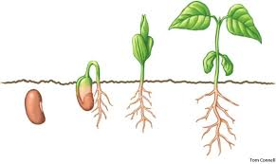
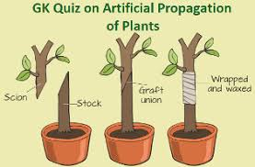
Let’s be introduced with new Words:
Budding
Germinate
Grafting is a horticultural technique whereby tissues of plants are joined so as to continue their growth together.
Grafting

Slide 9
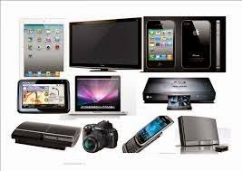
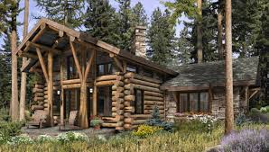
Let’s be introduced with new Words:
Gadgets
Appliance/Instruments
Plain/simple/ homely/ unsophisticated
Rustic

Slide 10
Answer the following questions:
Group Work
1. What is the best thing that ever happened to this man?
Ans. The best thing that ever happened to this man is to leave his last job.
2. Why didn’t Kamal like his last job.?
Ans. Kamal didn’t like his last job because it was boring to him being stuck in an office all day with computers and telephone.
3. What are the advantages and disadvantages of his present job?
Ans. The advantage is that he has a self satisfaction with his job and the disadvantage is that he can’t earn more than his friends.
4. When does he earn most money?
Ans. He earns most money in the winter and the monsoon.

Slide 11
Question: ‘I must say I’m a very happy man!’---- Do you agree with Sayeed? Write why/Why not.

Slide 12
Thanks a lot for being with me

