Slide 2
Identity
Achia Begum
Head Teacher
Uttarsur K.C GPS
Sreemangal,
Moulvibazar.

Slide 3
Identity
English For Today
Class:Three

Slide 4
Learning Outcomes
Students will be able to:
4.3.1 enjoy and understand simple stories.
3.1.1 ask and answer Wh questions.
5.1.1 read simple paragraphs.
8.1.3 write sentences from the textbook or model.
10.1.1 Write short and simple paragraphs by answering a set of questions.

Slide 5
Let’s enjoy a video

Slide 6
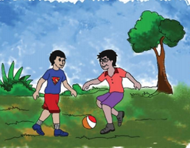
Look at the picture
Think in pair,what will be the picture?What is the relationship between them?

Slide 7
Title decleration
Today’s topic is:
My friend
Unit:35
Lesson:1-3
Pg:70

Slide 8
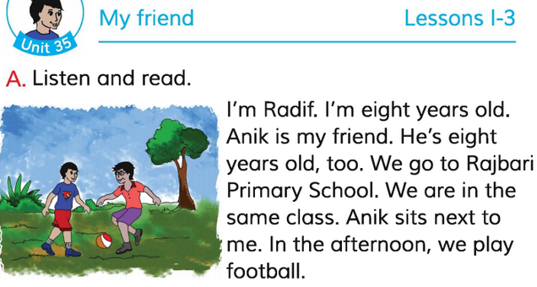
0pen your English book at pg:70.Listen to the audio carefully. Put your finger under the line.

Slide 9
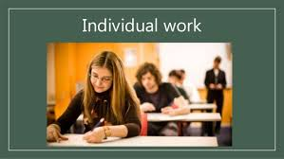
Answer the following questions.
1.Who is Radif?
2.How old is Radif?
3.Who has a friend?
4.Which school do they go?
5.Where do they go?

Slide 10
Teacher’s loud reading
Dear ss, put your finger under the line. Listen to me very carefully what I read and repeat after me.

Slide 11
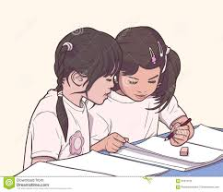
Pair work
Students will read the lesson each other. The teacher will ensure that the students all can read and help if needed.

Slide 12
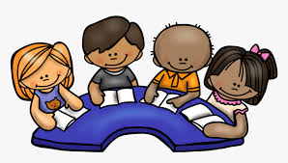
Fill in the blanks.
Group work
a.Radif is ……. Years old.
b. His friends name is……….
c………go to Rajbari Primary School.
d……. sits beside Anik in class.
e. Radif and Anik play…….in the afternoon.

Slide 13
Write 5 sentences about your friend.

