Slide 1
Welcome

Slide 2
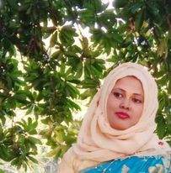
Teacher’s Introduction
Mst.Sharmin Akter
Assistant teacher
Matoin Govt. Primary School
Hajigonj, Chandpur
E-mail:
mstsharminakter1985@gmail.com

Slide 3
Lesson Identity
Class :Four
Subject : English
Lesson :3-5(B,A)
Unit:3
Time : 40 min

Slide 4
Learning Outcomes
Student’s will be able to-
Listening:1.1.1-become familiar with English sounds by listening to common English word.
Speaking:1.1.2-say simple words and phrases with proper sounds and stress.
Reading:1.4.1-read words and phrases with the help of visual clause (about 30 new words) and simple sentences.

Slide 5
What can you see in the picture ?
Do you understand what will be our todays lesson?

Slide 6
Todays lesson topic
Family

Slide 7
Input

Slide 8
Work
officer
play
homemaker
read
grandchildren
N
E
W
W
O
R
D
S

Slide 9
grandchildren
A child of one’s son or daughter

Slide 10
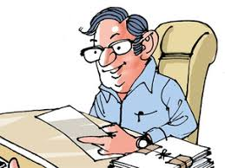
officer
worker

Slide 11
read
study

Slide 12
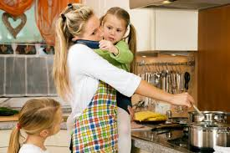
homemaker
housewife

Slide 13
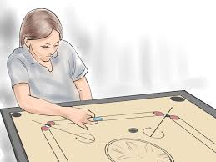
play
game

Slide 14
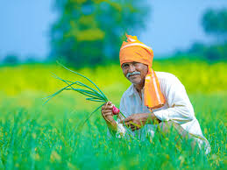
work
labor

Slide 15
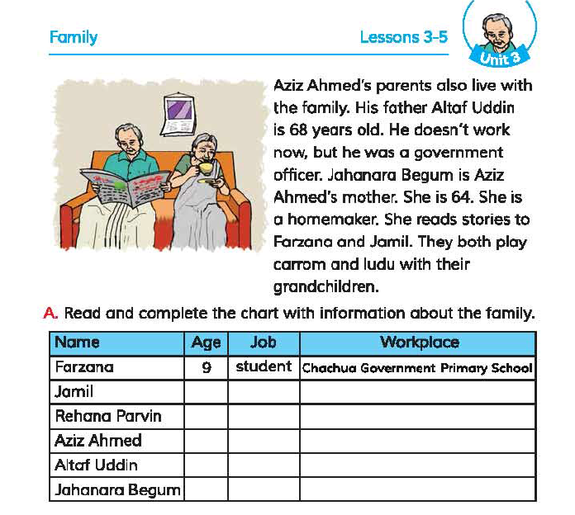

Slide 16
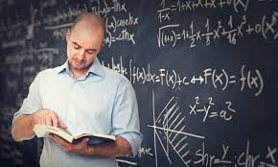
Teacher’s reading

Slide 17
Practice

Slide 18
Student`s reading

Slide 19
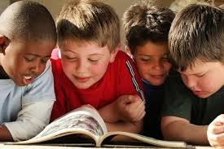
I. Where is Jamil from ?( p-1 )
Group reading

Slide 20
Silent Reading
5 minutes

Slide 21
Questions
1.Where is Jamil from?
2.What is his mother ?
3.What is his father ?

Slide 22
Answer `s
1. Jamil is from Kushtia .
2.His mother is a doctor.
3 .His father is a pilot.

Slide 23
Do it in group

Slide 24
evaluation

Slide 25
Choose the best answer:
IW-3 minutes
1. Who works in a hospital ?
a. jahanara
b. jasmine
c. Rehana Parvin
d. julia

Slide 26
Choose the best answer:
2. How old is Farzana ?
a. Nine years
b. Eight years
c. Ten years
d. Six years

Slide 27
Choose the best answer:
3. How many children do they have ?
a. One
b. Four
c. Three
d. Two

Slide 28
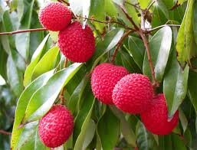
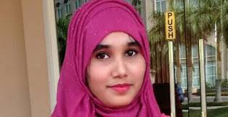
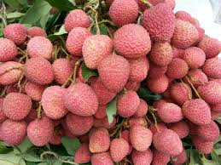
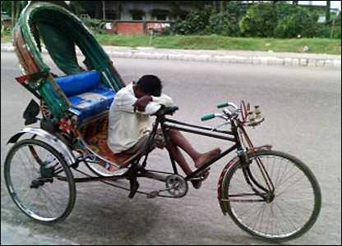
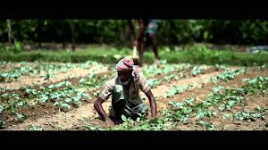
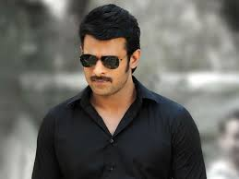
Match the words with their opposite meaning(PW)
Column A | Column B
Take | Rest
Some | Give
Father | Small
Work | Many
 | Mother
take
give
some
many
rest
father
mother
work

Slide 29
task
Write five sentences about your family.

Slide 30
Thanks

