Slide 2
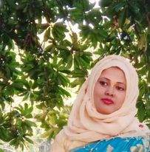
Teacher’s Introduction
Mst.Sharmin Akter
Assistant teacher
Matoin Govt. Primary School
Hajigonj, Chandpur
E-mail:
mstsharminakter1985@gmail.com

Slide 3
Lesson Identity
Class :Four
Subject : English
Lesson : 1-2(A,B)
Unit:14
Time : 40 min

Slide 4
Learning Outcomes
Student’s will be able to-
Listening:1.1.1-become familiar with English sounds by listening to common English word.
Speaking:1.1.2-say simple words and phrases with proper sounds and stress.
Reading:1.4.1-read words and phrases with the help of visual clause (about 30 new words) and simple sentences.
Writing:7.2.1 write time (hours only) and mention a.m /p.m.

Slide 5
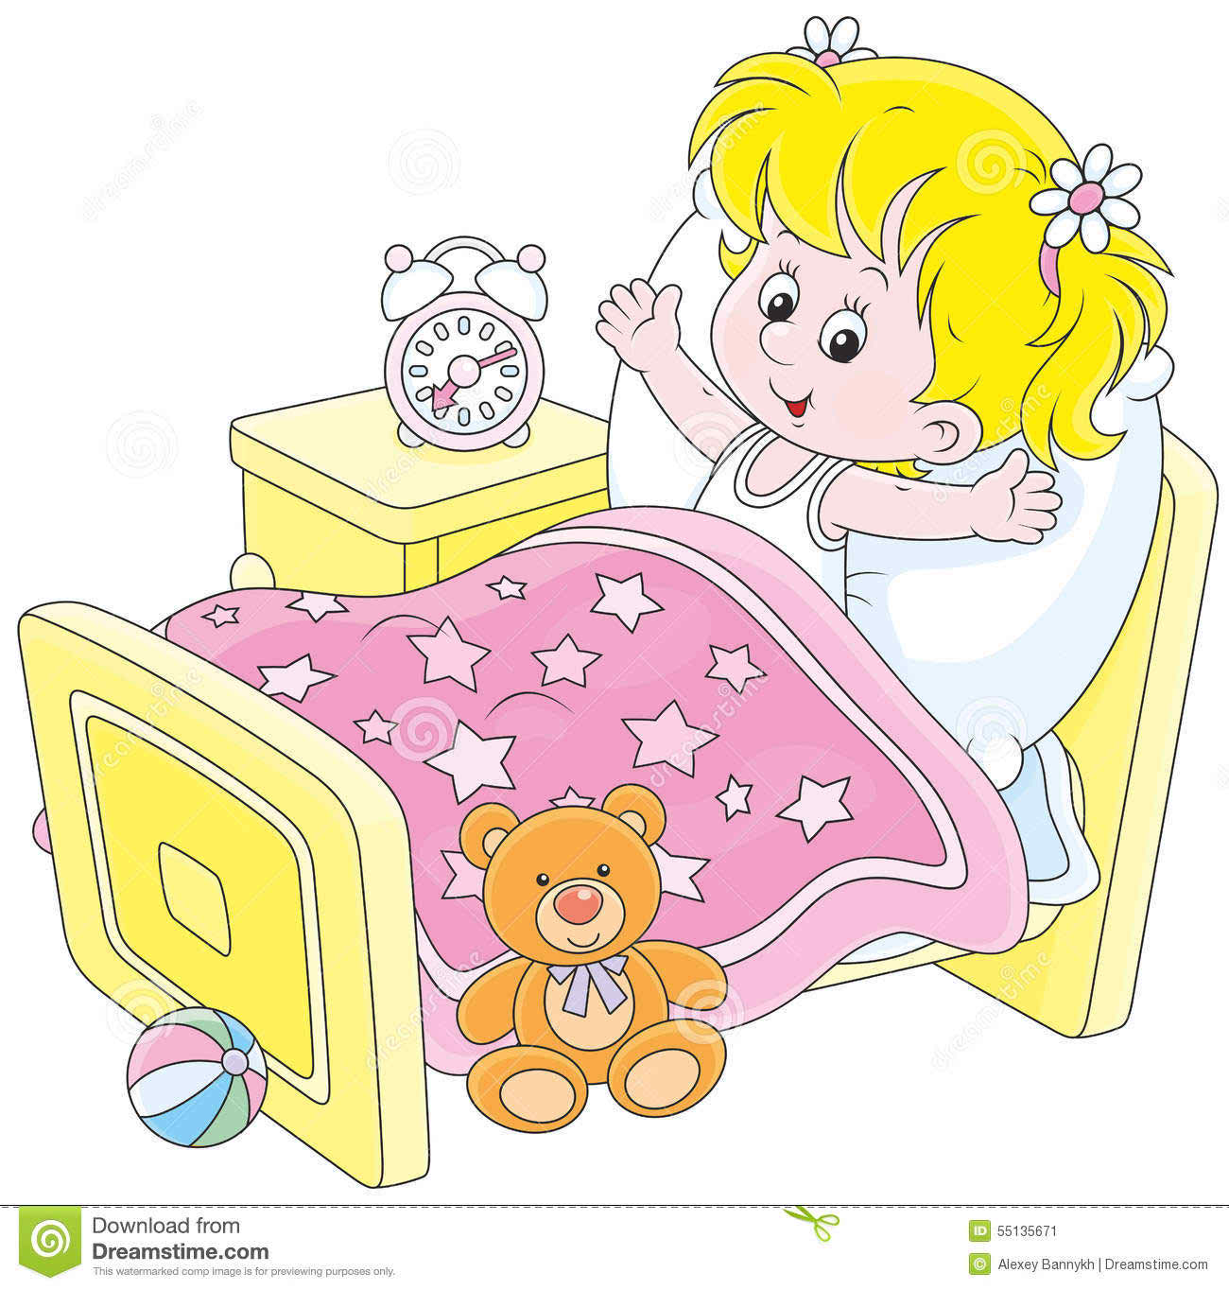
Look at the pictures and discuss with your friends.

Slide 6
Todays lesson topic
Mita’s day

Slide 7
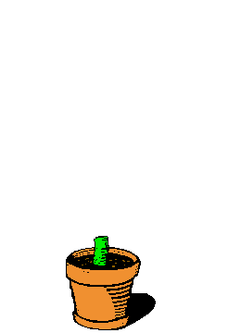
Input

Slide 8
getup
wash
visit
walk
face
return
N
E
W
W
O
R
D
S

Slide 9
Mita is in class 4..

Slide 10
She gets up at six o’clock.

Slide 11
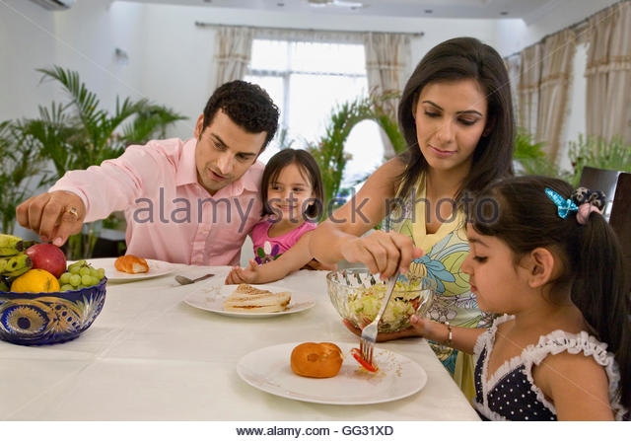
She has breakfast at seven o’clock

Slide 12
She brushes her teeth and wash face.

Slide 13
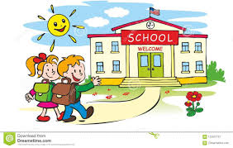
She goes to school at nine o’clock

Slide 14
She walks to her school.

Slide 15
She visits her grandmother at three o’clock.

Slide 16
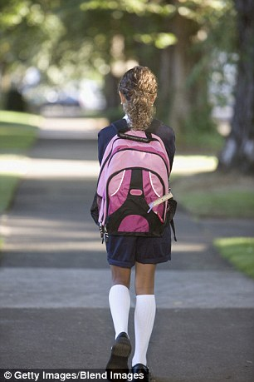
Then , Mita returns home at five o’clock.

Slide 17
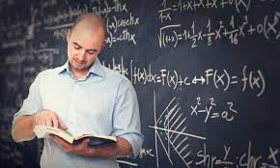
Teacher’s reading

Slide 18
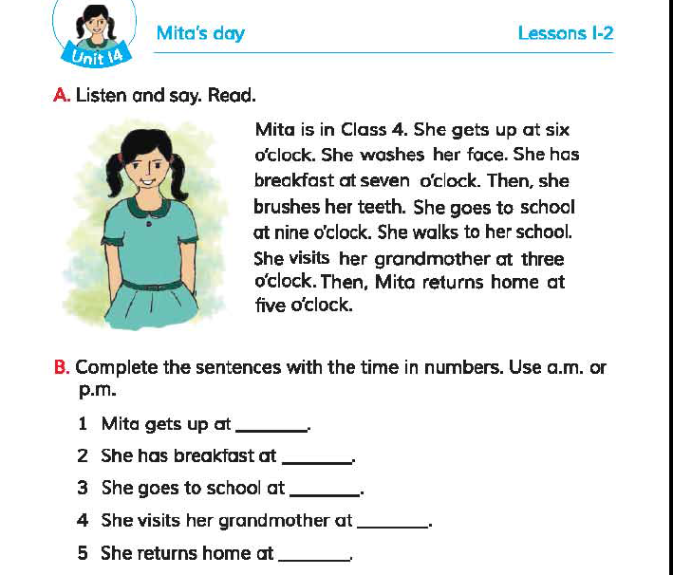

Slide 19
Practice

Slide 20
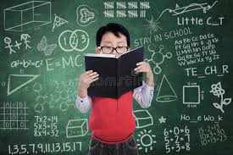
Student`s reading

Slide 21
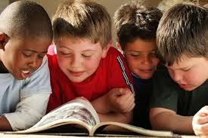
Group reading

Slide 22
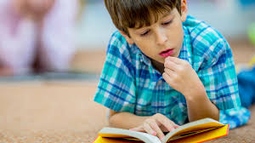
Silent Reading
5 minutes

Slide 23
Write in group

Slide 24
Now we will play “BINGO” game
get
wash
brush
clock
walk
visit
breakfast
return

Slide 25
task
Write five sentences about your day.

Slide 26
Thanks

