Slide 1
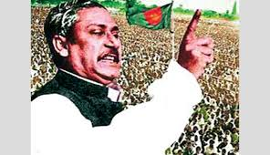
welcome
To English Class

Slide 2
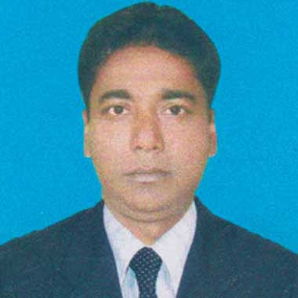
Introduction
Md. Monirul Islam
Assistant Teacher
monir19077@gmail.com
Mobile -01761714820
Azimnagor Computer Technical School & Commercial College
Subject – English 1st paper
Class – Ten
Time – 45 mins

Slide 3
Dear Students Let’s enjoy a historical video

Slide 4
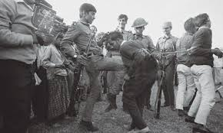
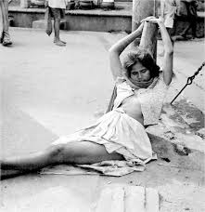
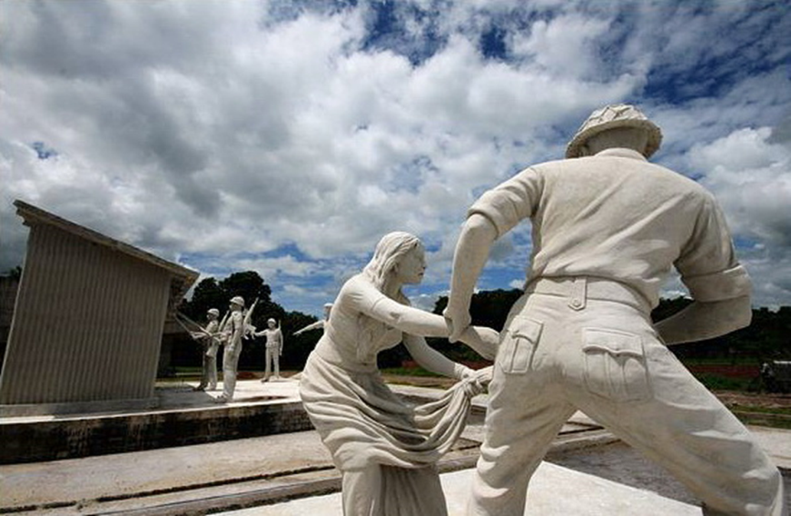
Tyranny of pakistani military

Slide 5
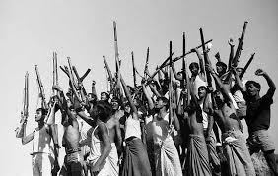
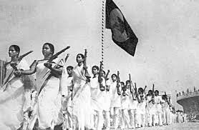
Look at the picture. What can you see in the pictures ?

Slide 6
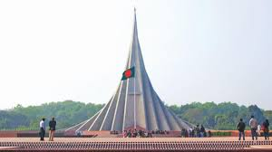
What can you see in the picture ? Why was it built ?

Slide 7
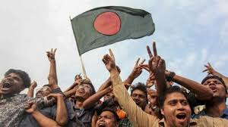
So, today we’ll read about
Independence Day
Unit – Three
Lesson-5

Slide 8
Learning Outcomes
After completing the lesson , we will be able to—
1 . Describing the history of our independence;
2 . Ask and answer questions;
3 . Read and analysis text through silent reading.
4 . write a short paragraph about independence day.

Slide 9
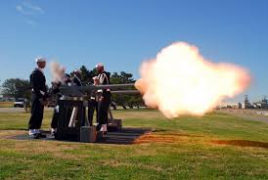
Let us introduce with some key words.
1.
Gun salute
gunfire
shot
26 March , our Independence day begins with a 31 gun salute

Slide 10
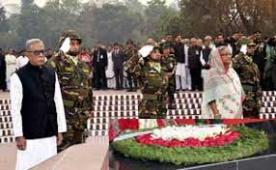
2.
Wreath
garland
bouquet
The President and the Prime Minister on behalf of the nation place floral wreaths at the National Mausoleum at Saver.

Slide 11
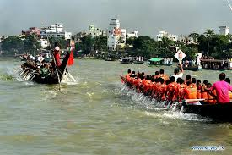
3.
Exciting
thrilling
stimulating
The exciting boat race in the river Buriganga

Slide 12
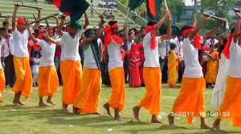
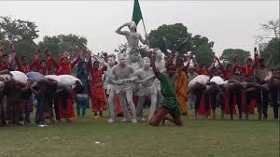
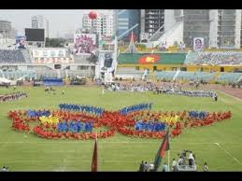
4.
Display
Parade
March-past
Show
School childrens,scouts and girl guides take part in various display to entertain thousands of spectators.

Slide 13
Now read the following words and try to understand the meaning---
Word | Meaning
Independence | Freedom from political control by other countries
Celebrate | To show that a day or an event is important by doing something on it .
Enthusiasm | A strong feeling of excitement and interest in something
Illuminate | To shine light on something
Martyr | One who dies or suffers for his faith or any great cause

Slide 14
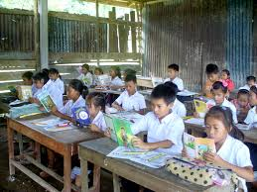
Open at page 36-37 from EFT
Read the text silently within 7 minutes to know about Independence Day

Slide 15
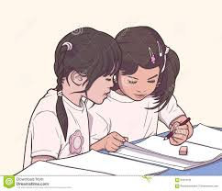
Now work in pair
Mach the words with their meanings
Words | Meanings
Fervour Alike Spectator Displays illuminate
Acts of performing skills
To light up
in a similar way
A strong feeling of excitement
a person who is watching an event
Ans :
Fervour
Alike
Spectator
Display
illuminate

Slide 16
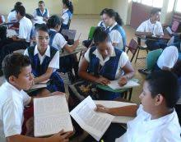
Dear students now work in group
Write in brief , how you have celebrated this year’s Independence Day at your school .

Slide 17
Evaluation
Answer the following questions.
1. What do you know about VDP ?
2 . What is Independence Day ?
3 . Who place the floral wreaths on behalf of the nation ?

Slide 18
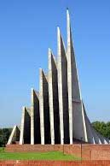
Dear students, remember
The seven pairs of walls of the National Memorial mark the seven successive stages of Bangladesh's independence movement .
1971 Liberation war
1969 Mass uprising
1966 Six point movement
1962 Education movement
1956 Constitutional movement
1954 United front election
1952 Language movement

Slide 19
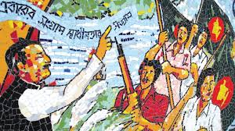
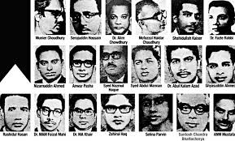
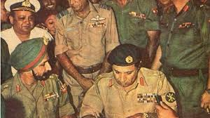
Refresh…
Bangabandhu Sheikh Mujibur Rahman, the great hero of independence and the architect of independent Bangladesh, in his historic speech on March 7, 1971, called for a great war of liberation.
Three million Bengalis were martyred in a long and bloody 9-month war
With 93,000 Pakistani troops, General Niazi was forced to surrender unconditionally to the joint forces.
In exchange for the blood of millions of martyrs and the honor of thousands of mothers and sisters in the war of liberation, we have today's independent map and red-green flag.

Slide 20
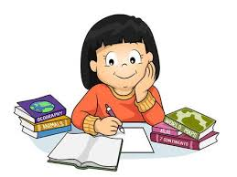
Home Work
write a short paragraph about independence day.

Slide 21
Thanks to all

