Slide 1
Welcome to my English class

Slide 2
How are you doing today ?

Slide 3
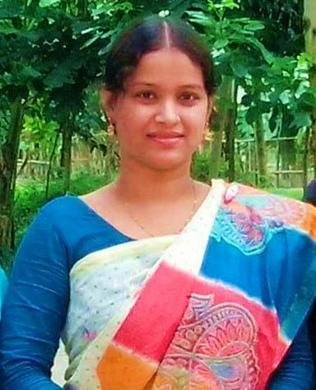
Teacher’identy
Kamrunnaher
Assistant teacher
Sreerampor purbopara govt.prymary school.
Raipura-Narsingdi

Slide 4
Lesson’s identy
Class: Four
Subject : English
Unit : 1 About me
Lesson 4-5 (B,C)

Slide 5
Learning outcomes-
Listening
1.1.1 Recognize sound differences in the context words.
1.4.1 recognize and use intonation patters for Wh andYes/ no questions,greetings and statements.
Speaking
1.1.1 Repeat after the teacher and say words,phrases and sentences with proper sounds , stress an intonation.
2.1.1 Change greetings and farewells.
8.1.1 take part in conversations onsimple topics( like,dislike hobbies,holydays,family,friends,etc.)
Reading
1.4.1 Read words,pharses and sentences in the text.
1.5.1 Read words,pharses and sentences in the text with proper pronunciation,strees and intonation.
1.7.1 read short paragrapha ,dialogues and simple letters.

Slide 6
Now we will sing the greeting song hello hello…

Slide 7
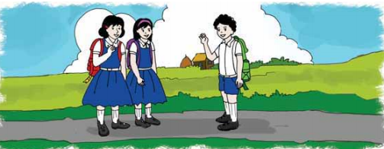
What do you understand to see the picture ?
They are talking.

Slide 8
Hello! dear students.
My name is Kamrunnaher.
I am your English teacher

Slide 9
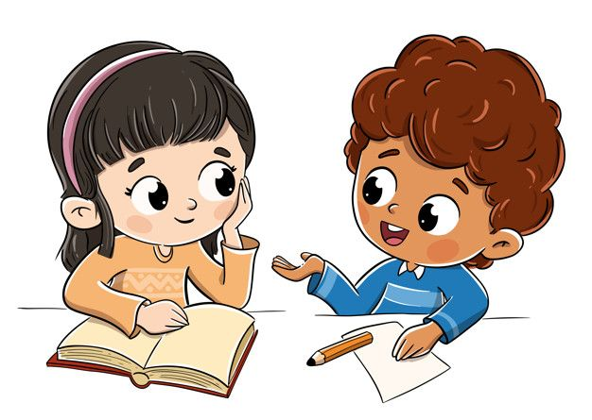
Do you know ,how to talk with anyone ?
Come here Mitu and Ritu do the activity.

Slide 10
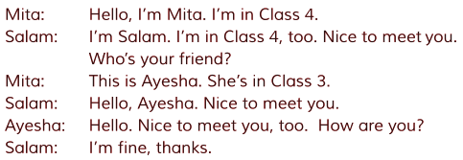
Now open your book at page 3.
Atfirst I will read you listen then repeat after me.

Slide 11
Individual work
Find out new word.
Nice
সুন্দর
Meet
দেখা
Dialouge
কথোপকথন

Slide 12
Read the text

Slide 13
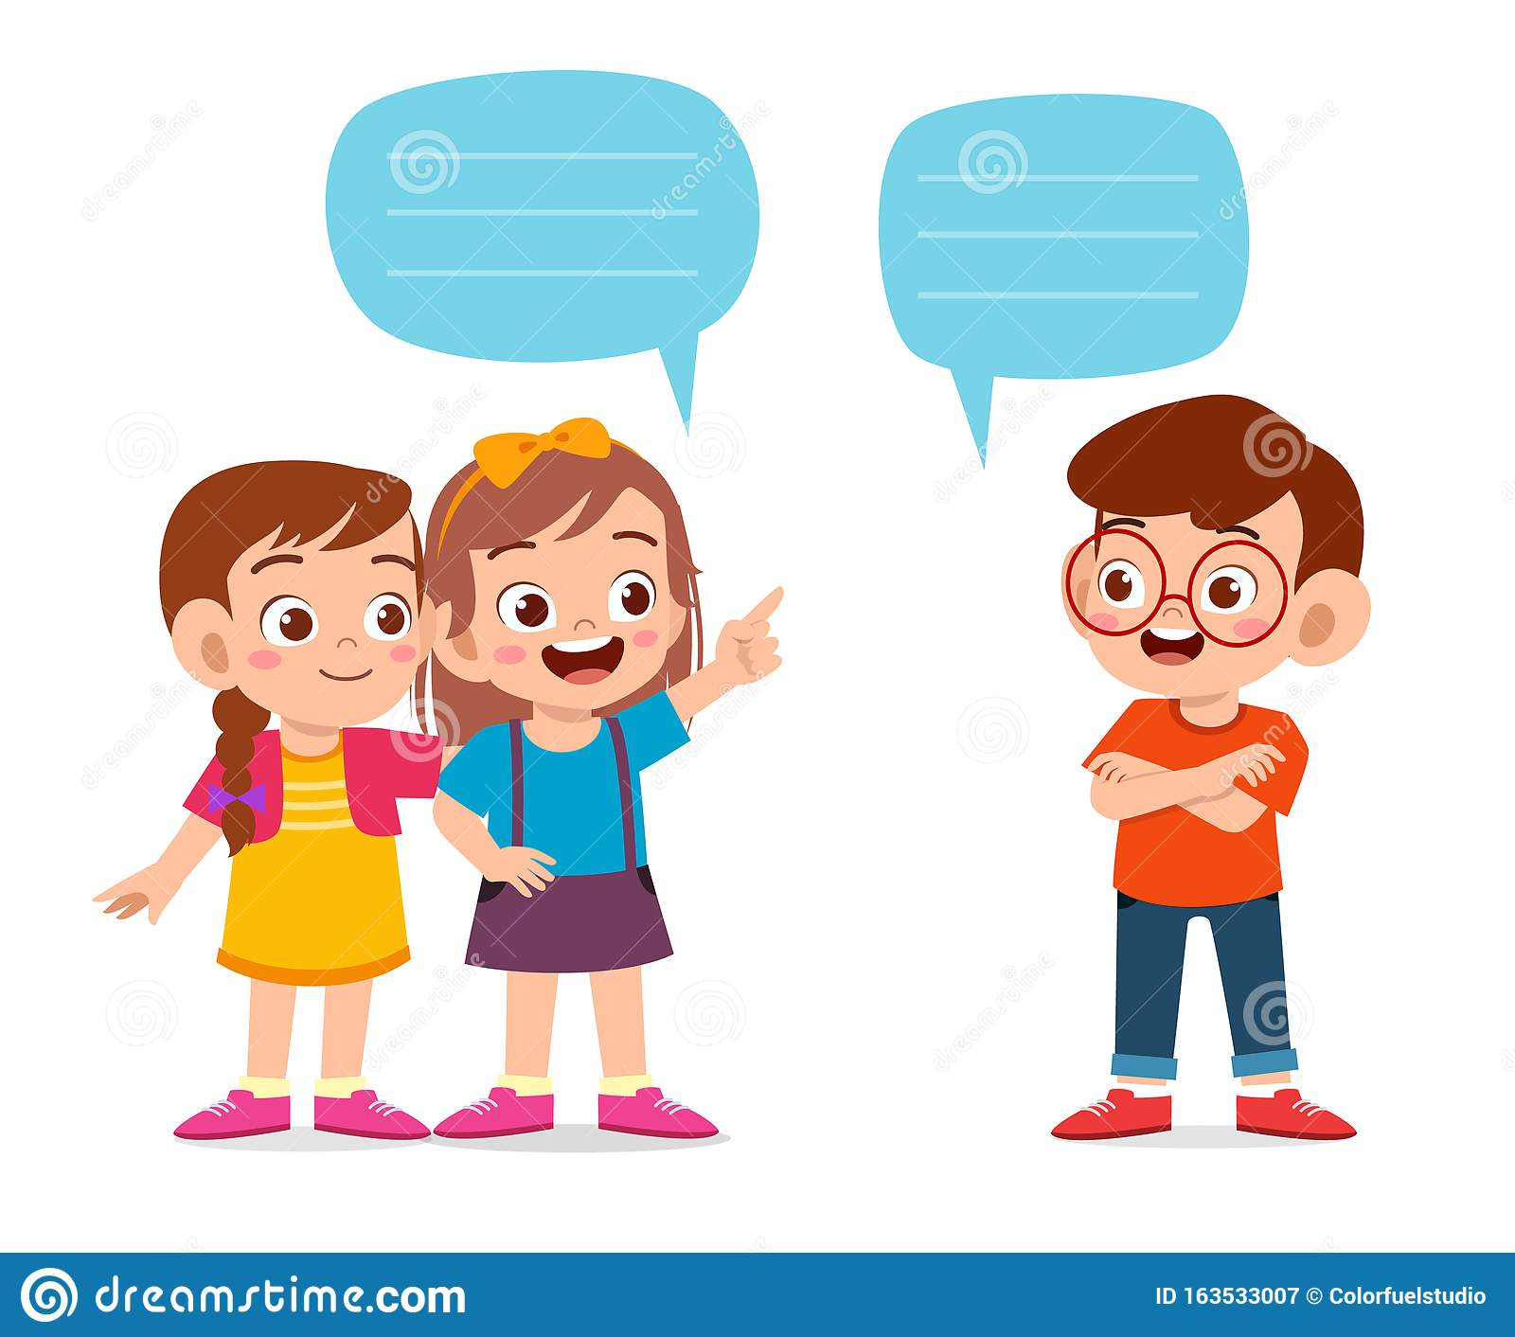
Group work
Now you will practice do the activity between 3 students as like Mita,Ayesha,Salam.

Slide 14
What we say after getting to know each other ?
Nice too meet you
Now the 3 student will com forword and practice the dialouge as Mita,Ayesha,Salam.

Slide 15
One day one word
Meet–
দেখা
Nice to meet you.

Slide 16
Home work
You will read the dialouge properlly .

Slide 17
Thank you, that’s all for today
See you tomorrow.

