Slide 1
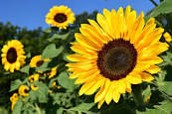
GOOD MORNING

Slide 2
Introducing:
Md. Saiful Islam
Assistant Teacher (English)
Bagbari Chowbaria High School,
Tangail Sadar, Tangail
E-mail: hridoy9555@gmail.com
Class: Eight
Subject: English for today
Unit: 06
Lesson: 09
Time: 50 Minutes
Date: 14-11-2020

Slide 3
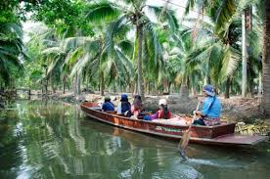
What is the picture about?
The Thakha river is surrounded by coconut palm trees

Slide 4
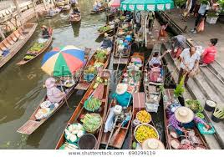
What is the picture about?
The Thakha people are selling and buying their goods in boats.

Slide 5
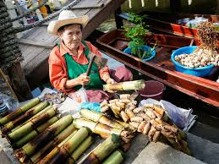
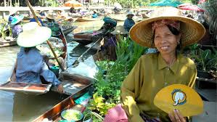
What is the picture about?
The Thai elderly women are displaying their goods.

Slide 6
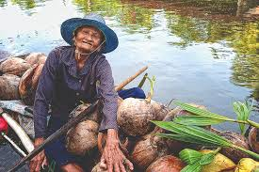
What is the picture about?
The farm fresh coconut of Thailand.

Slide 7
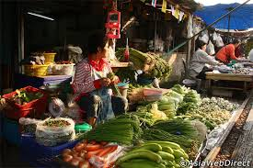
What is the picture about?
Different kinds of goods are displaying for sale.

Slide 8
Learning out comes
After finishing the lesson learners will be able to-
1. Answer the questions.
2. Write a paragraph.
3. Say true or false
Choose the best answer from the alternative
fill in the gaps.
Write a letter about a floating market.

Slide 9
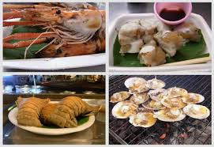
What is the picture about?
The delicious Thai foods of the Thakha Floating Market

Slide 10
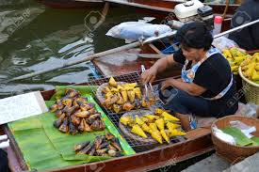
What is the picture about?
Local foods of Thakha Floating Market.

Slide 11
Let’s enjoy the video

Slide 12
Standard reading

Slide 13
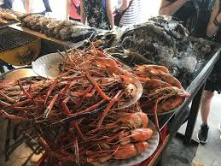
What is the picture about?
Local foods of Thakha Floating Market.

Slide 14
Lesson declaration
The Thakha Floating Market

Slide 15
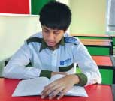
Individual work:
Why is Thakha floating market ‘traditional’?
How many days a week does the market sit?
Why do you think people at the floating market know each other so well?
What did they have at the market?
Answers:
(1) It is traditional because a few people visit it than other floating market.
(2) The market used to sit six or seven days a month.
(3) I think they know each other well because they were seen smiling and calling by name.
(4) They had ‘Pad Thai’ and ‘Kanom Krok’.

Slide 16
Pair work
Write a letter to your friend abut the about your experience after visiting The Thakha Floating Market

Slide 17
Group work:
Fill in the gaps with appropriate words from the box:
The Thakha floating market is more (a) ------------------------ with a few (b) -------------- visiting than other floating markets. (c) -------------- the Thakha floating market (d)----------- to sits only six or seven days a month depending on the (e)----------- of the moon. People seem to (f) ----------- each other very well. Every one (g) ------------ seen (h) ------------- and calling each other by name. The (i) -------------- did not notice Mita and others much. They were all (j) ---------- buying and selling.
 | travelers | actually | used | phase | know
 | be | conventional | busy | natives | laughing
conventional
travelers
actually
used
phase
know
was
laughing
natives
busy

Slide 18
Evaluation
Choose the best answer from the alternatives:
The people of Thakha are---- (i) friendly and polite (ii) very narrow minded (iii) educated (iv) uneducated
The food was served in a bowl made from----. (i) battle leaf (ii) banana leaf (iii) coconut leaf (iv) none of them.
The main buyers were ---- women .(i) old (ii) young (iii) aged (iv) both (i) and (iii)
Pad Thai is kind of ----- (i) noodles (ii) vegetable (iii) sweet (iv) curry
They ate ------ (i) mutton chop (ii) Kanom Krok (iii) Pad Thai (iv) both (ii) and (iii)

Slide 19
Say whether the following sentences are true or false. If false give the right answer.
The Tha Kha floating market is a tourist place.
It sits only six or seven days a month.
The buyers and sellers are the local people living near Thakha river.
(d) They all knew each other.
(e) They reached at the market just at 5.
True
True
True
True
False. Just at 7

Slide 20
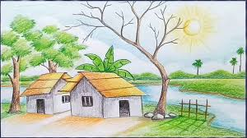
Home work
Write a paragraph about a floating market.

Slide 21
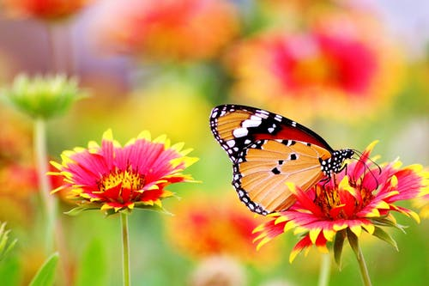
Thank you very much

