Slide 2
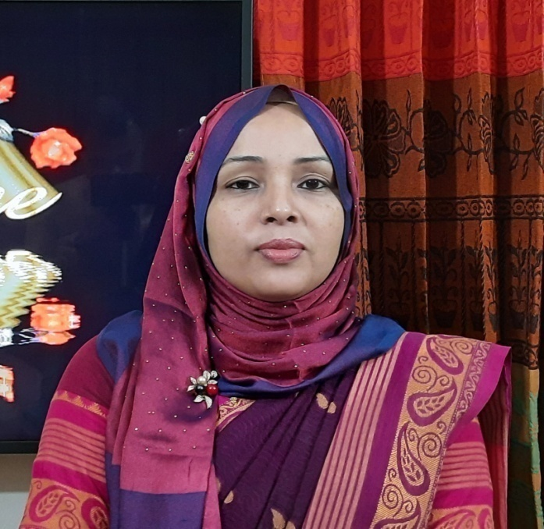
Achia Begum
Head Teacher
Uttarsur K.C GPS
Sreemangal,
Moulvibazar.

Slide 3
English For Today
Class: Three

Slide 4
Let’s enjoy a video

Slide 5
Learning Outcomes
Students will be able to
5.1.1 use full stop.
7.1.1 recognize punctuation marks and read accordingly.
6.1.1 use capital letters for sentence beginnings.
6.1.2 use capital letters for proper nouns.

Slide 6
What do you see in the picture?
How many people are there?
Where are they going?

Slide 7
Today’s topic is:
Punctuation and capital letters
Unit:30
Lessons: 1-3
Pg: 60

Slide 8
Listen to the audio carefully.
Open your book and Put your finger under the line.

Slide 9
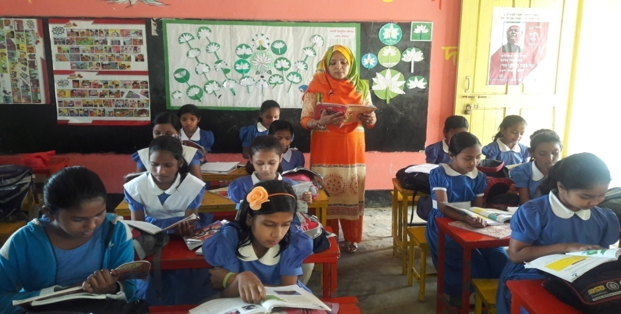
Teacher’s loud reading
Students repeat after teacher. And they will put their finger under the line.

Slide 10
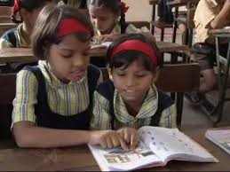
Pair work
What do you know from the text? Let’s see…
1.What day is today?
2.Who are at school?
3.Where are Riya and Mashuk?
4.What is the name of their teacher?

Slide 11
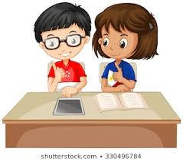
Pair work
Read in pair. One student will read
by turn and others will listen. Help him/
her .Do it in turn.

Slide 12
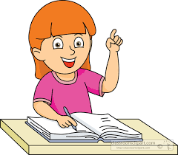
Individual work
Find the words with capital letters in Activity A. Underline them.

Slide 13
When writing, we use capital letters in some cases:
The first letter of the sentence has to be written with capital letter. Ex: It, They.
People’s name is always written with capital letter. Ex:Riya,Mashuk

Slide 14
Always write with a capital letter to address someone .Ex: Mr, Mrs.
Week’s name is always written with capital letter . Ex: Sunday.
It is Sunday morning. Riya and Mashuk are at school.They are in the school yard with their teachers,Mr. Mahbub and Mrs. Fareha.

Slide 15
Individual work
What is at the end of each sentence. Circle it .
It is Sunday morning .
Riya and Mashuk are at school .
They are in the school yard with their teachers, Mr. Mahbub and Mrs. Fareha .
At the end of the sentence, just as we use ‘।’‌ in Bengali. We use full stop(.) in English.

Slide 16
You have to practice activity C at your home.

