Slide 2
About Me & Book
Md. Robiul Islam
Assistant Teacher English
Pioneer Girls’ High School, Khulna
ICT4E Ambassador, Khulna Sadar
Khulna
English For Today
Classes -9-10
Unit- 14, Lesson- 9

Slide 3
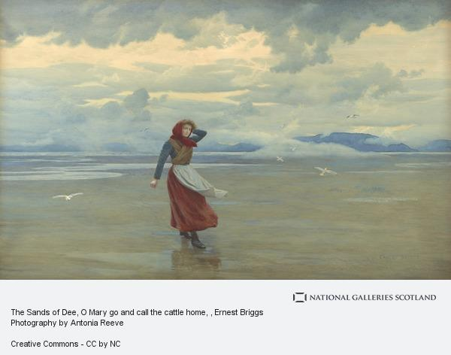
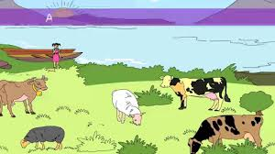

Slide 4
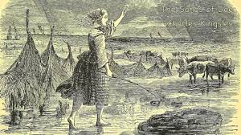
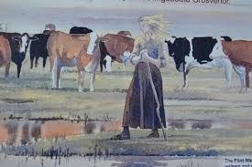

Slide 5
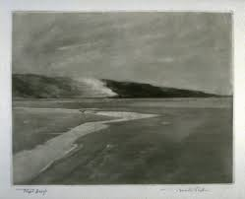
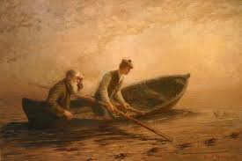

Slide 6
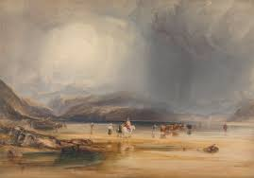
Do you have any idea about the smallest river in the world….Can you tell the name?
The Sands of Dee

Slide 7
Today we are going to read about -

Slide 8
After we have studied the lesson, we will be able to -
Understand and enjoy the poem.
Write answer the questions.
Evaluate literary text.

Slide 9
A. Listen to the poem. Read it aloud in groups.
The Sands of Dee

Slide 10
“O Mary , go and call the cattle home,
And call the cattle home,
And call the cattle home
Across the sands of Dee!”
The western wind was wild and dank with foam.
The western tide crept up along the sand,
And o’er and o’er the sand,
And round and round the sand,
As far as eye could see,
The rolling mist came down and hid the land
And never home came she.
“Oh! Is it weed , or fish , or floating hair,
A tress of golden hair,
A drowned maiden’s hair
Above the nets at sea?
Was never salmon yet that shone so fair
Among the stakes of Dee.”
They rowed her in across the rolling foam,
The cruel crawling foam,
The cruel hungry foam,
To her grave beside the sea:
But still the boatman hear her call the cattle home
Across the sands of Dee.

Slide 11
Meaning of First Stanza:
Cattle – Cows and Oxen
Sands of Dee – Shores of the river Dee in Wales
Western wind – Wind from the west
Dank – Unpleasantly damp and cold
Foam – (Here) Waves
Meaning of Second Stanza:
Western tide – Waves from the west
Crept up along the sand – Moved to the shore
O’er – Over
As far as eye could see – In the vicinity
Rolling mist – Floating mist
And never home came she – She never came home

Slide 12
Meaning of Third Stanza:
Weed
Tress
Drowned
Maiden – A girl
Nets
Salmon
Shone
Stakes
Meaning of Fourth Stanza:
They – The fishermen
Rowed
Rolling foam
Crawling
Grave

Slide 13
B. Answer these questions.
1. What was the weather like when Mary went to bring the cattle home?
When Mary went to bring the cattle home that time the weather was rough like wild.
2. Look at some words, phrases and sentences that have been repeated several times. Explain why the poet has done that.
Some sentences that have been repeated several times in the poem - And call the cattle home, And call the cattle home, And o’er and o’er the sand, And round and round the sand, The cruel crawling foam, The cruel hungry foam. Because the poet has done it to give pressure on metaphor and simile.
3. How has the poet described the sea?
The poet has described the sea like a wild beast , in another sense the western wind was wild and dank with foam.

Slide 14
4. Narrate the story of Mary in your own words.
Mary was a little girl who was asked to bring the cattle home, which had gone away for grazing. She went out of the house alone calling out to them. Dusk was falling by then and the day was stormy and dark, tides were rising. As soon as she landed on the shores of Dee to reach the land on the other side, mist covered her eyes. She couldn’t even see where the land lay and ultimately the sea pulled her in. Her body was discovered later by the fishermen who went to catch salmon in the sea. They found her by shining golden tresses of the sea and brought her to the shore where her grave lasts till this day. But even now, when the fishermen walk along those shores in search of fish, they can hear Mary’s frantic shrill calling the cattle home.
5. Suppose you were walking on the shore with a couple of your friends while Mary was drowning . Describe what you would have done.
If I were walking on the shore with a couple of my friends while Mary was drowning that time I will go there and tried to rescue Mary from drowning because she was a little girl.

Slide 15
Literary Terms Applicable to “The Sands of Dee”:
Alliteration,Ambiguity,AuditoryImagery,Connotation,Denotation,Diction,FigurativeLanguage,Foreshadowing,Imagery,LiteralLanguage,Metaphor, Meter, Mood, Motif, Personification, Repetition, Rhyme, Rhythm, Sestain, Setting Simile, Stanza, Structure, Symbol, Symbolism, Syntax, Theme, Tone, Verbal ,Imagery, Visual Imagery.

