Slide 1
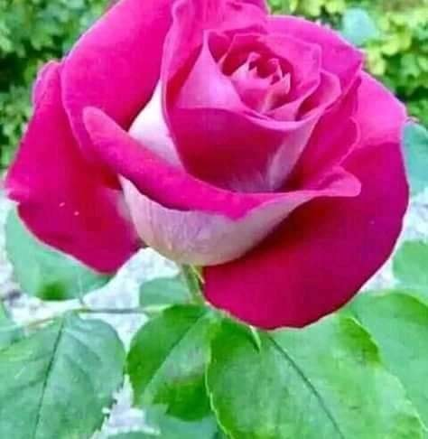
Welcome to
Our today’s Class

Slide 2
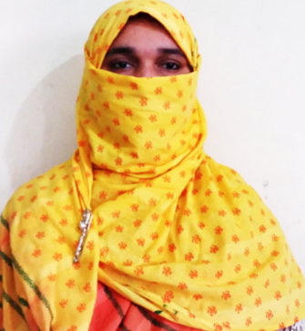
Identity
Mohammat Nelufa Afrose (Bithi)
Lecturer in English
Khilbaisa Rahmania Fazil Madrasah
Khailbaisa, Sadar, Lakshmipur
E-mail:nelufa.afrose@gmail.com

Slide 3
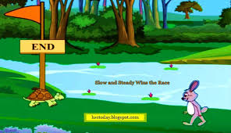
Class: Eleven/Twelve/Alim
Subject: English 1st paper
Part-B, Writing Test
Board Question no-8
Marks-7

Slide 4
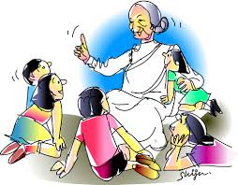
Let us watch the image below.
They are listening story..
Think, what are they doing?

Slide 5
The topics of our today’s lesson is -
Completing story…….

Slide 6
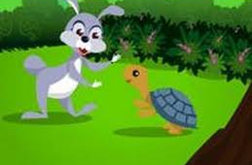
Do you know the two animals from below picture?
Hare and tortoise.

Slide 7
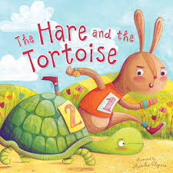
Can you guess what is the story?
Yes, you have already read the story.
It’s the popular story of Aesop –
The hare and the tortoise.

Slide 8
By the end of the lesson students will able to -
read and understand the story.
Know the moral of the story.
learn the word meanings.
write the story in free hand.

Slide 9
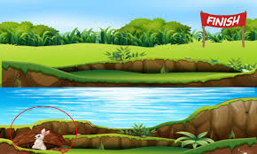
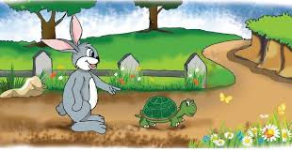
Let’s learn the story-
Once a tortoise lived in a pond near a forest. There was a hare near the pond. One day the hare met the tortoise. The hare laughed at the tortoise and said, “You have as many legs as I have. But l am sure that you cannot run as fast as I can. Perhaps, you can’t run at all.” The tortoise became very angry. Being angry, the tortoise answered quietly, “Yes, you can run too fast, no doubt. But I think, you can talk even faster than you can run ever.” The hare told the tortoise to run race with him. The tortoise quietly agreed. At this, the hare was much amused. So the hare said, “Come along, let’s fixed a date for the race“

Slide 10
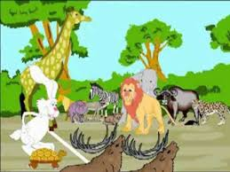
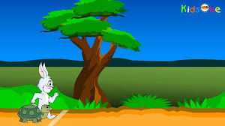
They fixed a date. All animals came to see the race. The tortoise & the hare finally came to the starting point o the race. The race began. The hare began to run very fast. He jumped and jumped. He ran a mile in a few minutes. Soon the hare found the tortoise far behind him. Then he stopped. The hare said to himself, “What’s the use of going too fast? Perhaps, the tortoise has gone only a few yards by this time. So, I can very well have a good sleep before the tortoise comes up.” So the hare went to sleep in a bush. In the meantime, the tortoise walked on and on. It did not stop anywhere.

Slide 11
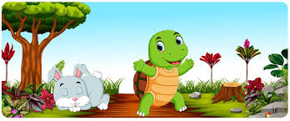
When the tortoise came to the bush, it saw the lazy hare lying fast asleep there. The tortoise smiled and quietly passed by the hare. Many hours passed. The hare woke up. He saw that it was already evening. He immediately got on his feet. He began to run very fast. But alas! The tortoise had already gone far. It came in sight of the goal. But the steady tortoise was already crossing the winning post. The hare felt much ashamed. Now the hare realized that slow but steady wins the race.”

Slide 12
Slow and steady wins the race.

Slide 13
Word meaning
Race- দৌড়বাজি;a contest in running.
Immediately-তৎক্ষণাৎ;without any delay.
Steady-দৃঢ়;firm in standing..
Goal –গন্তব্যস্থল ;the point where race end.

Slide 14
Read the story silently

Slide 15
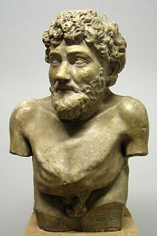
Let’s know about Aesop
Aesop was a Greek fabulist and storyteller credited with a number of fables now collectively known as Aesop's Fables. Although his existence remains unclear and no writings by him survive, numerous tales credited to him were gathered across the centuries and in many languages in a storytelling tradition that continues to this day. Many of the tales are characterized by animals and inanimate objects that speak, solve problems, and generally have human characteristics.
Hellenistic statue thought to depict Aesop,
Art Collection of Villa Albani, Rome
Born : c. 620 BCE
Died 564 BCE (aged c. 56)
Delphi, Greece
Nationality : Greek
Genre : Fable, (The hare and The Tortoise, Grasshopper and the Ants etc. famous story)

Slide 16
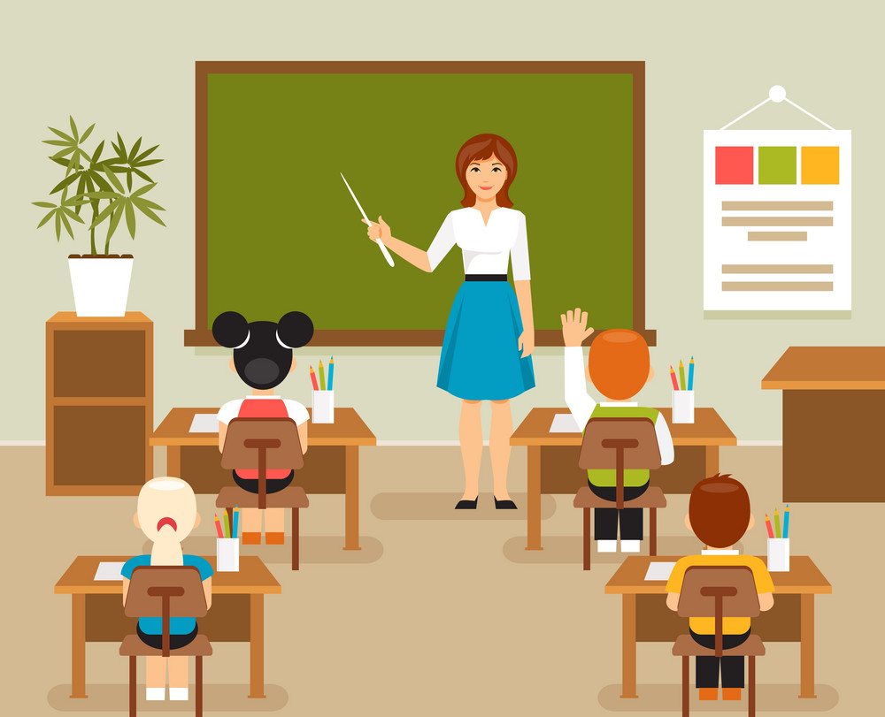
Evaluation
Tell the story,
" the hare and the tortoise” one by one.

Slide 17
Individual Work
Write down the story of “the hare and the tortoise” in your own words.

Slide 18
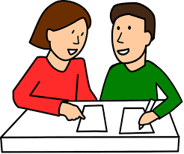
Pair work
Write down the 3 names of Aesop story.

Slide 19
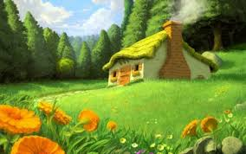
Homework
8. Read the beginning of the following story and complete it your own way. Give a title to it:- 7
Once a tortoise lived in a pond near a forest. There was a hare near the pond.

Slide 20
No more today.
Read the story properly.

Slide 21
Thank you.

