Slide 1
WELLCOME

Slide 2
Introducing
Md. Monirul Haq Chowdhury
Assistant Teacher
91 No. Narail GPS
Kashiani, Gopalgonj.
monirulhaqchowdhury@gmail.com

Slide 3
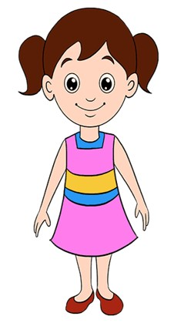
Safety environment by greetings song.
Hello! Hello! How are you?
I’m well, I’m good.
I’m great, I’m wonderful.
Hello! Hello! How are you?
I’m fine! I’m great today.

Slide 4
Checking homework and justify the previous lesson.

Slide 5
Dear students-
Touch your head.
Touch your shoulder.
Now try to say-
What can be the topic of our today’s lesson?

Slide 6
Lesson Introducing
Sub: English
Class: Two
Lesson : Head and shoulder
Parts of the lesson: Activity-A
Page No-22

Slide 7
Our today’s lesson is--
Head and shoulders
Activity-A

Slide 8
LEARNING OUTCOMES
By end of the lesson students will be able to-------
Listening: 1.1.1 become familiar with English sounds by listening to common
English words.
2.1.1 following simple commands and instructions.
3.1.1 understand simple questions and statements about them.
3.1.2 understand simple questions and statements about familiar objects.
4.1.1 enjoy the rhyme and music of simple rhymes.
Speaking: 1.1.1 repeat after the teacher simple words and phrases with proper
sounds and stress.
1.1.2 say simple words and phrases with proper sounds and stress.
Reading: 1.3.1 recognize and read the names of objects having the same initial
and final sounds.
1.4.1 read words and phrases with the help of visual clues and simple
sentences.

Slide 9
Look, listen and say.
Teacher touch his/her body parts (head, eyes, ear, nose, mouth, shoulder, knee and toes) and says.
This is my------------.
Teacher do this work several times.
Then students repeat after teacher.

Slide 10
Look, listen and say.
What is this?
head
ear
nose
eyes
shoulder
mouth
knee
toes

Slide 11
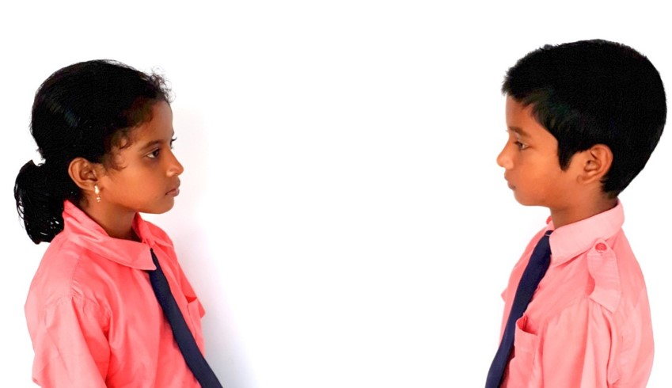
Pair work.
This is my--------.
one more

Slide 12
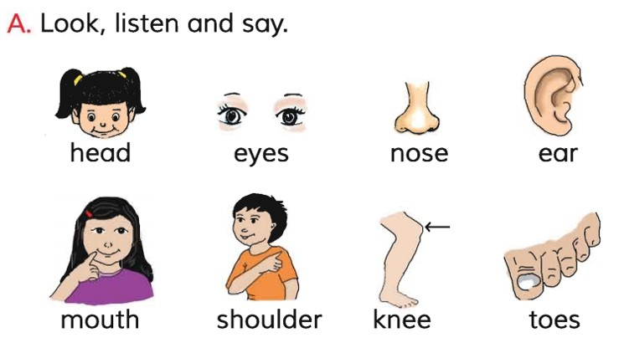
Open your English book at page- 22 and see the Activity-A.
Repeat after me.
Spell out the words. (SGW)

Slide 13
Pair work.
Point out the picture.

Slide 14
Read and say.
mouth
eyes
toes
shoulder
nose
knee
ear
head
mouth
eyes
mouth
eyes
toes
shoulder
nose
knee
ear
head
mouth
eyes
Identifying weak students and taking to cure.

Slide 15
One day one word
What is this?
ear
কান
Spell out the word - SGW

Slide 16
Find out the letters that are made by the word ------.
i
e
r
j
a
b
r
k
p
Find out the correct word ------.
eare
air
ear
eir

Slide 17
Say the missing letter.
ea-
e-r
-ar
Write the word to your notebook.
Date-
/ /20
ear
ইয়ার
কান

Slide 18
Home work
Page 12 will be well read and written.

Slide 19
That’s all for today. Goodbye. See you tomorrow.

