Slide 1
Wellcome

Slide 2
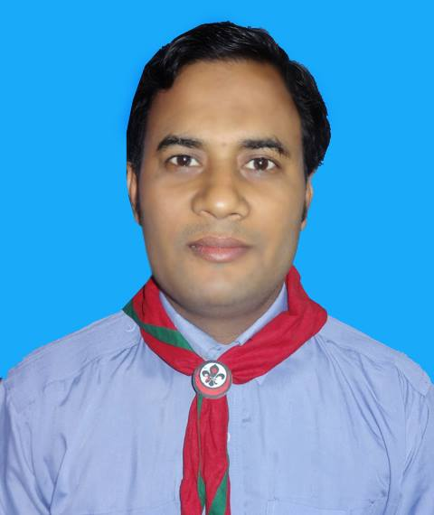
Introduction
Md. Abdur Rokib
Assistant Teacher
Chatrajitpur Govt.Primary school
Shibganj, Chapainawabganj
Mobile: 01716-819576
Email: marokibgpst@gmail.com

Slide 3
Let’s watch a video

Slide 4
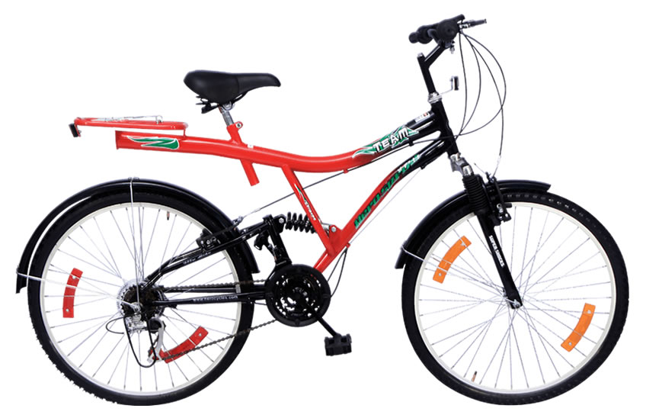
What can you see?

Slide 5
Today’s lesson
Numbers
Unite : 2
Lesson 1-3
1,2,3,4

Slide 6
Learning outcomes
Students will be able-
2.1.1 Recognize and read cardinal numbers up to 4.
4.1.1 Copy numbers up to 4 in figures and in words
4.1.2 Write numbers up to 4 in figures and in words

Slide 7
Look and say.
1
2
3
4
one
two
three
four

Slide 8
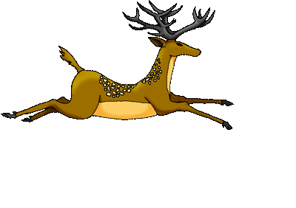
Look and say.
1
one

Slide 9
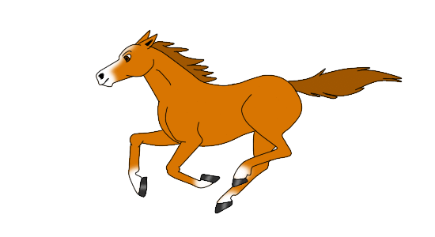
Look and say.
2
two

Slide 10
Look and say.
3
three

Slide 11
Look and say.
4
four

Slide 12
Look and say.
Say it again
1
one

Slide 13
Look and say.
Say it again
2
two

Slide 14
3
Look and say.
Say it again
three

Slide 15
4
Look and say.
Say it again
four

Slide 16
B. Say, trace and write
WCW
3
3
1
1
2
2
4
4

Slide 17
B. Say, trace and write
WCW
one
two
three
four
one
two
three
four

Slide 18
Match correctly:
P.W
1
three
2
four
one
3
4
two

Slide 19
Group work
Count and write the number of the balls.
Group-A
Group-B
Group-C
3
2
4

Slide 20
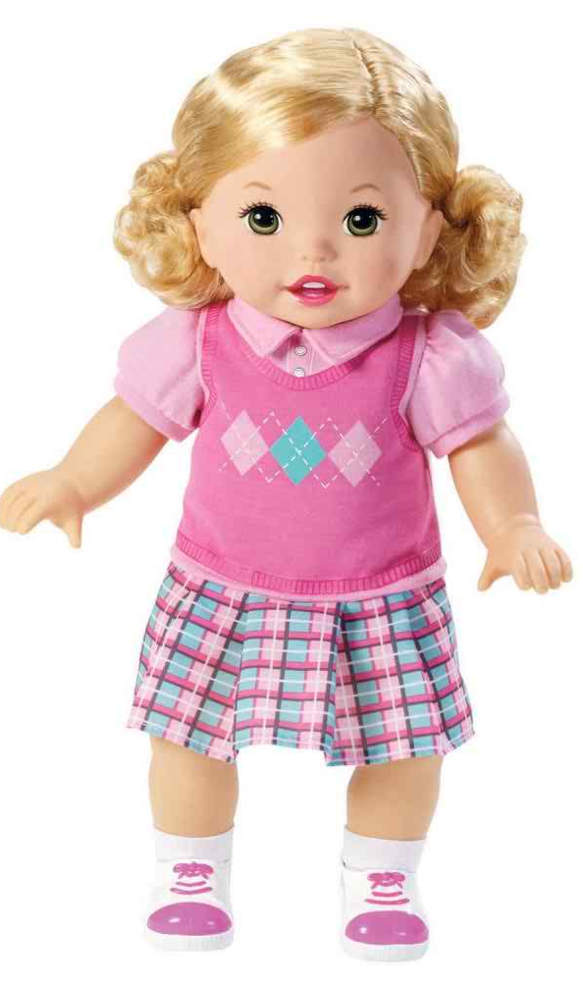
Evaluation
Count and write the numbers.
2
1
4
3

Slide 21
Thanks
everyone

