Slide 1
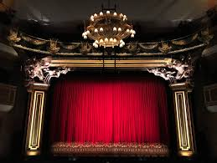

Slide 3
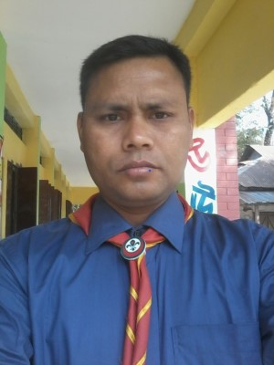
Teacher’s
Identity
Md. Farhad Hossain
Assistant Teacher
Modhuram GPS , Lalmonirhat Sadar.

Slide 4
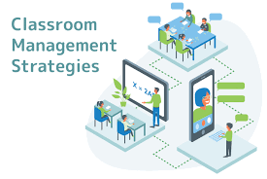
Greeting
Enough light facility
Seat planning
Cleanliness classroom
Etc.

Slide 5
Let’s enjoy a song

Slide 7
Today’s Lesson
I am Radif……..
Class : Three
Unit : 3
Lesson : 1 – 3
Lesson Title : My friend

Slide 8
Learning Outcomes
Students will be able to know---
Listening 4 .3.1 Enjoy and understand simple stories .
Speaking 3.1.1 ask and answer Wh questions .
Reading 5.1.1 read simple paragraps .
Writing 10.1.1 write short and simple paragraph by answering a set of questions .

Slide 9
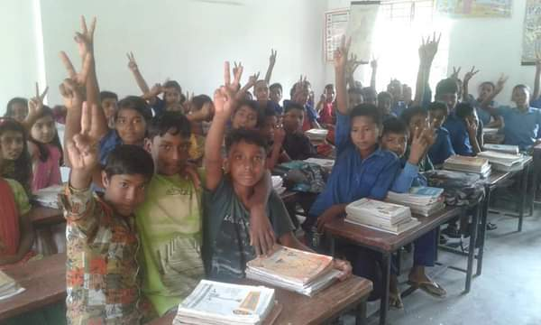
friend
You are the students of class three .What is the relation among yourselves ?

Slide 10
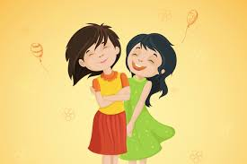
What is the relation between them ?
friend
T Ask some of the students..
What is your friend’s name ?

Slide 11
Declaration of the lesson
Today we will learn about my friend .

Slide 12
Open your English book
At page 70

Slide 13
Let’s learn some
Newwords

Slide 14
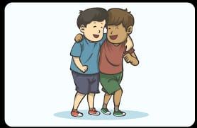
friend
A well - wisher
bengali meaning - বন্ধু

Slide 15
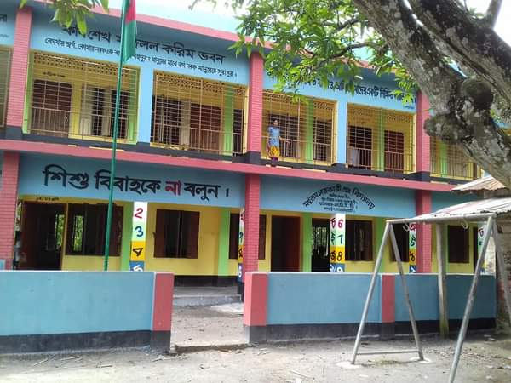
school
A learning place
bengali meaning - বিদ্যালয়

Slide 16
same
Not differnt / similar
bengali meaning – সম / একই

Slide 17
afternoon
The time from noon to evening
bengali meaning – বিকাল / অপরাহ্ন

Slide 18
newwords
Friend/ বন্ধু
School/বিদ্যালয়
Same / একই
Afternoon / অপরাহ্ন

Slide 19
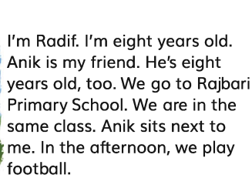
Teacher’s
Loud reading
SS listen to their teacher
&put their finger under the lines.

Slide 20
Make groups of 4 .
Students will read the text in groups .

Slide 21
Let’s play
a game
How we play ?
I’ll read the text missing some words.When I will miss a word you will say ‘’gap’’ then I will stop and you have to say the missingword .
I am Radif . I’am eight years old . Anik is my friend . He’s eight yers old , too . We go to Rajbari Primary School . We are in the same class . Anik sits next to me . In the afternoon we play football .

Slide 22
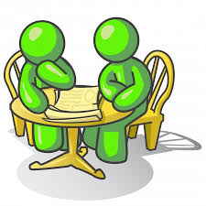
Pair Work
S 1 ask S2 answer
S 2 ask S1 answer
1.How old is Radif ?
2 What is his friends name ?
3.How old is Radif’’s friend ?
4.What school do they go to?
5.Where does Radif sit in class?
6. What do they do in the afternoon?

Slide 23
Individual
Assessment
What is your friend’s name ?
How old is your friend ?
What school do you go to ?
Where does your friend
sit in the class ?
What do you do in the
afternoon ?
Write a paragraph about a friend answering the following questions . Use capital letters , punctuation marks and correct spelling .

Slide 24
Oneday one word
Same
Same- Rina and mina live in same village .

Slide 25
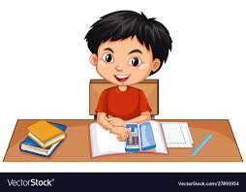
Home
Work
Read the text again properly .
Write the answer of the questions
of activity B .

Slide 26
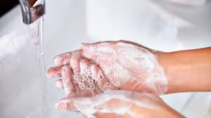
follow the rules of keeping good health .

