Slide 1
_{স্বাগতম}
Md. Alamgir Hossain(ass: teacher ict) Rahimapur Fazil Madrasha, Patnitala,Naogaon. Mob: 01723626108

Slide 2
Presented by
Md. Alamgir Hossain
(ICT Teacher)
Rahimapur Fazil Madrasah, Patnitala, Naogaon.
Cell : 01723-626108
G-mail : alamgirchz@gmail.com
Date – 25/10/2020
Md. Alamgir Hossain(ass: teacher ict) Rahimapur Fazil Madrasha, Patnitala,Naogaon. Mob: 01723626108

Slide 3
Let’s enjoy
What an exciting water game it is!
How amazing the show is!
Md. Alamgir Hossain(ass: teacher ict) Rahimapur Fazil Madrasha, Patnitala,Naogaon. Mob: 01723626108

Slide 4
What kind of sentence have you observed?
Exclamatory Sentence
Md. Alamgir Hossain(ass: teacher ict) Rahimapur Fazil Madrasha, Patnitala,Naogaon. Mob: 01723626108
Notes:
Leading to lesson declaration.

Slide 5
Our today’s lesson is-
Exclamatory
Sentence
Md. Alamgir Hossain(ass: teacher ict) Rahimapur Fazil Madrasha, Patnitala,Naogaon. Mob: 01723626108
Notes:
Lesson declaration.

Slide 6
Learning outcomes
At the end of the lesson, we will be able to –
identify the definition of exclamatory sentence
identify the structure of exclamatory sentence
make exclamatory sentences with clues
Md. Alamgir Hossain(ass: teacher ict) Rahimapur Fazil Madrasha, Patnitala,Naogaon. Mob: 01723626108
Notes:
The above points will be achieved by this lesson.

Slide 7
What is an Exclamatory Sentence?
What a beautiful flower it is!
How beautiful the flower is!
The sentence that expresses something surprising, amazing
and abnormal feelings are called exclamatory sentences.
Md. Alamgir Hossain(ass: teacher ict) Rahimapur Fazil Madrasha, Patnitala,Naogaon. Mob: 01723626108
Notes:
Definition with example.

Slide 8
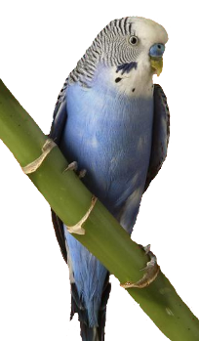
Formation of Exclamatory sentence-1
+
+
+
What a/an or How
Subject
+
Adjective
Verb
!
What a
beautiful bird
it
is
!
How
beautiful
is
the bird
!
Md. Alamgir Hossain(ass: teacher ict) Rahimapur Fazil Madrasha, Patnitala,Naogaon. Mob: 01723626108
Notes:
The structure is triggered twice. It shows two examples one after another.

Slide 9
Formation of Exclamatory sentence-2
Exclamation word (Alas, Hurrah, Oh)
!
+
Assertive sentence
+
Alas
!
I am undone.
Hurrah
!
We have won the match.

Slide 10
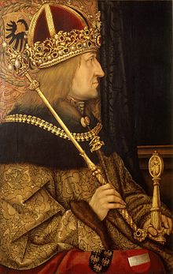
Formation of Exclamatory sentence-2
If/Had
+
Subject
+
Verb
+
Extension
+
!
a king
If
I
were
!
Had
I
been
a rich man
!
Md. Alamgir Hossain(ass: teacher ict) Rahimapur Fazil Madrasha, Patnitala,Naogaon. Mob: 01723626108

Slide 11
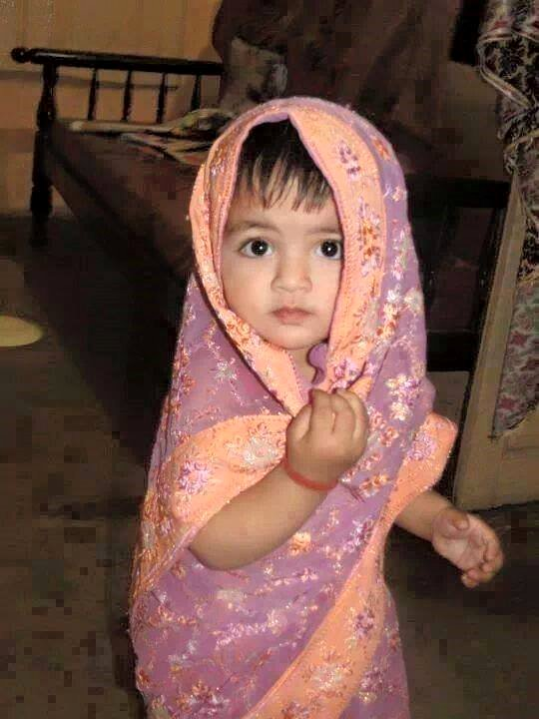
Formation of Exclamatory sentence-3
Would that
+
Assertive sentence !
Would that
I could be a child again !
Md. Alamgir Hossain(ass: teacher ict) Rahimapur Fazil Madrasha, Patnitala,Naogaon. Mob: 01723626108
Notes:
The structure is triggered twice. It shows two examples one after another.

Slide 12
Rearrange the jumbled words to
make exclamatory sentences.
a it, beautiful, frame, what, is, !
nice, the, frame, how, is,!
I, wings a, of, had, the, bird,!
I, that, be, again, child, I, would, could, a, !
were, if, a, I, butterfly!
Md. Alamgir Hossain(ass: teacher ict) Rahimapur Fazil Madrasha, Patnitala,Naogaon. Mob: 01723626108
Notes:
Evaluation in the class.

Slide 13
Make five exclamatory
sentences with the pictures
Md. Alamgir Hossain(ass: teacher ict) Rahimapur Fazil Madrasha, Patnitala,Naogaon. Mob: 01723626108

Slide 14
Md. Alamgir Hossain(ass: teacher ict) Rahimapur Fazil Madrasha, Patnitala,Naogaon. Mob: 01723626108
Notes:
Ending greeting.

