Slide 1
My greeting to all.

Slide 2
English First Paper
For class – xi & xii
Writing skill
Smlobib
Lecturer in English
NAMILA ANSARIYA FAZIL (DEGREE) MADRASAH.
KAPASIA. GAZIPUR.

Slide 3
Today’s topic is
Writing E-mail
Sub-topic: Informal email

Slide 4
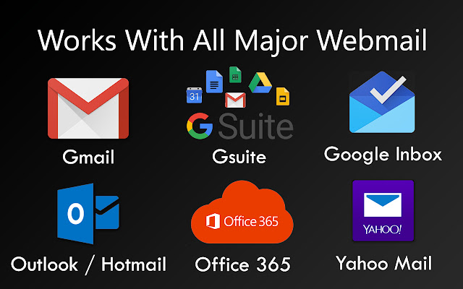
What is email?
Email is a system for sending messages to one or more recipients via telecommunications links between computers, laptops, using dedicated software or a web-based service:

Slide 5
Formal vs Informal email
* What Is a Formal Email?
A formal email is typically sent to someone you don’t know well or to someone who’s in authority. Examples of someone who you might send a formal email to include your professor, a public official, or even a company you’re doing business with.
* What Is a Informal Email?
An informal email is written to any relatives, family or friends. There are no particular rules for informal email writing. A person can use any language of his or her choice.

Slide 6
Informal Email
Purpose of an informal email:
The purpose of an informal email will depend on each task.
Some tasks ask you to provide your friend with some important information, while others might ask you to ask for some advice.
It is common for a friend or relative to ask you something about the place where you live, while saying that they will be visiting soon.
Language:
Given that we are writing to a friend or close relative, our language will be relaxed and friendly.
We could call it informal language if you want. So we will be making use of contracted forms, common phrasal verbs, colloquial expressions and even flexible punctuation (E.g.: using em dashes «–»)

Slide 7
Informal Email
Structure:
One of the cool things about emails is that they always follow the same structure.
In general terms, we always need
- an opening and a closing formula;
- an introductory and closing paragraph;
- the body, which will consist of as many
paragraphs as ideas you are asked to discuss.
Common topics:
Many informal emails to friends and relatives deal with giving advice on a certain subject, such as - visiting your hometown,
- keeping fit,
- advice on which cities to visit in your country,
- organising a party for a mutual friend, etc.

Slide 8
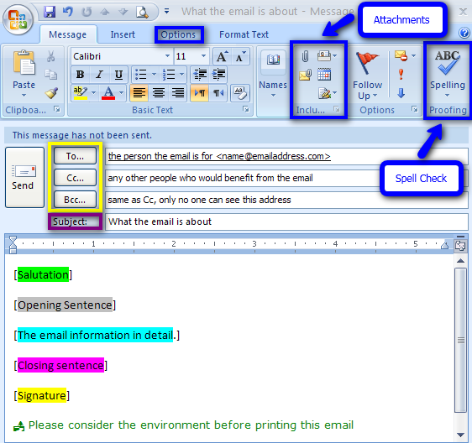
Email

Slide 9
USEFUL PHRASE REFERENCE
INFORMAL LETTER
Greetings Dear + first name ( Dear Ritu)
Asking about them Hi! How are things? How’s it going?
Referring to the news Great news about… Glad to hear that…
Giving news Listen, did I tell you… You’ll never believe what…
Making suggestions Why don’t you..? Maybe you could…
Closing expressions Well, got to go now. See you soon.
Signing off (ending) Love, Lots of love, Yours,
Name your first name (Jemmy)

Slide 10
Sample informal email
From : Sarat Chowdhury <saratchy32@gmail.com>
To : Rajib Haldar <rajib254@gmail.com>
CC : Shamim Hasan <shamim36@gmail.com>
BCC : Hridoy <hridoy25@gmail.com >
sent : 10am, 20 October, 2020
Subject : invitation to join a picnic.
Hi Rajib,
How are you? Hope you are passing good time after your examination.
You will glad to hear that we have arrange a picnic to make our vacation more meaningful and enjoyable. We are planning to visit Cox’s Bazar for a week. We will start our journey next Saturday.
Now we want you as our companion. You will surely enjoy the tour. Take permission from your parents and ensure me as soon as possible. Don’t make delay. See you on Friday next.
Your friend
Sarat

Slide 11
Size of informal email
It’s not necessary to write a long email.
It carries only 5 marks
It should be written in 1 page
The body of the email should be written within 70-80 words.
It can be 1 or 2 para

Slide 12
Thank you, Good bye.

