Slide 1
Welcome

Slide 2
Learning outcomes
1.Read and understand text through silent reading.
2.Tell about the river gypsies.
3.Choose the best answers from the alternatives.
4.Fill in the blanks with appropriate words.
5.Ask and answer questions.

Slide 3
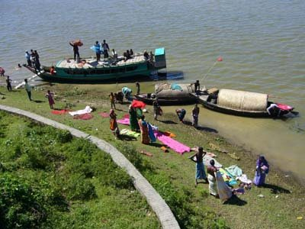
Gypsy
Meaning: Nomads, Traveller

Slide 4
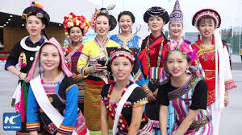
Ethnic
Meaning: Tribal

Slide 5
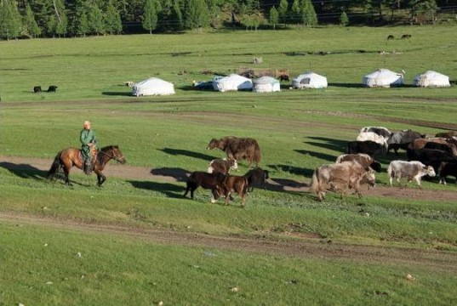
Nomadic
Meaning: Temporary, vagabond like.

Slide 6
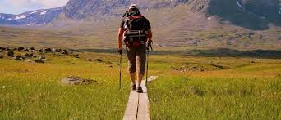
Roam
Meaning: Travel without any definite aim.

Slide 7
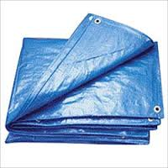
Tarpaulin
Meaning: Waterproof canvas

Slide 8
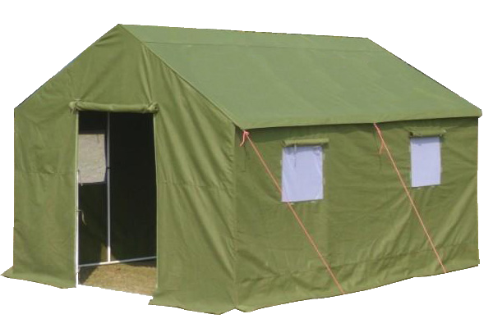
Tents
Meaning: A portable shelter.

Slide 9
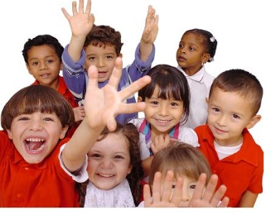
Toddlers
Meaning: Infant, minor, baby

Slide 10
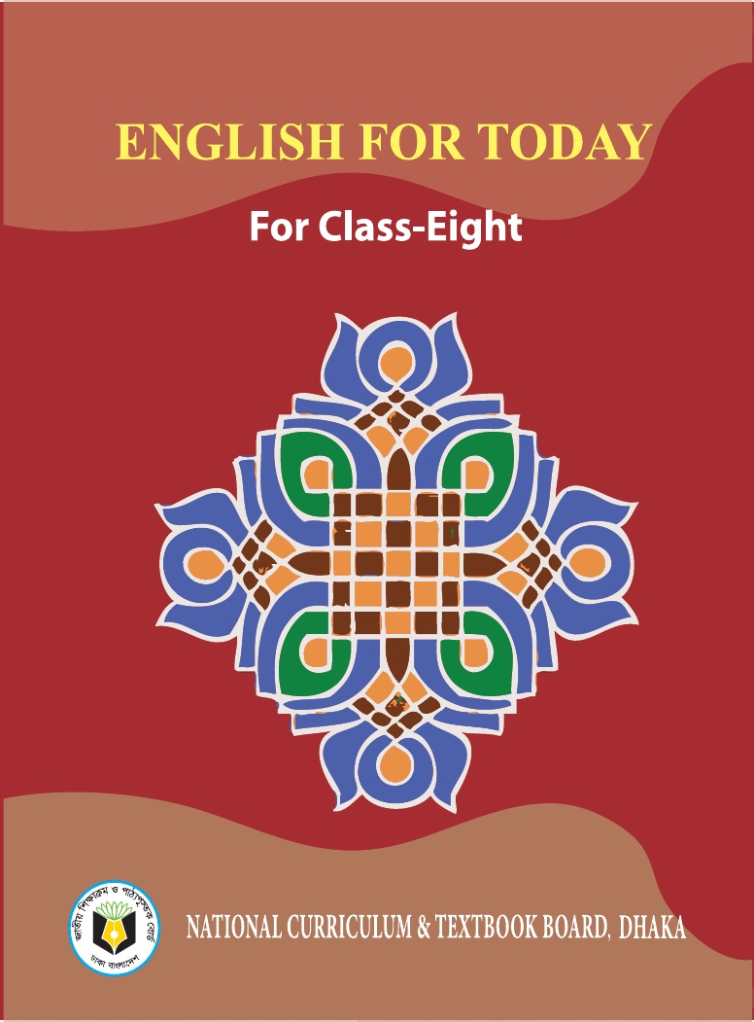
Let’s read the text.

Slide 11
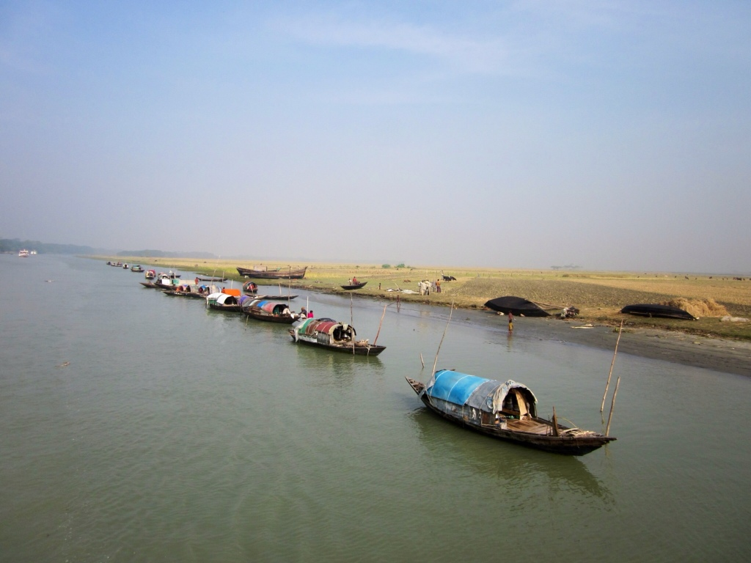
River gypsies are an ethnic group of people in Bangladesh. They are known as beady to local people. The gypsies have their own lifestyle and culture. They live in groups and do not own any land. Therefore, they live a nomadic life, travelling from one place to another. These people roam across our rivers and waters from May to December in small country boats. These boats are their houses and these people are a part of our waters.

Slide 12
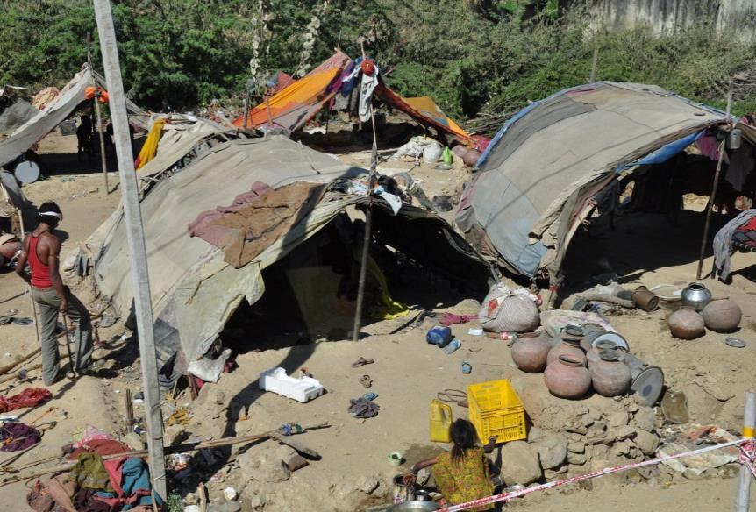
Throughout the monsoon, they remain busy with fishing. They also dive for natural pearls in waters. Sometimes, they camp for a couple of weeks. Men catch snakes and entertain people with snake charming and sell herbal cures. Women go from door to door to sell bangles, cosmetics and other things. They also try to heal pains of old people often by sucking out blood from their body.

Slide 13
In summer vacation last May, Sohan went to Lauhajang in Munshigonj to visit his maternal uncle. His elder cousin, Jihan studies sociology at Dhaka University. One afternoon, Jihan took Sohan to a bedey camp to know about their life. They talked to a middle aged bedey woman who was cooking in front of her tent. Listen and read the conversation of the text.

Slide 14
Fill in the gaps with appropriate words
Throughout the monsoon, the river gypsies (a) _____ busy with fishing. They also dived for natural (b) _____ in waters. Sometimes, they (c) ____ for a couple of weeks. Men catch (d) _____ and entertain people with snake charming and sell (e) _____ cures. Women go for door to door to sell bangles, (f) _______ and other things. They also try to heal (g) ____ of old people often by (h) ______ out blood from their body. Many villagers believe in the (i) __________ of the gypsies. They can make an (j) ___ spirit leave someone’s body by magic or special powers.

Slide 15
Thank you

