Slide 1
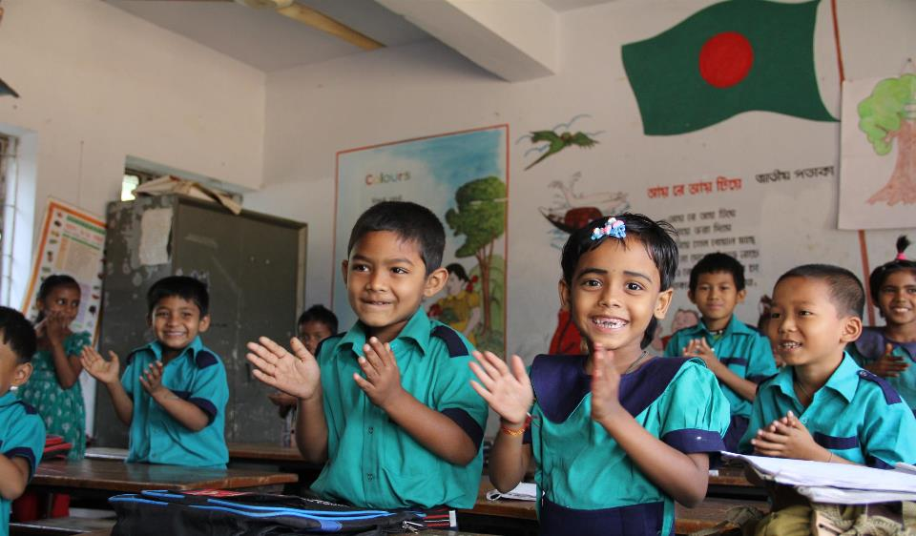
Welcome
to my dear students

Slide 2
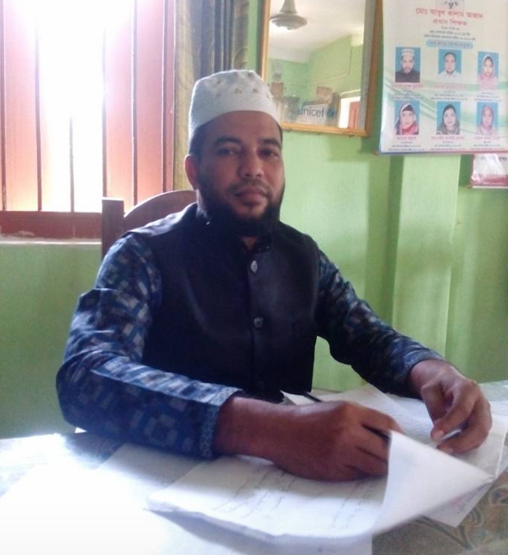
Class: Two
Subject: English
Time: 40 Min.
Muhammad Abdul Muhaimin
Assistant Teacher
Chhakapan Govt. Primary School
Kulaura,Moulvibazar.

Slide 3
Unit:4
Lesson:4 (Alphabet)

Slide 4
By the end of the Lesson Student will be able to_
Listening : 1.1.1._became familiar with English sound by Listening to common English Words.
Speaking : 1.1.1_repeat after the Teacher simple words and phrases.

Slide 5
Look and Listen

Slide 6
Lesson : 4
Unit : 3 (Alphabet : P,Q,R,S,T)

Slide 7
Look Listen and Say
P p
pot
Quail
Q q
R r
Rose

Slide 8
S s
Sun
T t
Tiger

Slide 9
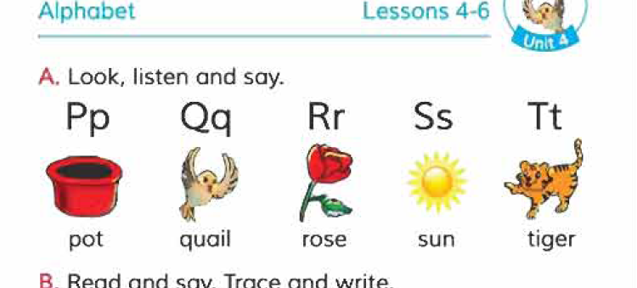
Open the Book.
Page no : 9

Slide 10
Match
P | Tiger
Q | Pot
R | Sun
S | Quail
T | Rose

Slide 11
Find out the T,S,R,P
Tiger | Picture
Sun | Red
Rose | Seed
Pot | Tub

Slide 12
Kim’s game
Quail
Pot
Net
Sun
Kite
Ox
Tiger
Moon
Rose

