Slide 1
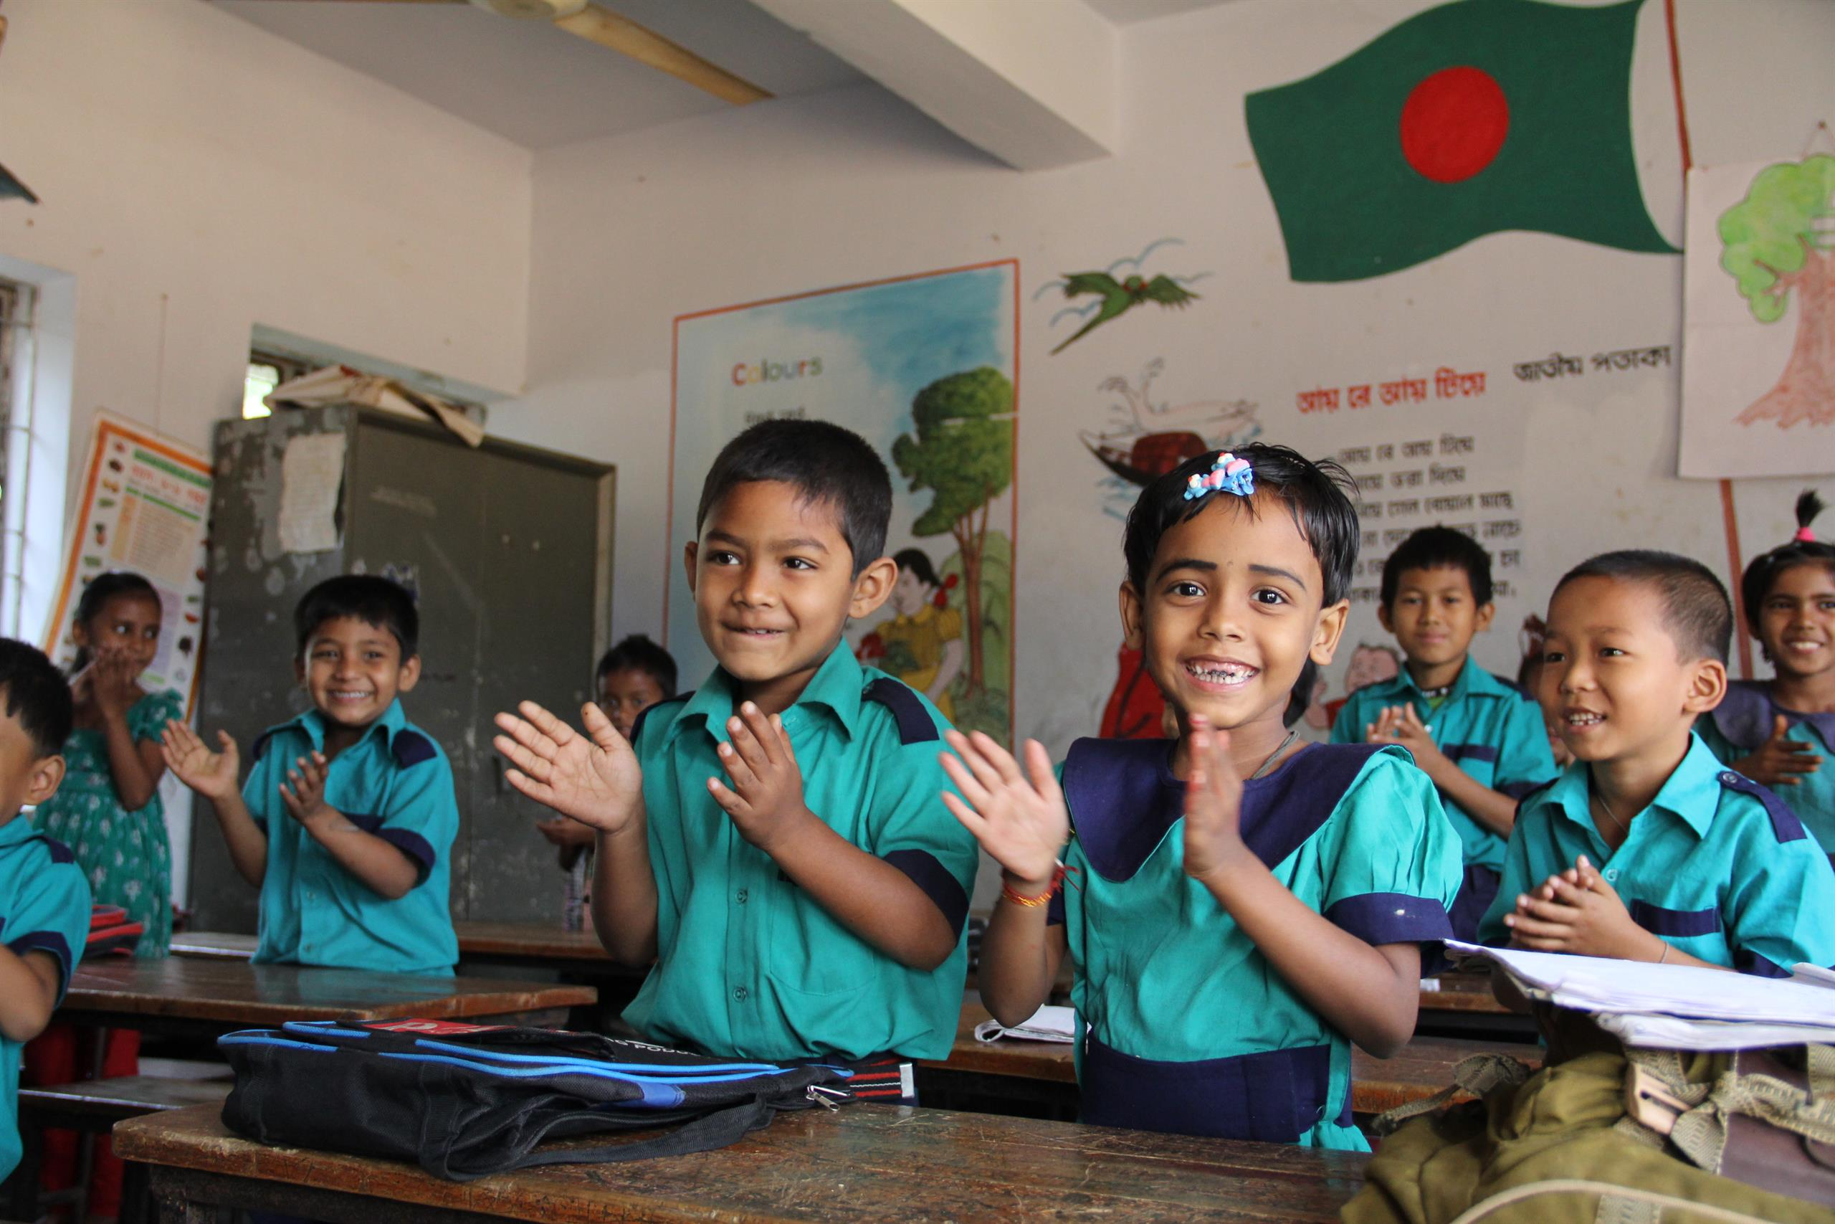
Welcome
to my dear students

Slide 2
Class: 3
Subject: English
Time: 40 Min.
Muhammad Abdul Muhaimin
Assistant Teacher
Chhakapan Govt. Primary School
Kulaura,Moulvibazar.

Slide 3
Unit:29
Lesson : 1

Slide 4
Students will be able to -
Listening:1.1.1 recognize English sound
differences in the context of words.
Speaking:1.1.3 repeat words, phrases and
sentences after the teacher with proper sounds and stress.

Slide 5
Let’s Watch a video

Slide 6
Where is it?

Slide 7
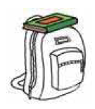
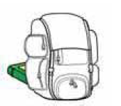
under
on
in
in font of
behind
between

Slide 8
Open at page-58

Slide 9
Matching
In front of
On
In
under
behind
between

Slide 10
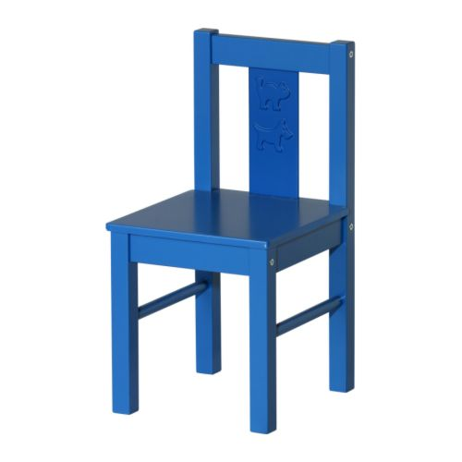
Where is the ball?

Slide 11
behind
under
In front of
in
between
on

