Slide 1
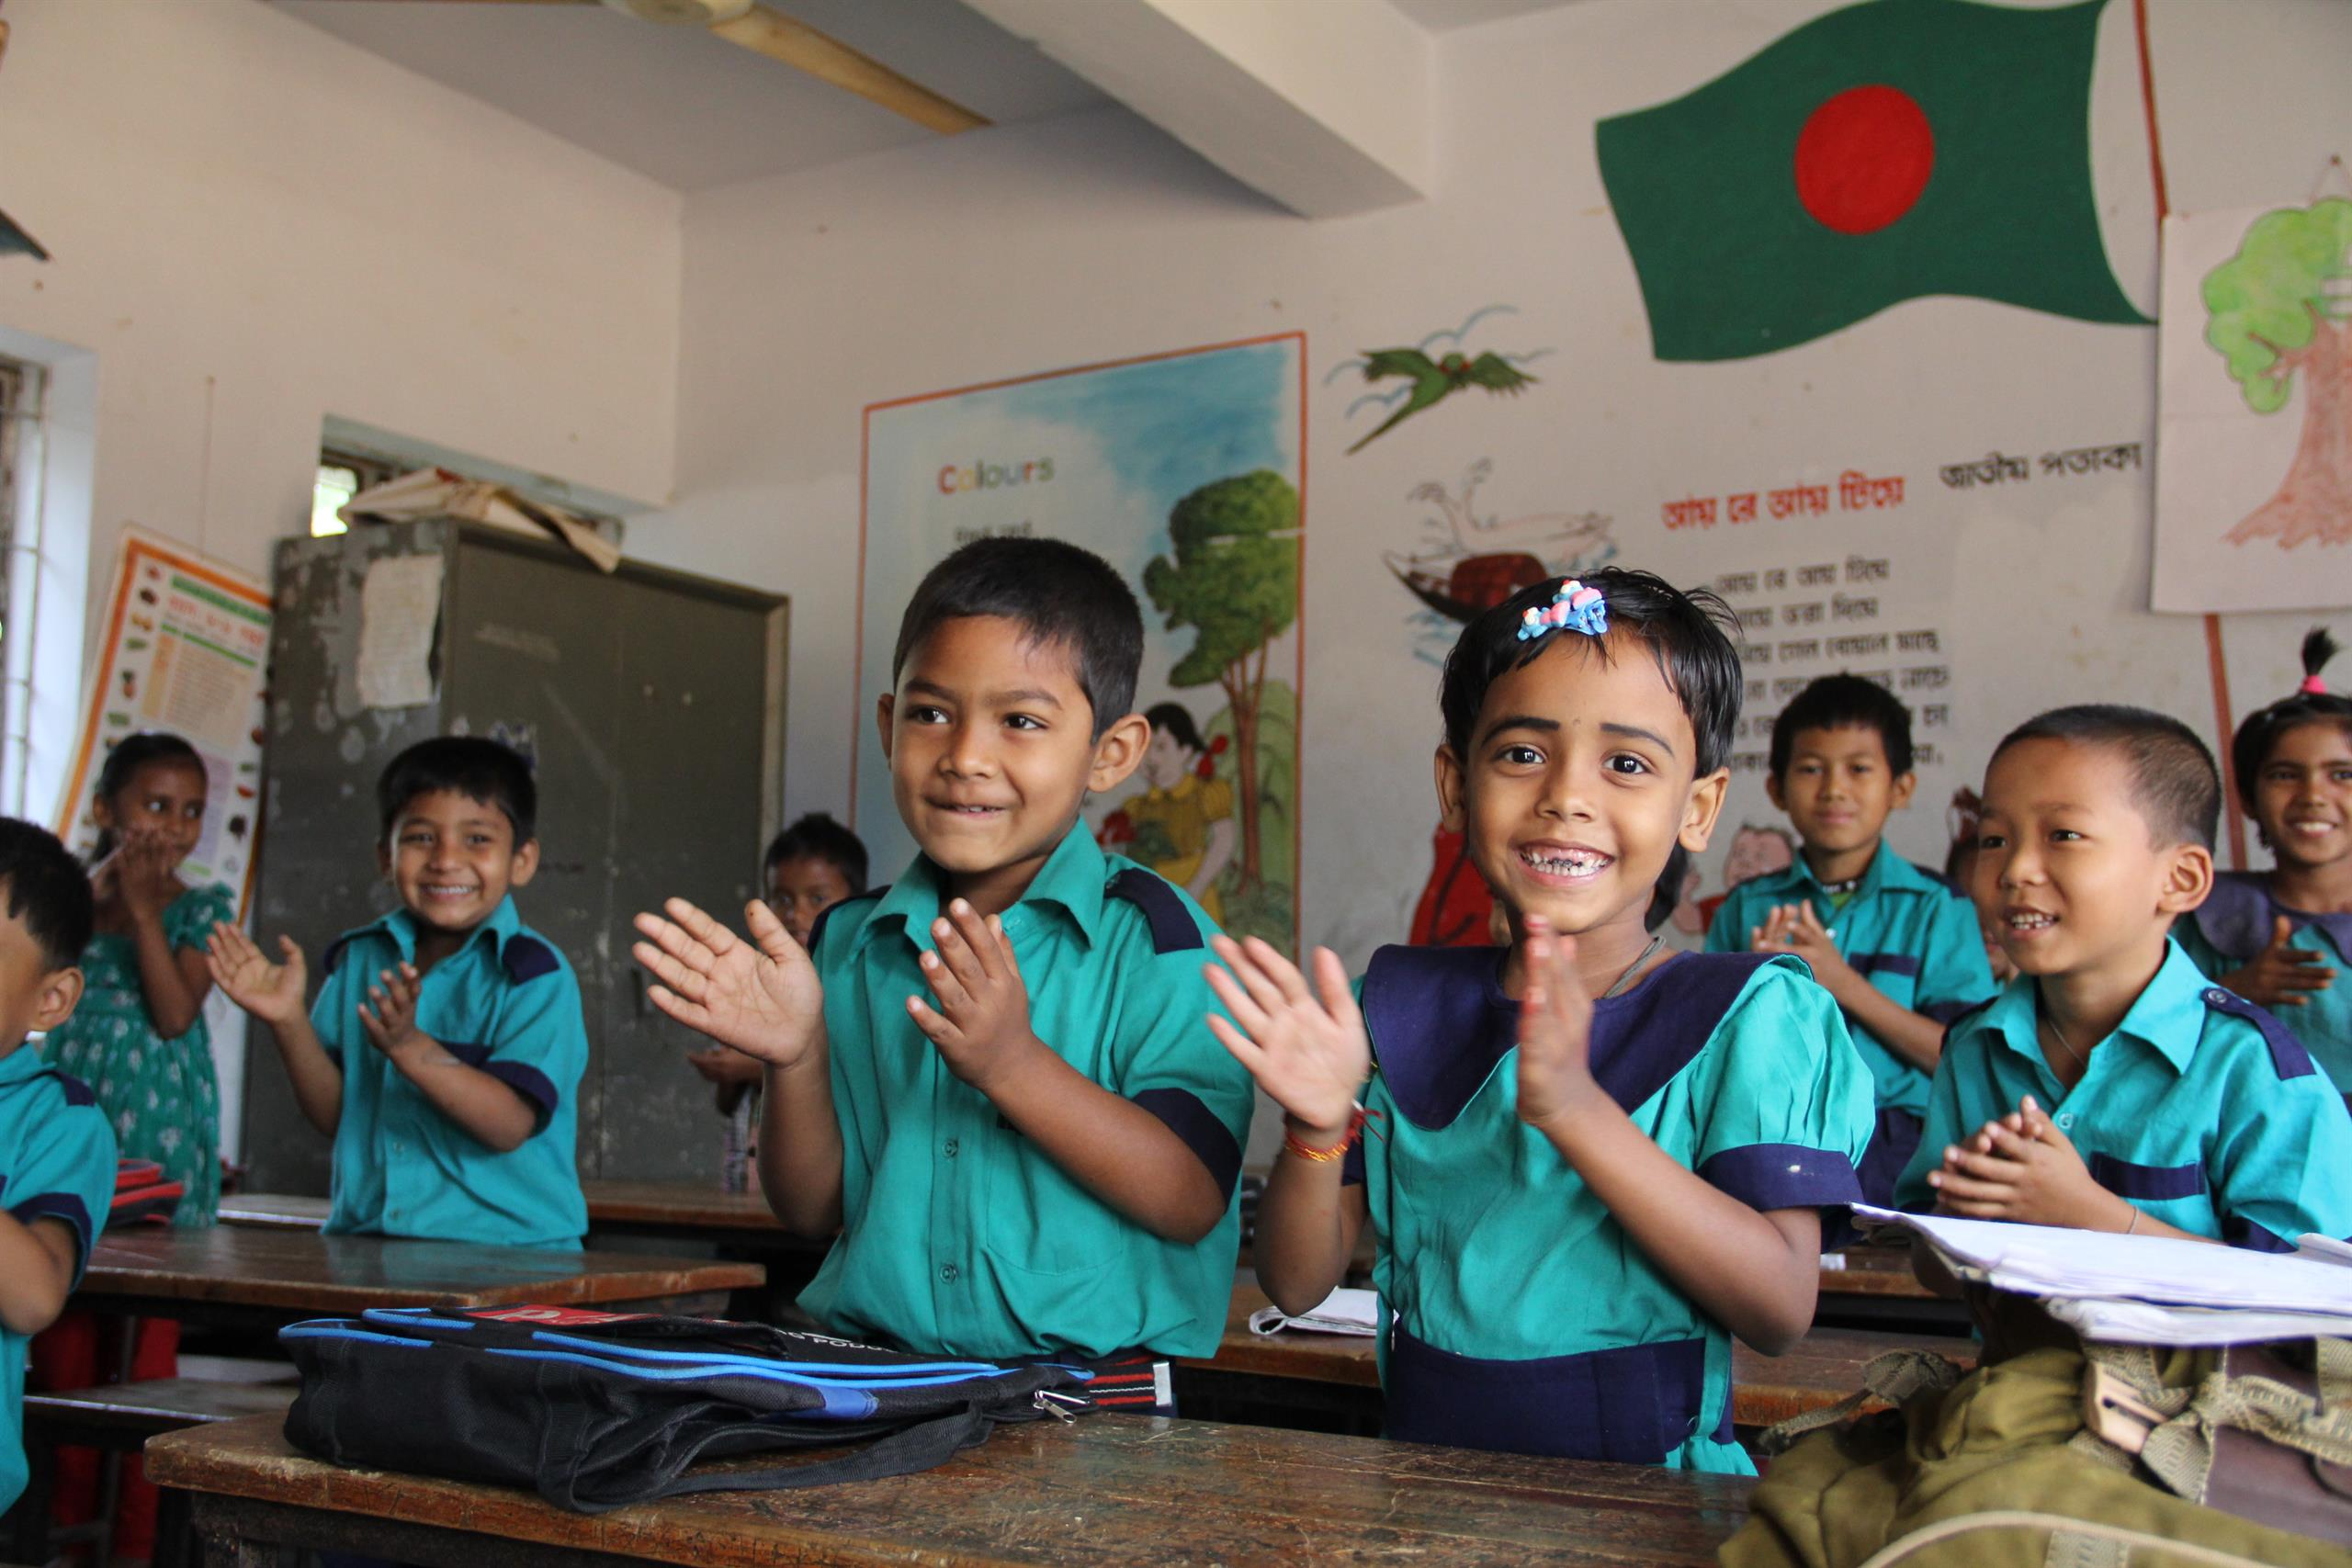
Welcome
to my dear students

Slide 2
Class: 1
Subject: English
Time: 40 Min.
Muhammad Abdul Muhaimin
Assistant Teacher
Chhakapan Govt. Primary School
Kulaura,Moulvibazar.

Slide 3
Unit: 6
Lesson: 4 (Alphabet E)
Time : 30 minutes

Slide 4
By the end of the lesson ss will be able –
Listening : 1.1.1 Became familiar with English sounds by listening to common English words.
Speaking : 1.1.1 Repeat after the Teacher simple words and phrases.
Writing : 1.1.1 To practice letter shapes / simple Writing patterns.

Slide 5
Look and Listen
E
e
elephant
E
egg
e

Slide 6
Look, Listen and Say
E
e
elephant
E
egg
e

Slide 7
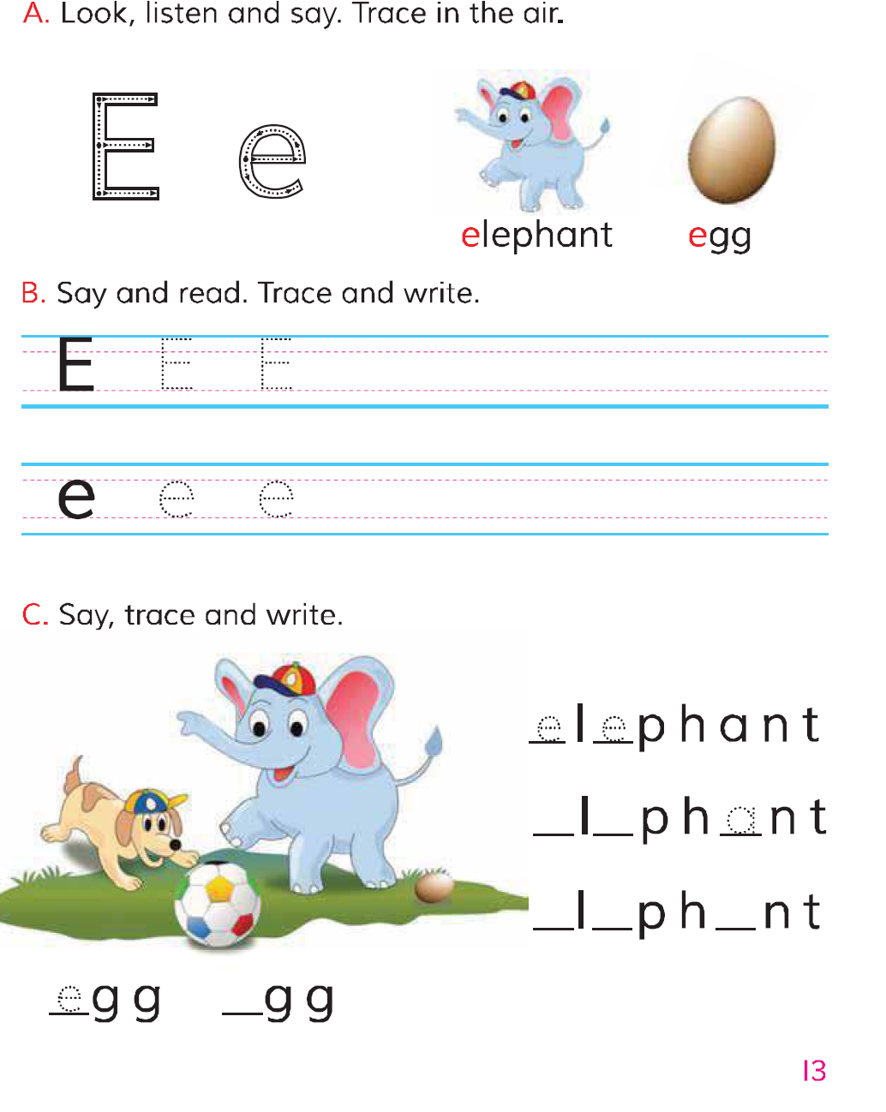
Open at page 13

Slide 8
Match
e
Eye
egg
E
apple
e
Ear
E
elephant

Slide 9
Trace in the air

Slide 10
Kim’s game
E
A
e
E
b
e
e
E
e
Which letter is missing?

Slide 11
Find out E e
Elephant
egg
Ant
ear
Eyes
Cap
Dog
end
Bet

