Slide 1
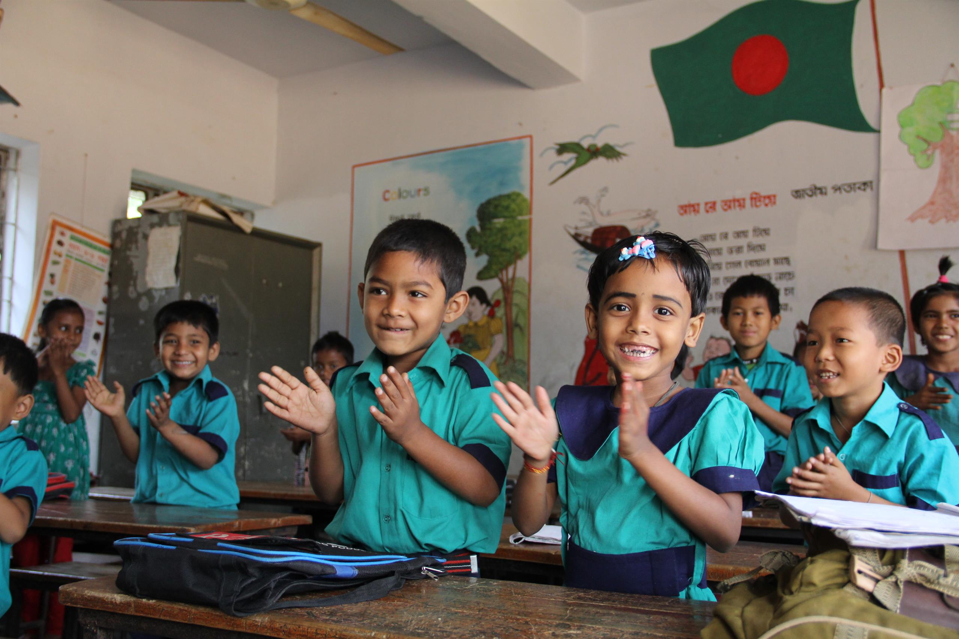
Welcome
to my dear students

Slide 2
Class: Two
Subject: English
Time: 40 Min.
Muhammad Abdul Muhaimin
Assistant Teacher
Chhakapan Govt. Primary School
Kulaura,Moulvibazar.

Slide 3
Unit -16
Lesson-4

Slide 4
Students will able to-
Listening 1.1.1 become familiar with English sounds by listening to common English words
Speaking 1 .1.1 repeat after the teacher simple words a pharaes with proper sounds and stress

Slide 5
Let’S watch a picture

Slide 6
Colours

Slide 7
What do you see in the picture?

Slide 8
Listen and say
yellow
red
green
orange
blue
violet
indigo

Slide 9
Open at page -33

Slide 10
Color
red
blue
indigo
violet
orange
yellow
green

Slide 11
Say the color
yellow
red
green
orange
blue
violet
indigo

