Slide 1
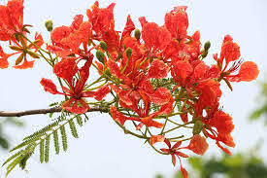
/
Good morning everybody

Slide 2
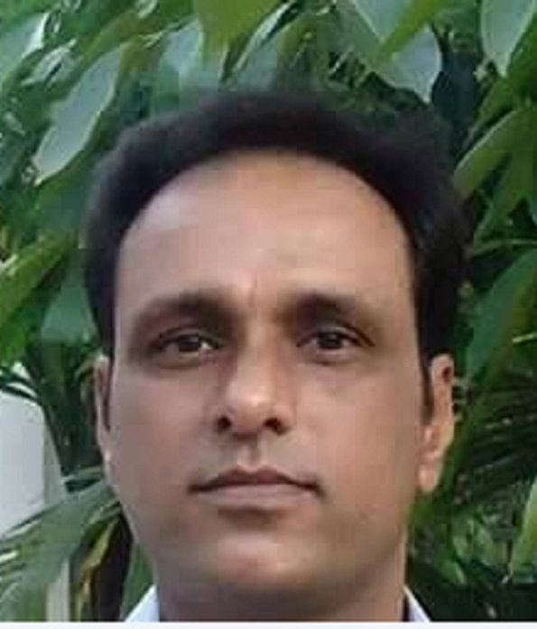
/
Presented by
Randhir Das
Assistant teacher
Dokkhin sagor govt.Primary school.
Baniyachang, Habigonj.
Phone :01734151582

Slide 3
/
Lesson Introduction
Class:Five
Unit:17
Sport
(H.Listen and read)
Time: 45 minutes

Slide 4
/
Learning outcomes
By end of the lesson student will be able------
2.2.1 recognix ad rea ordeinal numers.
5.1.1 read silently with undeerstnding paragraph.
2.1.1 write cardinal 1-500 in figures.
write cardinal up to 20th in figures and in words.

Slide 5
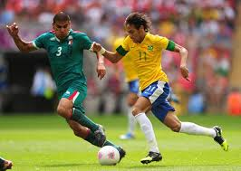
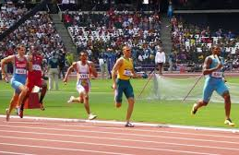
/
Can you guess what may be our today’s lesson?
Sport

Slide 6
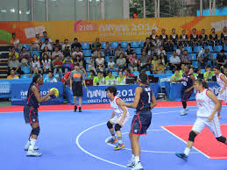
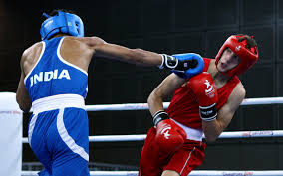
Let us watch some picture
Sports
What can you see in these picture?

Slide 7
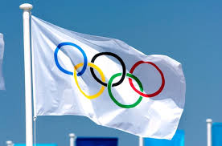
/
It’s olympic rings flag.
What’s this picure?

Slide 8
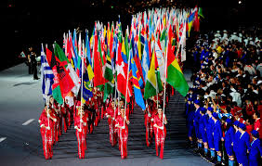
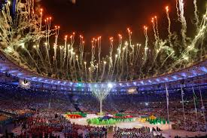
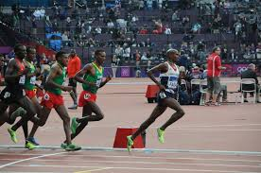
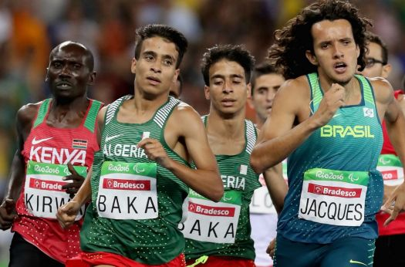
/
The Olympic Games
The Olympic Games is the biggest sports competition in the world.

Slide 9
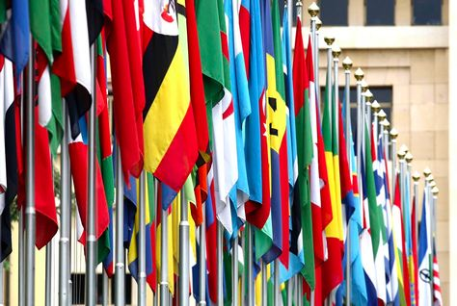
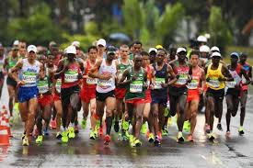
/
Athletes
More than 200 nations send a total of about 13,000 athletes to compete in more than
30 different sport.
The Olympics are held every four years in a different host city.

Slide 10
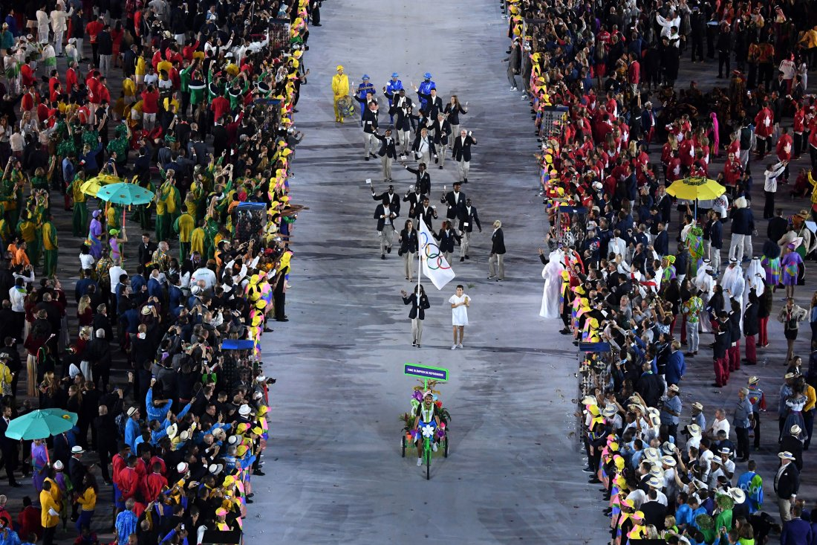
Look at the picture
/
The modern Olympic Games - 1896
The first Olympic Games
The modern Olympic Games started in 1896 ,and there have been 31 Olympic competitions since then.
The first Olympic Games were held in Greece almost 3,000 years ago.

Slide 11
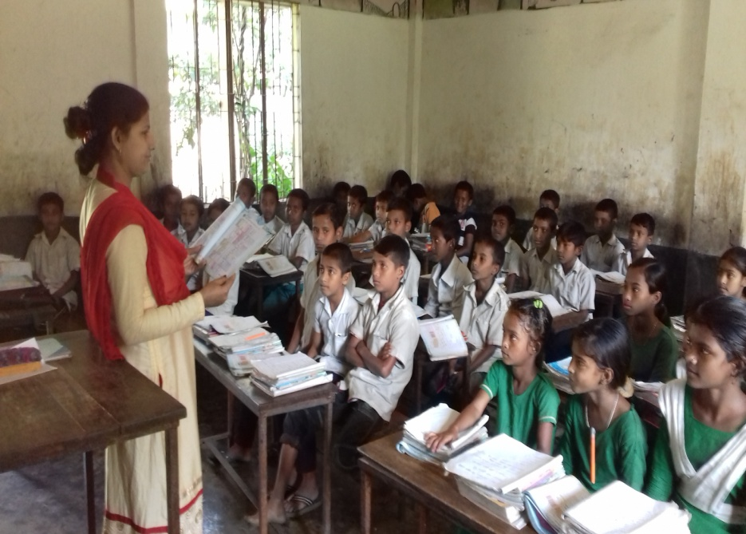
/
Teacher’s loud reading and discuss the lesson.

Slide 12
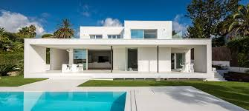
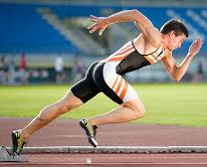
/
New words with sentences by using picture
Relating to present times
Not the same
A person proficient of sport
Different
Modern
Athlete
13,000 athletes to compete in the Olympics.
It is a modern house.
I have many different kinds of pencil.

Slide 13
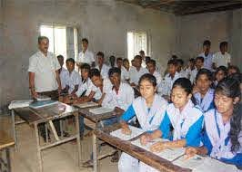
/
Student’s loud reading help by teacher.

Slide 14
Individual work
/
Match the answer
Fill in the blanks with appropriate words
sports
The Olympic Games is the world’s biggest ------------
Competition.
b.More than 200 countries ------------------ in this competition.
c. There are more than 300 ----------- in the Olympics.
d. The --------------- Olympics was held in Greece.
e. The ---------------- Olympics started in 1896.
participate
events
first
modern

Slide 15
/
Pair work
Write five sentences about The Olympic Games.

Slide 16
/
Group work
Answer the following questions
How many countries compete in the Olympics?
b. When did the modern Olympic Games begin?
c. Where were the first Olympic Games held?

Slide 17
Evualuation
/
Match the answer
Write the answer on the answer paper:
1. How many nations take part in Olympic?
(a) 200 (b) 100
(c)300 (d) 400
2. Where were the first Olympic Games held?
(a) In France (b) In Greece
(c) In Italy (d) In Japan
3. When did the modern Olympic Games start?
(a) 1696 (b) 1896
(c) 1796 (c) 1996
4. How many years are there between two Olympic Games?
(a)3 years (b) 4 years
(c) 2 years (d) 5 years
✓
✓
✓
✓

Slide 18
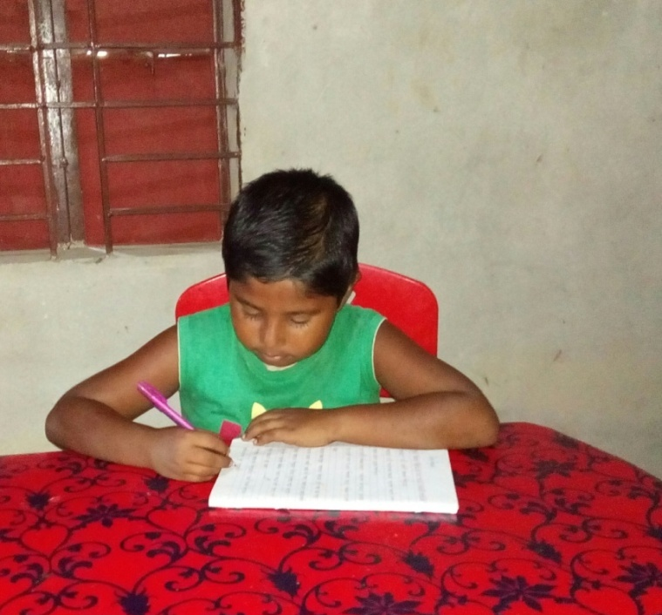
/
Home work
You will write five sentences about your favourite game.

Slide 19
/

