Slide 1

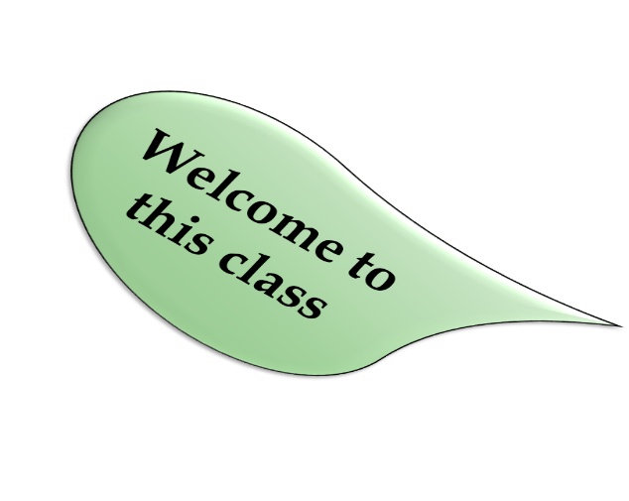
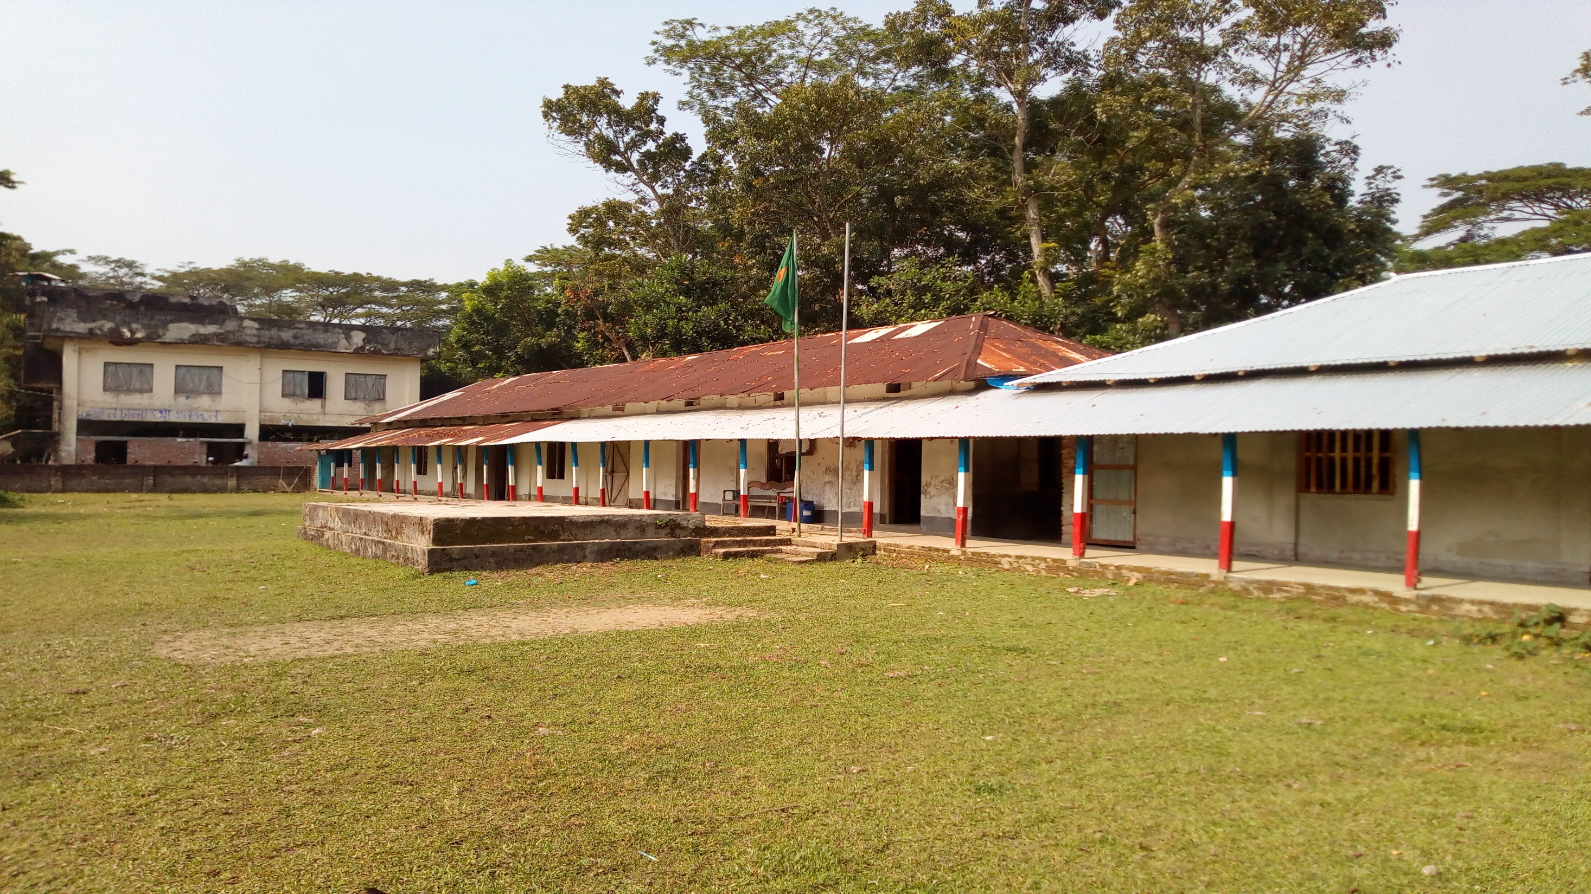
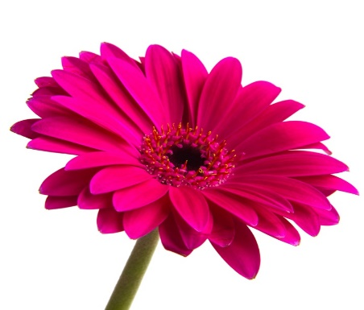
Welcome
TO
OUR
ONLINE CLASS
The best teacher in the earth

Slide 2
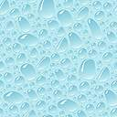
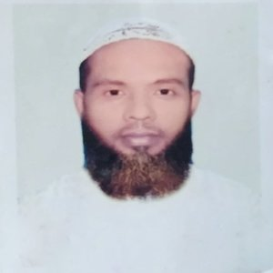
teacher IDENTITY
Muhammad Ahsan Habib
Assistant Teacher
Mohsenuddin Nuria Fazil (Degree) Madrasah
Bauphal, Patuakhali
Mobile-01754755169
E-mail- ahsanhabib251281@gmail.com

Slide 3

Introduction of lesson
Class- Nine & Ten
Subject –English 1st paper
Unit: One
Lesson: 3
(Good character)

Slide 4
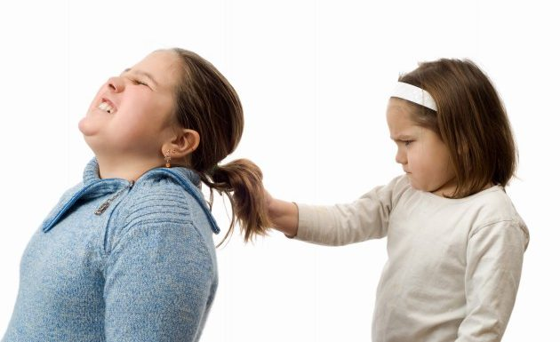
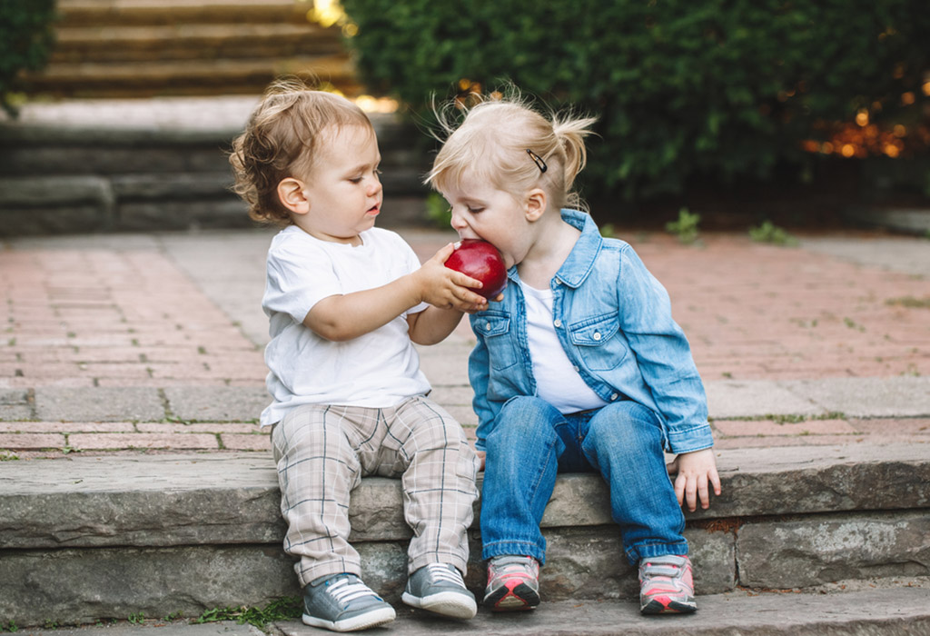
What about the picture?
Discuss with your partner
Notes:
This slide only for mind set up. Teacher can ask another questions for grow class arrange.

Slide 5
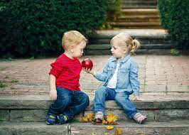
So today we’ll discuss about
Class- Nine &ten , U-1, L-3
Good character

Slide 6
Learning outcomes
After completing this lesson, students will be able to---------
Ask and answer questions,
Read and understand chart,
Tick the best answer,
Fill in the blanks.
Notes:
All the four skills will be focused in this lesson.

Slide 7
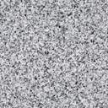

Read
the text
silently
and
carefully
Unit-One
Lesson-3

Slide 8
Good citizen means “gain good quality”. To be a good citizen you should gain all the good and positive attitudes to life that you do not gain automatically but personally. It is not God given. These qualities differentiate you from others. So, you obviously learned and practiced it.

Slide 9

Look at the chart
Good character traits-
Optimism
Conscientiousness
Self-
discipline
Reliability
Loyalty

Slide 10
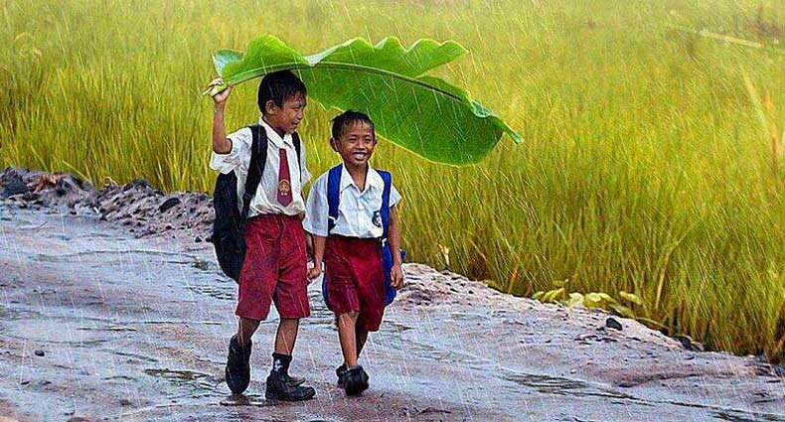
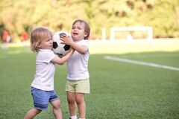
Individual works.
Look at the pictures and answer these questions.
What do you understand by character?
What does a person with a good character usually do to others?
Notes:
This slide only for mind set up. Teacher can ask another questions for grow class arrange.

Slide 11
Look at the chart
Good character traits-
Generosity
Kindness
Courageousness
Politeness
Lovingness

Slide 12
Look at the chart
Good character traits-
Responsibility
Sympathy
Fairness
Humanity
Forgiveness

Slide 13
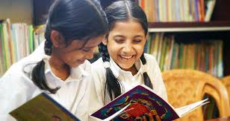
Pairs work
Fill in the blanks in the following passage with appropriate words from the box.
harmonious allow behaviour respect
good doing family class others
sense qualities believe personally

Slide 14
Citizens possessing good character live a life of virtue. They may belong to any social 1)------, upper or lower. Their thoughts and 2) ------ show high moral values. That is, they have a strong 3) ------ of right and wrong. So what they do is 4)------ for themselves as well as for others in the 5)------ and in the society. In fact, they cannot even think of 6)------- any wrong to others. One of the most positive 7)------ of these people is tolerance towards 8)-------. Suppose a group of people in your community 9)------ or practise something which you do not like 10)------. But as a good citizen you should 11)------ them to perform their activities. Thus tolerance can generate 12)------- for people of other cultures. Tolerance and respect together can make life 13)------ and peaceful in society.
Correct answer: 1, class; 2, behaviour; 3, sense;4, good; 5, family; 6, doing; 7, qualities; 8, others; 9, believe; 10, personally; 11, allow; 12, respect; 13, harmonious

Slide 15
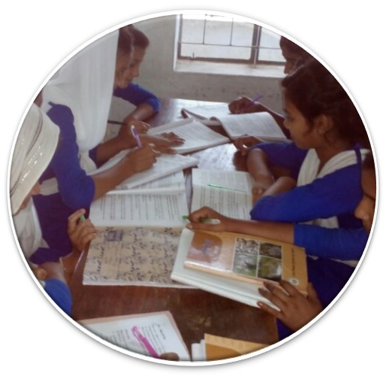
Groups work
Find the opposites of these words. If you do not know any, look it up in your dictionary. Then make a meaningful sentence with each of these opposites:
tolerance, respect, allow, enjoyable

Slide 16
Look at the chart:
Good character traits-
Integrity
Positive
attitudes
Honesty
Respect
Faithfulness

Slide 17

Evaluation
  Which is the correct statement according to the information in the listening /above text?
Good character does not mean special qualities.
Good citizens must have good character along with other qualities.
Character means a tool to curve wood.
Character traits are distinctive marks always seen on a person’s face.

Slide 18


2. The red crest of a rooster
is a symbol of power and strength.
enables it to crow in the morning.
makes the bird tall and beautiful.
shows how it is different from a hen.
3. The expression ‘distinctive qualities’ means those qualities of a person, which
are the same as others’.
emphasise honesty in him/her.
make him / her different from others.
he / she gets from their parents.

Slide 19

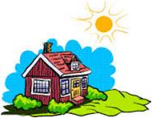
Home Work
Write a paragraph about how tolerate or intolerant you are towards your family members.
Notes:
This is a creative work that the students will perform at home to show the teacher in the nest class.

Slide 20


THANK YOU FOR
YOUR ATTENTION
GOOD BYE
(May allah bless you)

