Slide 1
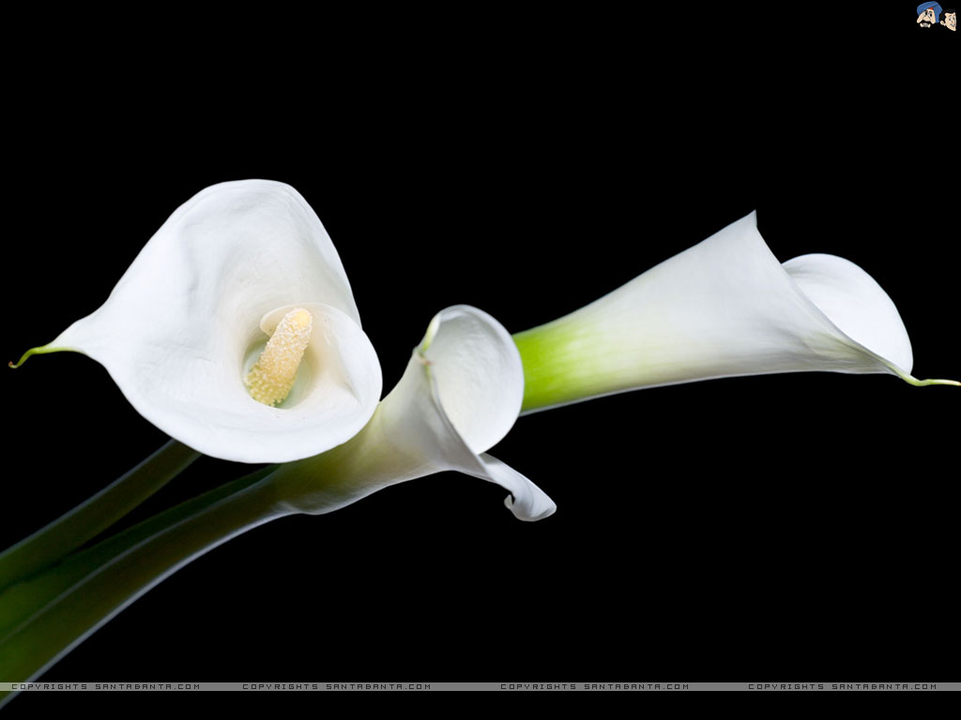
Welcome dear students.
Welcome dear students
Notes:
This is a welcome slide.

Slide 2
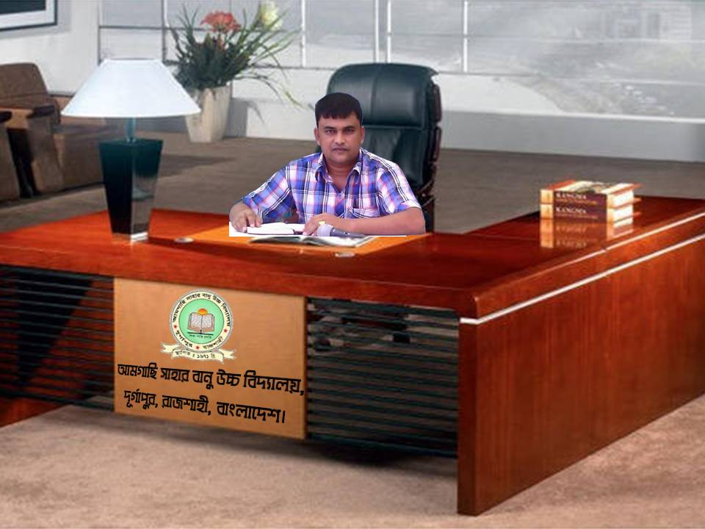

Slide 3
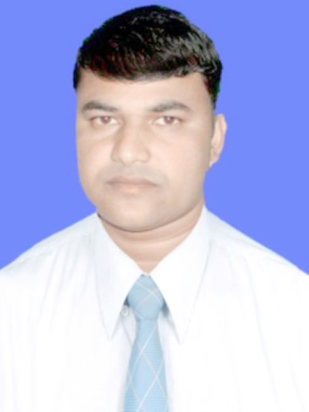
Introduction
Presented by:
On-line Class
Md. Sukur Uddin
(Saajal Raj)
Assistant Teacher
Amgachhi Shaher Banu High School
Durgapur, Rajshahi, Bangladesh.
Cell: +8801721913872
E-mail: saajalahmed@gmail.com
Class: Nine-Ten
Subject: English 2nd Paper
Dated: 21. 09. 2020
Notes:
Identity of the teacher & class as well as subject

Slide 4
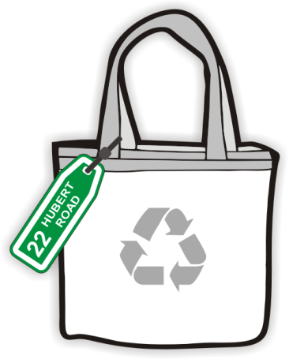
Look at the pictures and think about these.
Bag
Tag
A bag with a tag.
Notes:
To show actual meaning of Tag (Tag means to add something with other thing).

Slide 5
Our To-day’s Topic is

Slide 6
Learning outcomes
At the end of the lesson, we will be able to—
Tell the definition of Tag Question
Define right Tag operator easily
Describe some important rules and practice
Click

Slide 7
Definition
A tag question is a question
that is added at the end of a statement
to make sure the information
is correct or to seek agreement.
Click

Slide 8
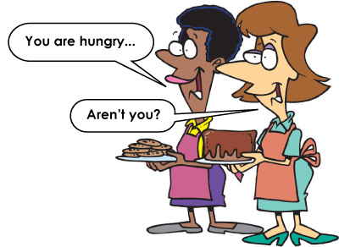
Right Tag Operator
Click

Slide 9
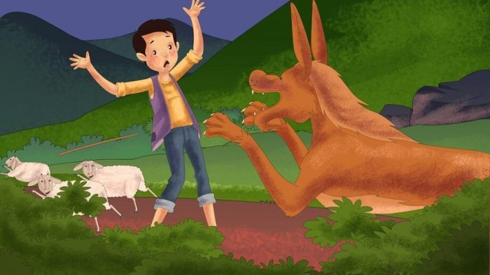
Right Tag Operator
He is a liar, isn’t he?
Click

Slide 10
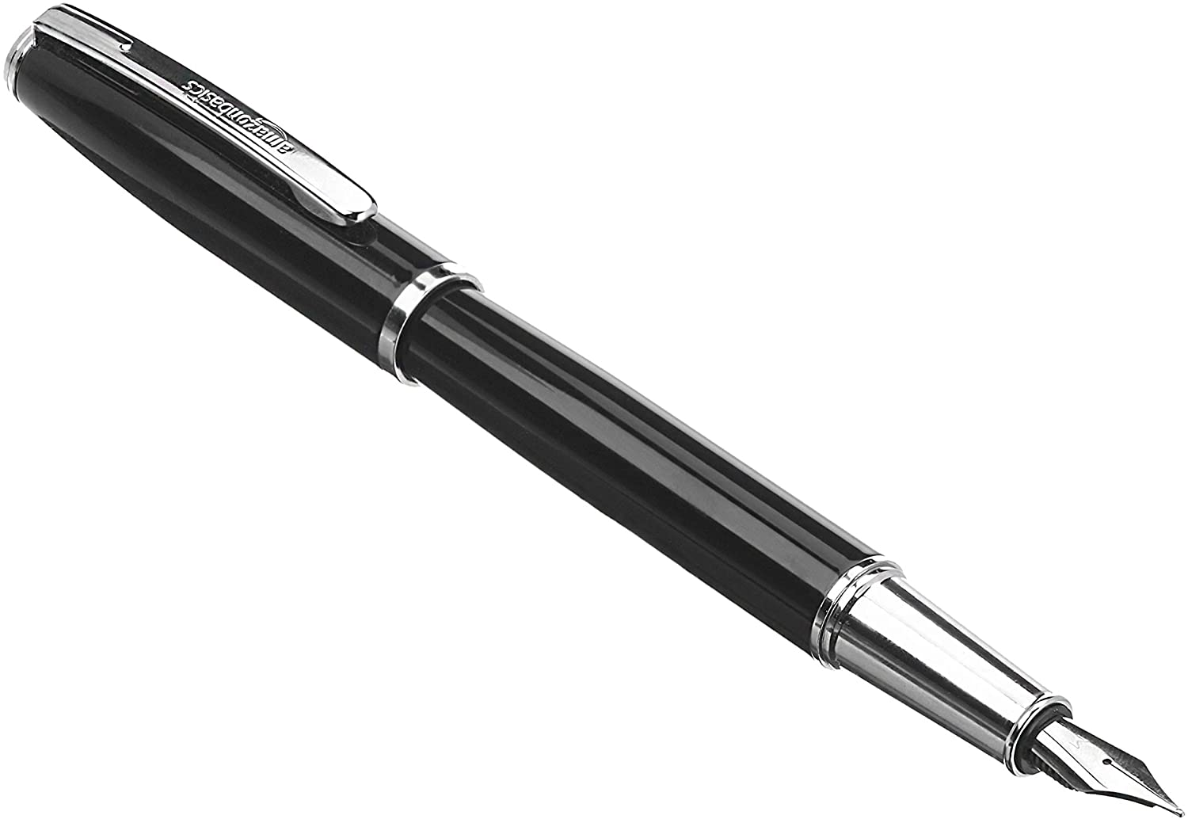
Right Tag Operator
This is a nice pen, isn’t it?

Slide 11
Some important Figures
Base | Contracted figure (Statement Figure) | Un-contracted Negative figure | Contracted negative figure (Tag Figure)
1. P.V |  | do not | don’t
2. P.V-s,es |  | does not | doesn’t
3. P.V-(past) |  | did not | didn’t
4. am | I’m | am not | aren’t/ain’t
5. is | He’s | is not | isn’t
6. are | We’re, You’re, They’re | are not | aren’t
7. was |  | was not | wasn’t
8. were |  | were not | weren’t
9. have | I’ve, You’ve, We’ve, They’ve | have not | haven’t
10. has | He’s | has not | hasn’t
11. had | I’d, He’d, You’d, We’d, They ‘d | had not | hadn’t
12. shall |  | shall not | shan’t
Click

Slide 12
Some more important Figures
Base | Contracted figure (Statement Figure) | Un-contracted Negative figure | Contracted negative figure (Tag Figure)
13. should |  | should not | shouldn’t
14. will | I’ll, He’ll, You’ll, We’ll, They’ll | will not | won’t
15. would | I’d, He’d, You’d, We’d, They’d | would not | wouldn’t
16. can |  | can not | can’t
17. could |  | could not | couldn’t
18. may |  | may not | mayn’t
19. might |  | might not | mightn’t
20. ought to |  | ought not to | oughtn’t to
21. need |  | need not | needn’t
22. dare |  | dare not | daren’t
24. used to |  | used not to, did not use to | usedn’t to, didn’t use to
Click

Slide 13
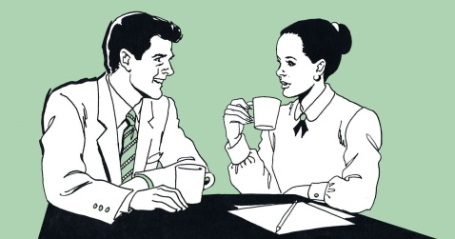
Some important rules
Rule-1
If the statement part is affirmative, tag part will be negative;
If the statement part is negative, tag part will be affirmative
He is a teacher, isn’t he?
You have not done the work, have you?
Click

Slide 14
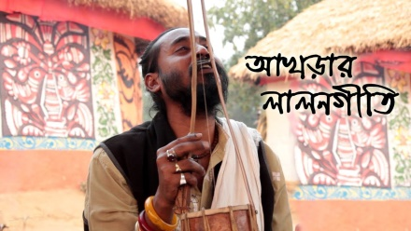
Rule-2
If the subject of statement is noun,
the operator of tag will be pronoun.
Tutul Bhero is a great singer, isn’t he?
Click

Slide 15
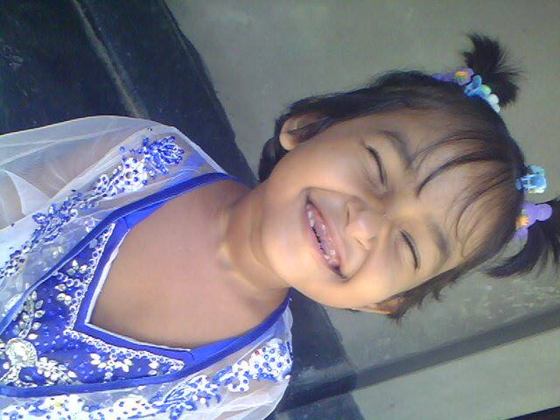
Hi, I’m Shishir
Shishir is a good girl, isn’t she?
Click

Slide 16
Books
The Book is very popular, isn’t it?
Books are our best friend, aren’t they?
Click

Slide 17
Rule-3
If the main verb of statement is base form, verb of Tag part will be ‘do’
If the main verb of statement adds ‘s or es’, verb of Tag will be ‘does’
If the main verb of statement is past form, the verb of tag will be ‘did’

Slide 18
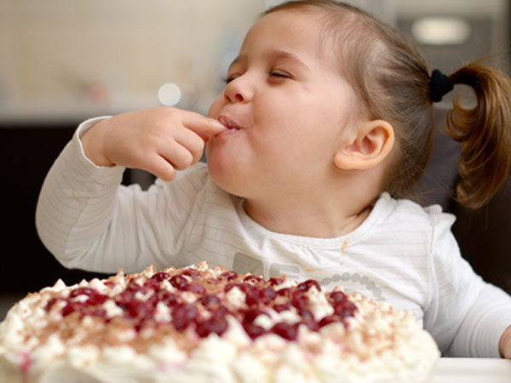
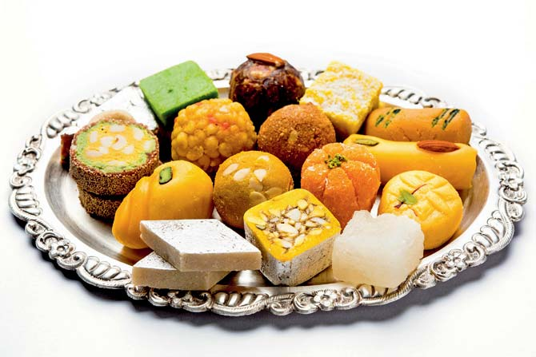
Hey, Look at me…
I like sweets, don’t I?
Structure: Sub:+PV(base form)+…………….+,+ don’t+sub:+?

Slide 19
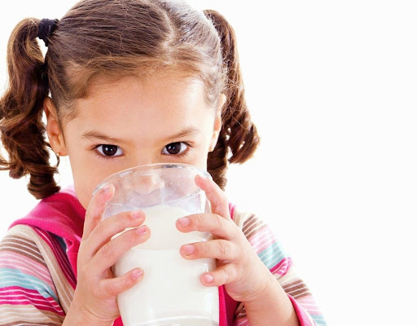
Hey, Look at me …
Tuni drinks milk, doesn’t she?
Structure: Sub:+PV(s/es)+…………….+,+ doesn’t+sub:+?

Slide 20
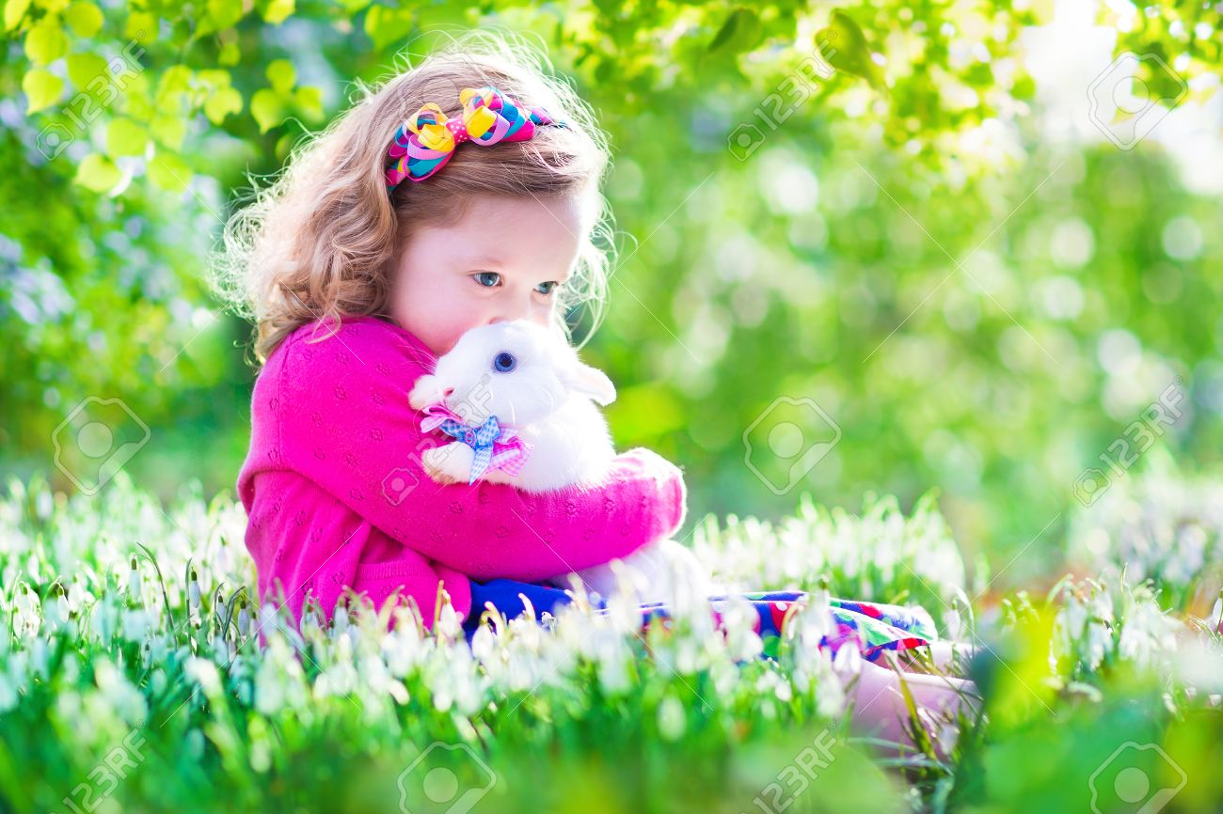
Hey, Look at my doll….
Diana made a doll, didn’t she?
Structure: Sub:+PV(past form)+…………….+,+ didn’t+sub:+?

Slide 21
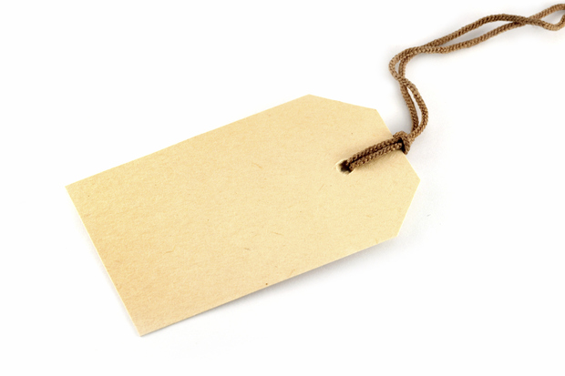
Rule-4
Tag…..
If the statement starts with Everyone, Everybody, Someone, Somebody, Anyone, Anybody and All, the statement is considered as affirmative sentence and the the subject or operator of tag will be ‘they’.
Click

Slide 22
Who does not like flower?
Everybody likes flower, don’t they?
Structure: Everybody:+PV(s/es)+…………….+,+ don’t+they+?

Slide 23
All loves a good student, don’t they?
Structure: All:+PV(s/es)+…………….+,+ don’t+they+?

Slide 24
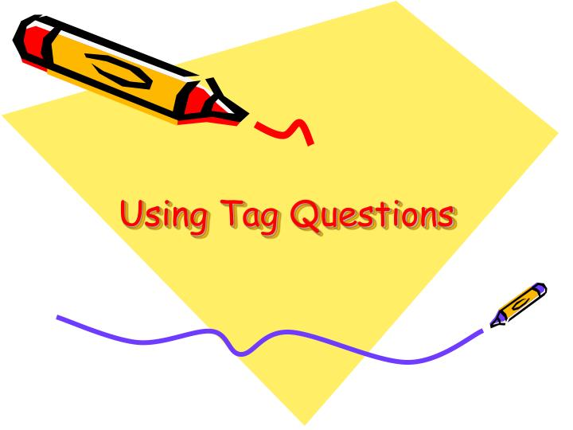
Rule-5
If the statement starts with No, Nobody, No one, None, the statement is considered as negative sentence and the subject or operator of tag will be ‘they’.
Click

Slide 25
Nobody believes a liar, do they?
Structure: Nobody:+PV(s/es)+…………….+,+ do+they+?

Slide 26
No one likes a lipped, do they?
Structure: No one:+PV(s/es)+…………….+,+ do+they+?

Slide 27
Rule-6
There are some words such as, hardly, rarely, barely, scarcely, seldom, never etc. appear to be affirmative but they originally give the negative meaning.
Click

Slide 28
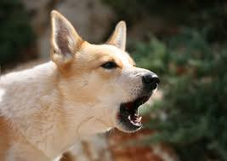
Look at the picture and try to understand
A barking dog seldom bites, does it?
Barking dogs seldom bite, do they?

Slide 29
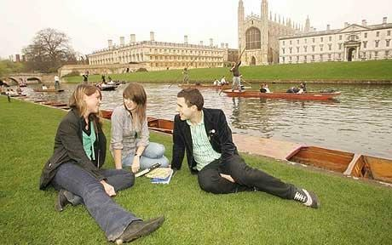
We are good friends
Roy hardly comes here, does she?
Such a good friend like you is rarely found, is he/she?

Slide 30
Rule-7
If the subject of statement is not personal noun, the subject of tag part will be ‘it’.
Click

Slide 31
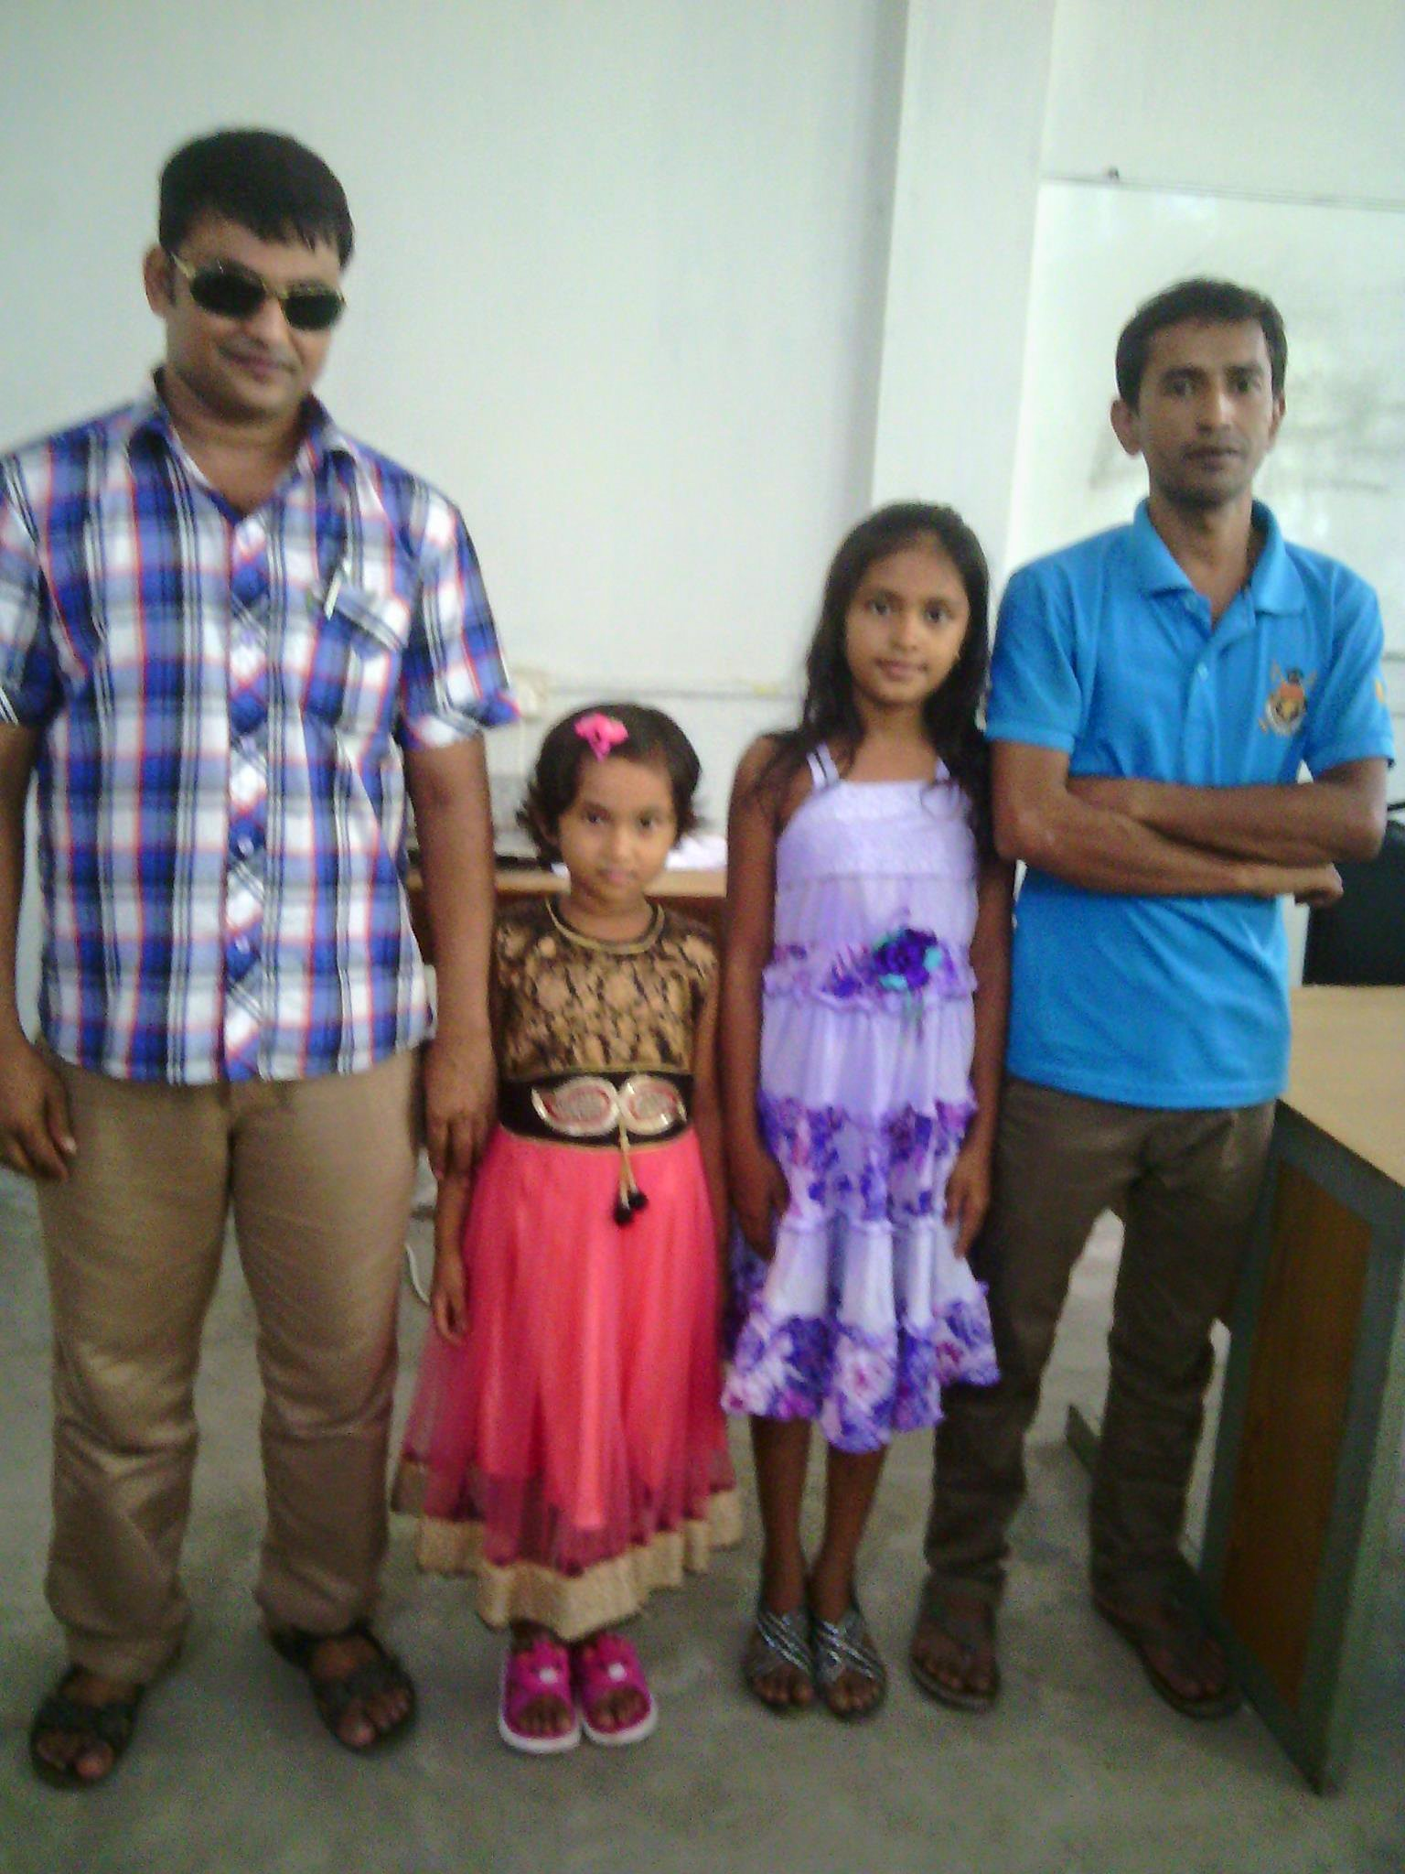
Look at the picture and try to understand
Her father’s name is Milton, isn’t it?
Note: Here her father is a person but her father’s name in not personal noun

Slide 32
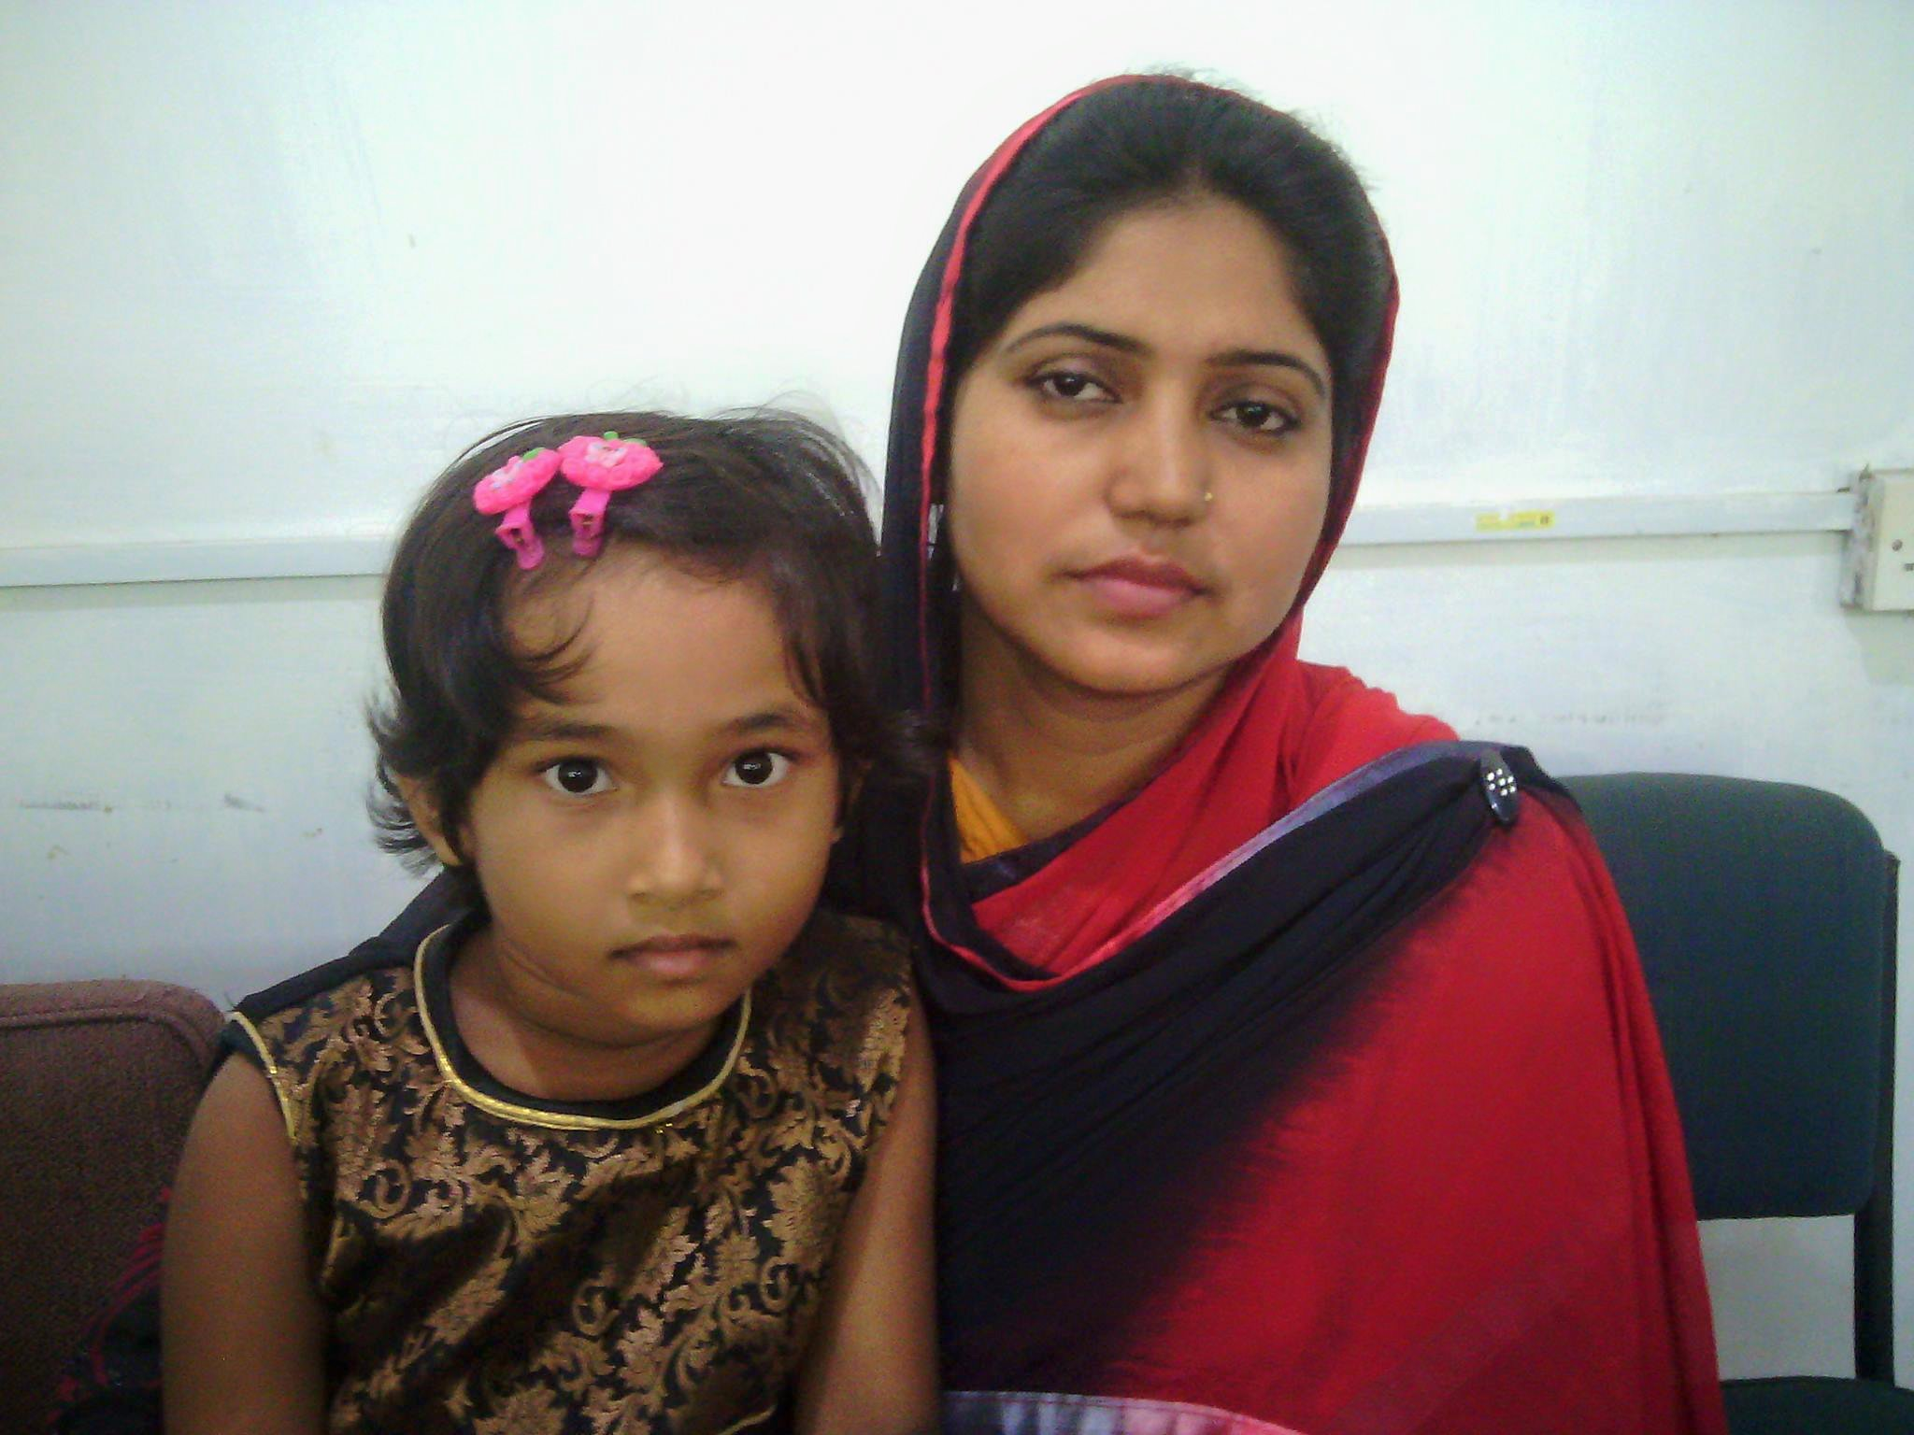
Look at the picture and try to understand
The mother rose in her, didn’t it?
Note: Here, the mother means the deep feelings of a mother.

Slide 33
Rule-8
There are some nouns of which have no gender. Yet, according to the rules of English Grammar the following pronoun is considered.
Noun…………………...........................................................................………….Pronoun (Tag part)
Allah……………………………………………………………………..………………….. He
The Padma (River)…………………………………………………………………….….. She/it
The Sun…………………………………………………………………………………….. He/it
The Moon ………………………………………………………………………………….. She/it
Bangladesh (Country)…………………………………………………………………….. She/it
Click

Slide 35
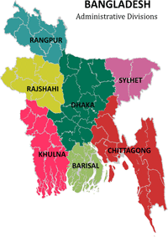
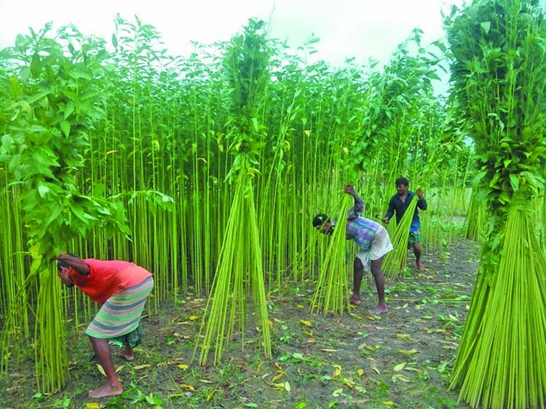
Look at the picture and try to understand
Bangladesh grows a lot of jute, doesn’t she?
Bangladesh is a small country, isn’t it?
Note: In first statement production plays a role of mother But
in second statement, it is only a description of Bangladesh

Slide 36
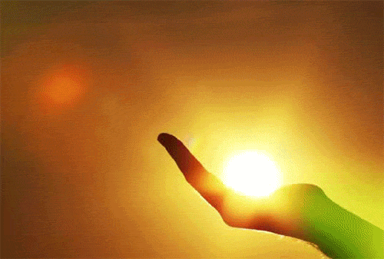
Look at the picture and try to understand
The Sun
The Sun has light of his own, hasn’the?
Note: Here the sun is consider as masculine gender.

Slide 39
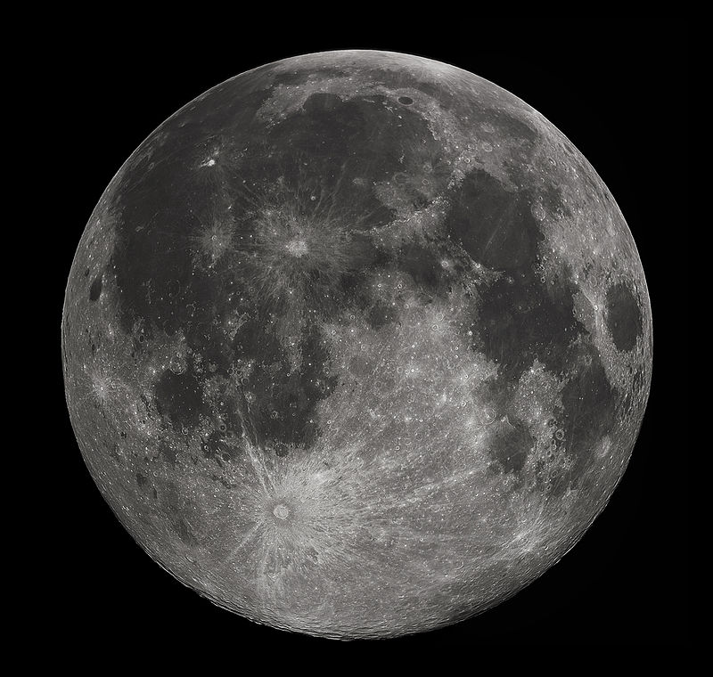
Look at the picture and try to understand
The Moon
The Moon is the only natural satellite of the Earth, isn’t it?
Note: Here the moon is described it’s identity.

Slide 40
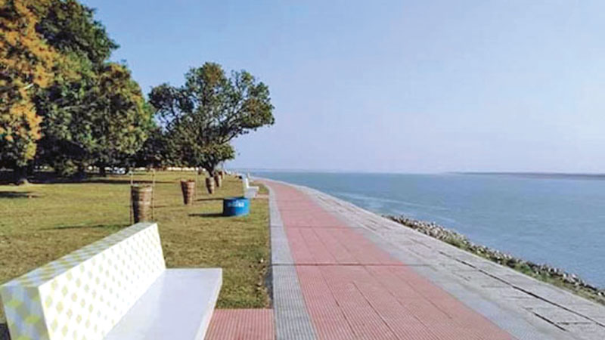
Look at the picture and try to understand
The Moon
The Padma is rich in hilsha fishes, isn’t she?
Note: Here the Padma river is considered as a feminine gender.

Slide 41
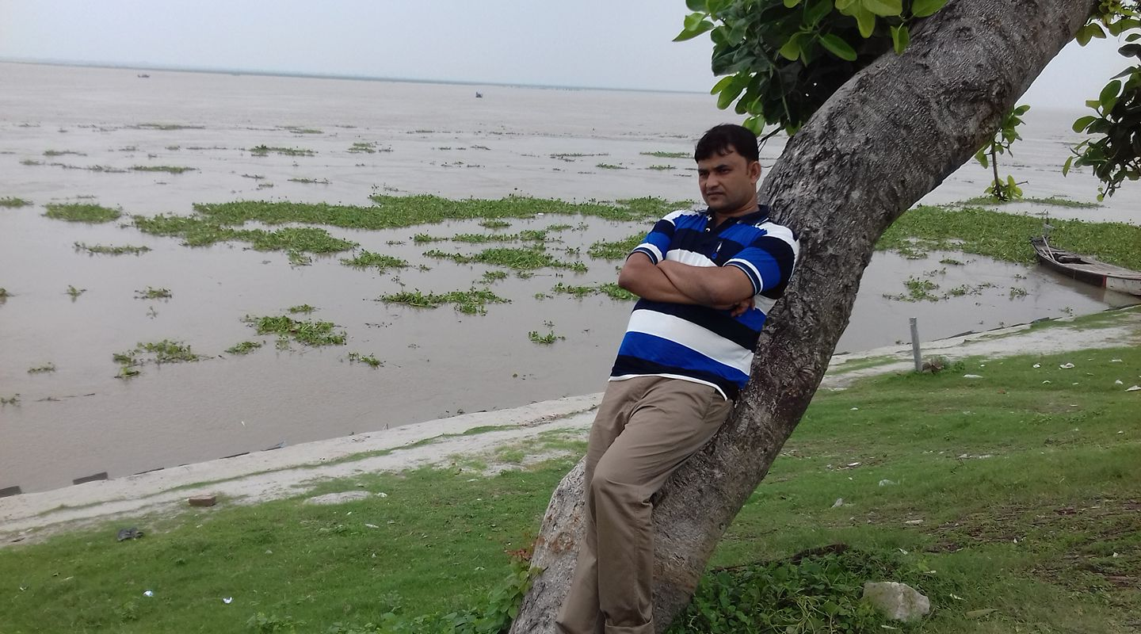
Look at the picture and try to understand
The Padma
The Padma is a big river, isn’t it?
Note: Here, the Padma river is introduced.

Slide 42
Rule-9
If any minor creature play a human role,
it is considered as a personal noun otherwise it will be considered as usually.
Click

Slide 44
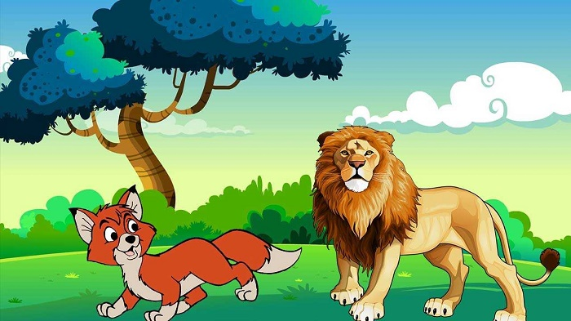
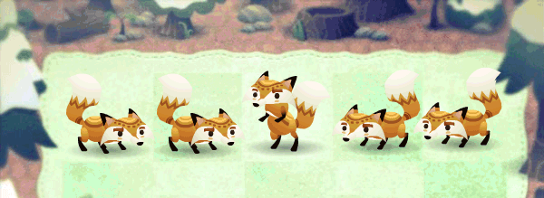
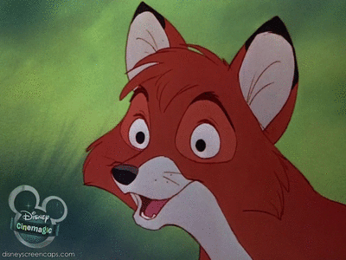
Look at the picture and try to understand
The fox declared a prize, didn’t he?
Note: This is used in a story of fables.

Slide 45
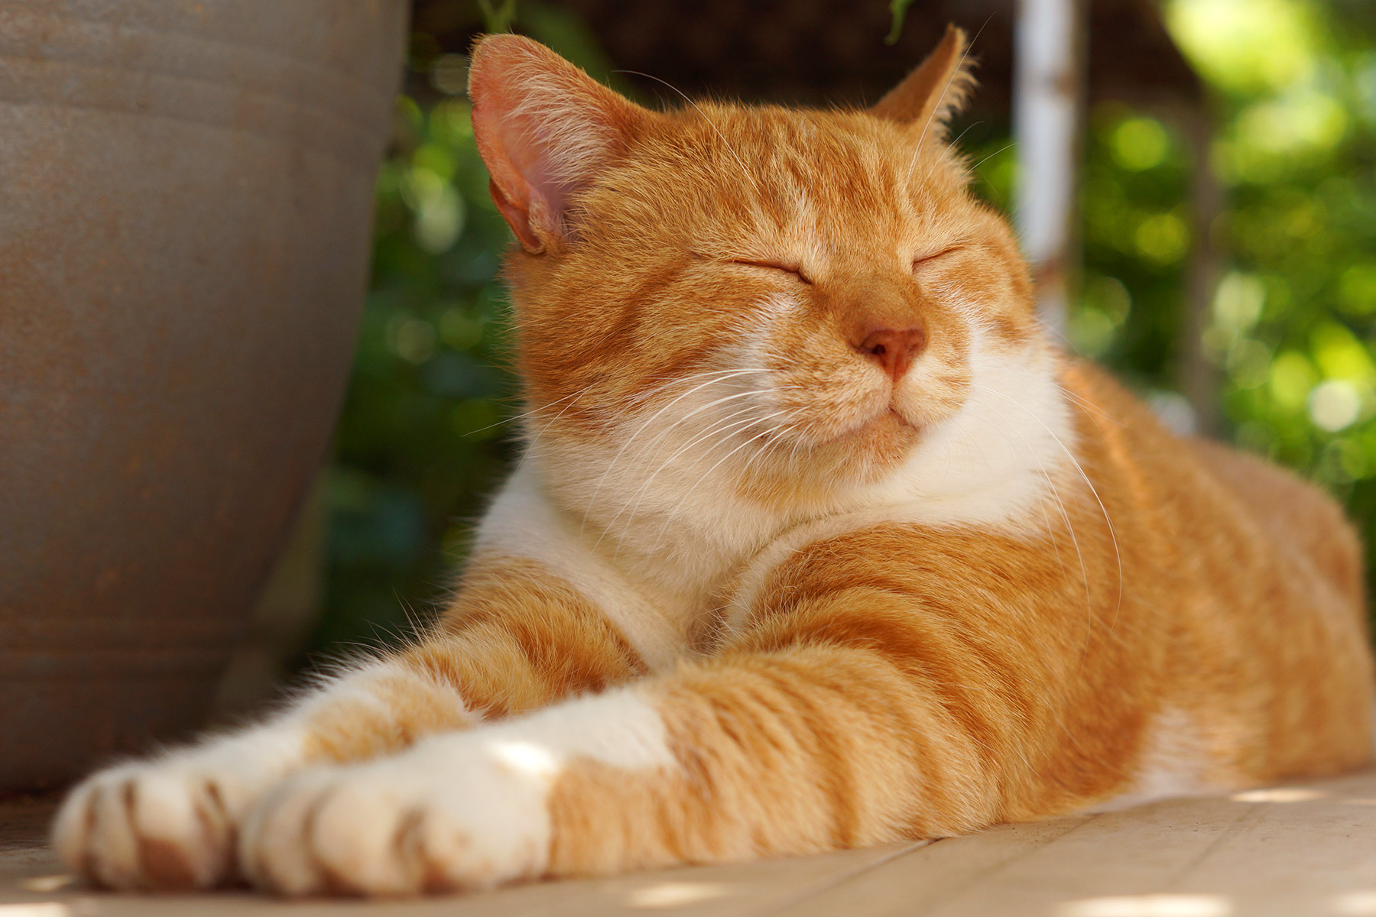
Look at the picture and try to understand
The cat is sleeping, isn’t it?
Note: This is only a description.

Slide 46
Rule-10
If by the imperative sentence means order, advise, forbid, request etc, tag will be-
will you?; won’t you?; would you?;
can you?; can’t you?; could you?; .
Click

Slide 47
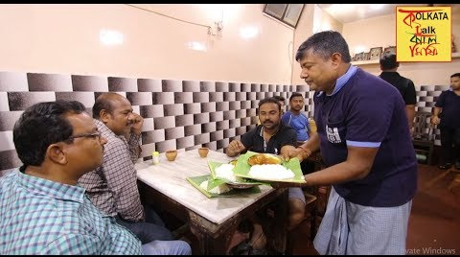
Look at the picture and try to understand
Have some more rice, will you?
Ref: will you= formal; won’t you = informal (Wren & Martin; page # 306)

Slide 50
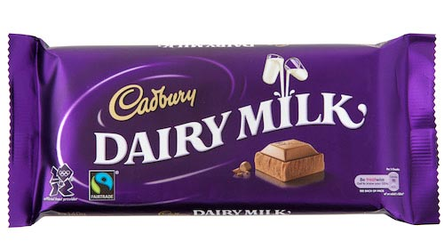
Look at the picture and try to understand
Have a chocolate, won’t you?
Ref: Oxford English Grammar; page # 22)

Slide 51
Test yourself
Can’t I
1. I can drive a car, ________?
2. None can escape from death, ________?
Can they
don‘t they
3. Everybody loves a freedom fighter,________?
have I
4. I have hardly money in my pocket,_______?
isn‘t it
5. The colour of her eyes is brown, ______?
will you
6. Shut down the computer, ______?
won‘t you
7. Look after the children, _________?
shan‘t I
8. I shall help you, ________?
isn‘t it
9. ‘You’ is a pronoun, ________?
am I
10. I’m not guilty, ____?

Slide 52
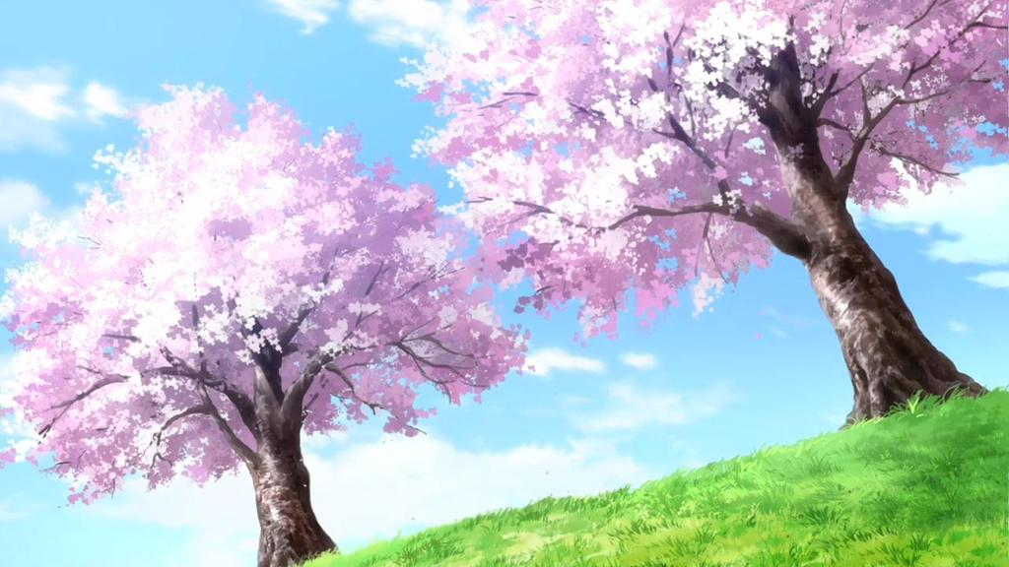
Thank you very much

