Slide 1
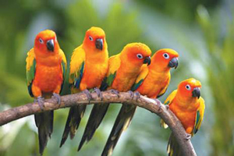
Welcome

Slide 2
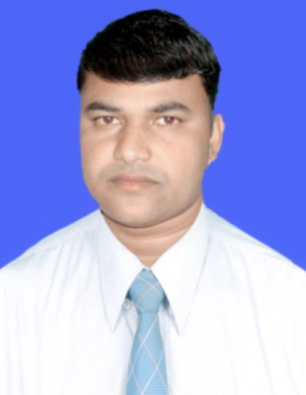
Presented by:
Md. Sukur Uddin (Saajal Raj)
Assistant Teacher
Amgachhi Shahar Banu High School
Durgapur, Rajshahi
Mobile: 01721913872
E-mail: saajalahmed@gmail.com

Slide 3
Lesson Introduction
Class : Six
Subject : English Second Paper
Unit : 3
Lesson : 6
Duration : 50 minutes
Dated : 01/02/2020

Slide 4
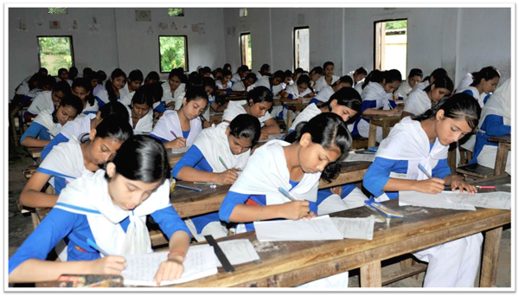
Look at the picture
Students

Slide 5
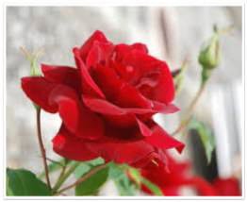
Look at the picture
Rose

Slide 6
Think about the pictures
and try to answer the following questions
What are the picture about ?

Slide 7
Title of the lesson
What may be the title of this topic?
Kinds of Noun

Slide 8
Learning Outcome
By the end of this lesson you will able to --
Tell the definition of noun
Find out different types of noun
Fill in the gaps
Turn into common noun from proper noun

Slide 9
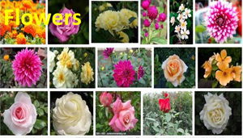
Look at the picture

Slide 10
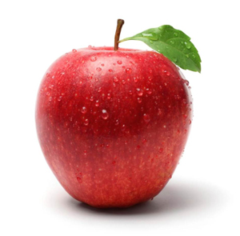
Look at the picture

Slide 11
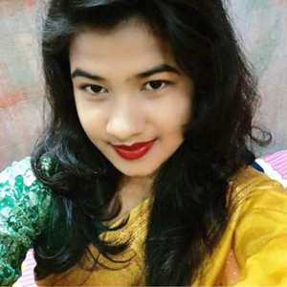
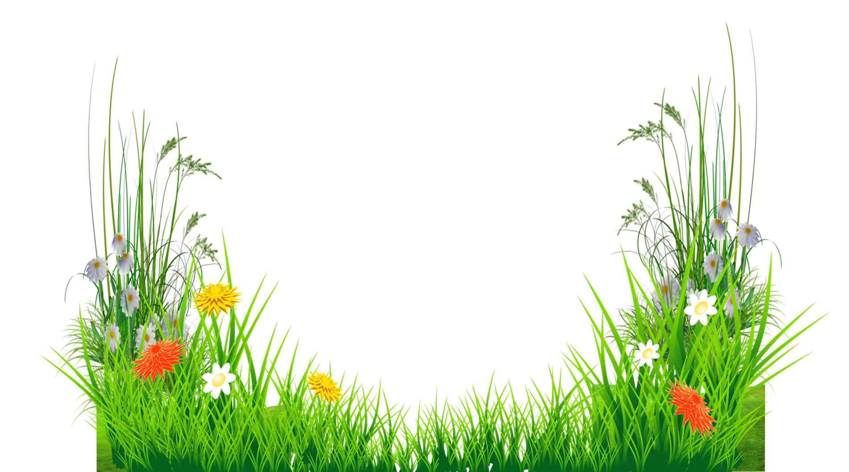
Look at the picture

Slide 12
Look at the picture

Slide 13
Do yourself
Time: 3 minutes
What is the definition of noun?
Definition: The name of anything is called noun.

Slide 14
Kinds of noun
Noun
Proper noun
Material noun
Common Noun
Collective noun

Slide 15
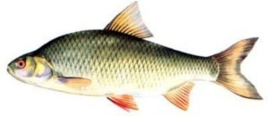
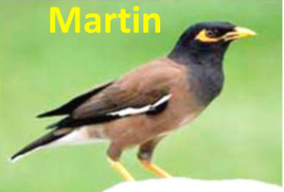
Look at the pictures below
Apple
Newspaper
Martin
Salmon
Rose
What type of noun are these?
Proper noun

Slide 16
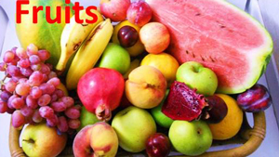
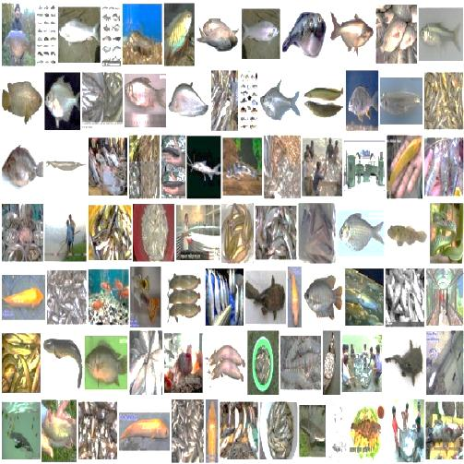
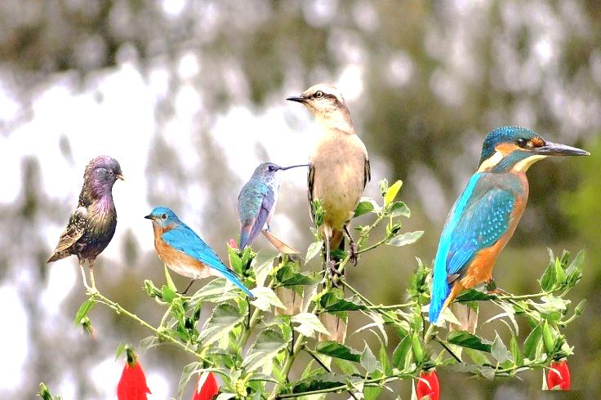
Look at the pictures below
Fruits
Paper
Birds
Flowers
Fish
What type of noun are these?
Common noun

Slide 17
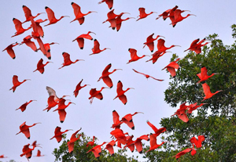
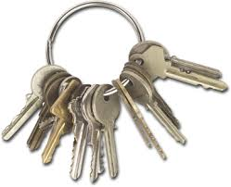
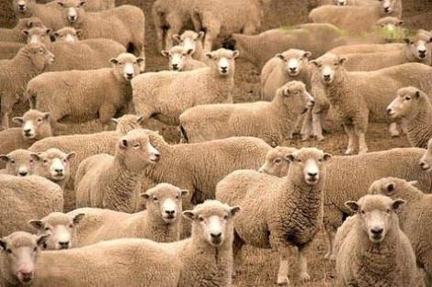
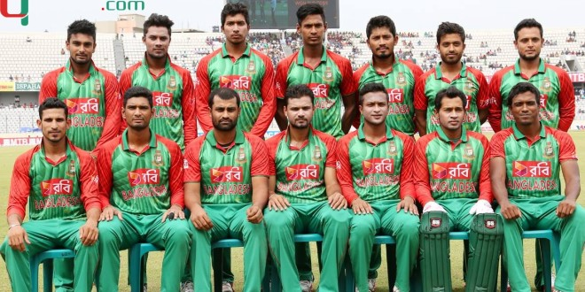
Look at the pictures below
A flock of birds
A clue of key
A flock of ram
A team of player
What type of noun are these?
Collective noun

Slide 18
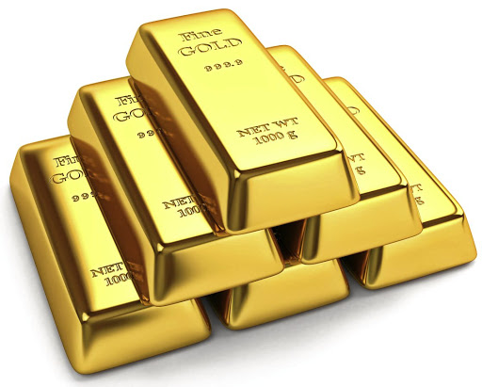
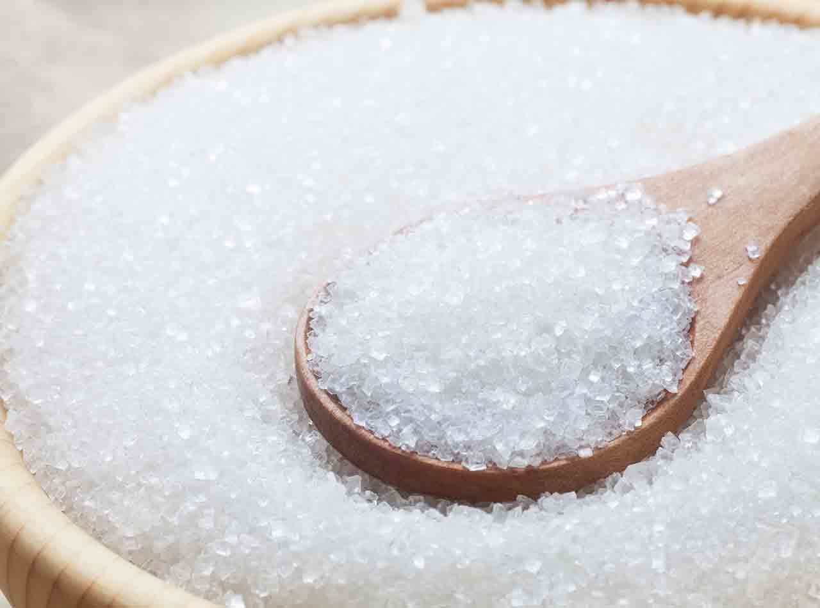
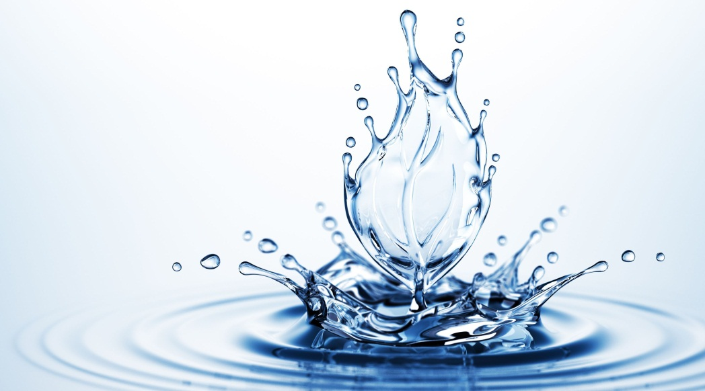
Look at the pictures below
Gold
Sugar
Wood
Water
What type of noun are these?
Material noun

Slide 19
Identify proper noun, Common noun, Collective noun and Material noun
Do yourself; Time: 3 minutes
Boy
Common noun
Tiger
Proper noun
Salt
Material noun
A crowd of people
Collective noun

Slide 20
Look at the picture

Slide 21
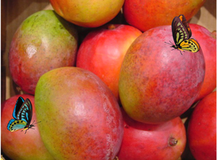
Look at the picture

Slide 22
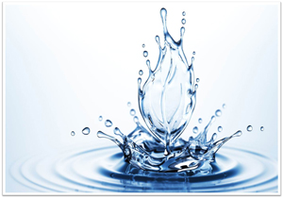
Look at the picture

Slide 23
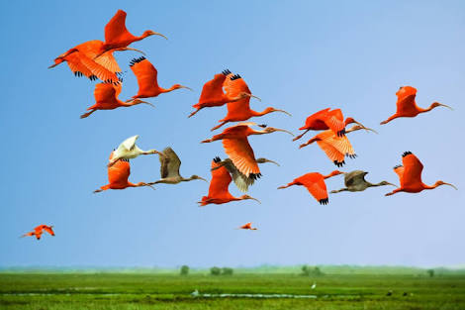
Look at the picture

Slide 24
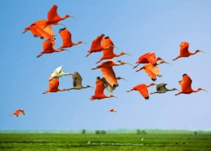
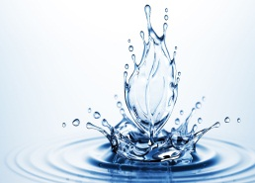
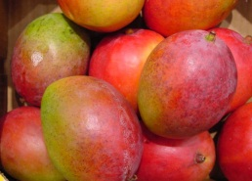
Match proper noun, Common noun, Collective noun and Material noun
Pair Work. Time: 5 minutes
Proper noun
Common noun
Collective noun
Material noun
Colour
A flock of birds
Water
Mangoe

Slide 25
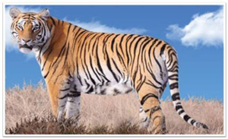
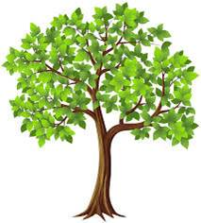
Look at the picture

Slide 26
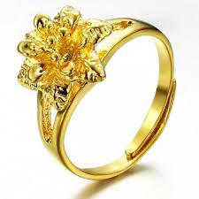
Look at the picture

Slide 27
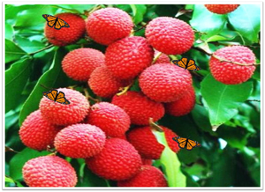
Look at the picture

Slide 28
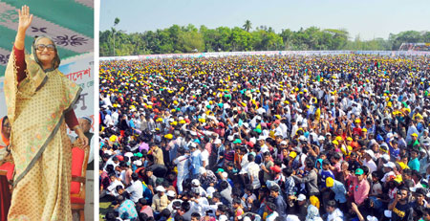
Look at the picture

Slide 29
Group Work. Time: 7 minutes
Make proper noun into Common noun
Proper noun
Common noun
Dove
Birds
Mahfuza Mitu
Girl
Bus
Vehicles
Tiger
Animal
Newspaper
Paper
Necklace of gold
Gold
Rafiq
Students
Hilsha
Fish

Slide 30
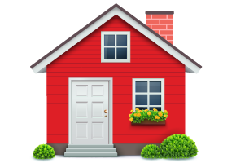
Home Work
You have to make a list of various types of nouns that you have seen in the side of your house and arrange them into proper noun, common noun, collective noun and material noun.

Slide 31
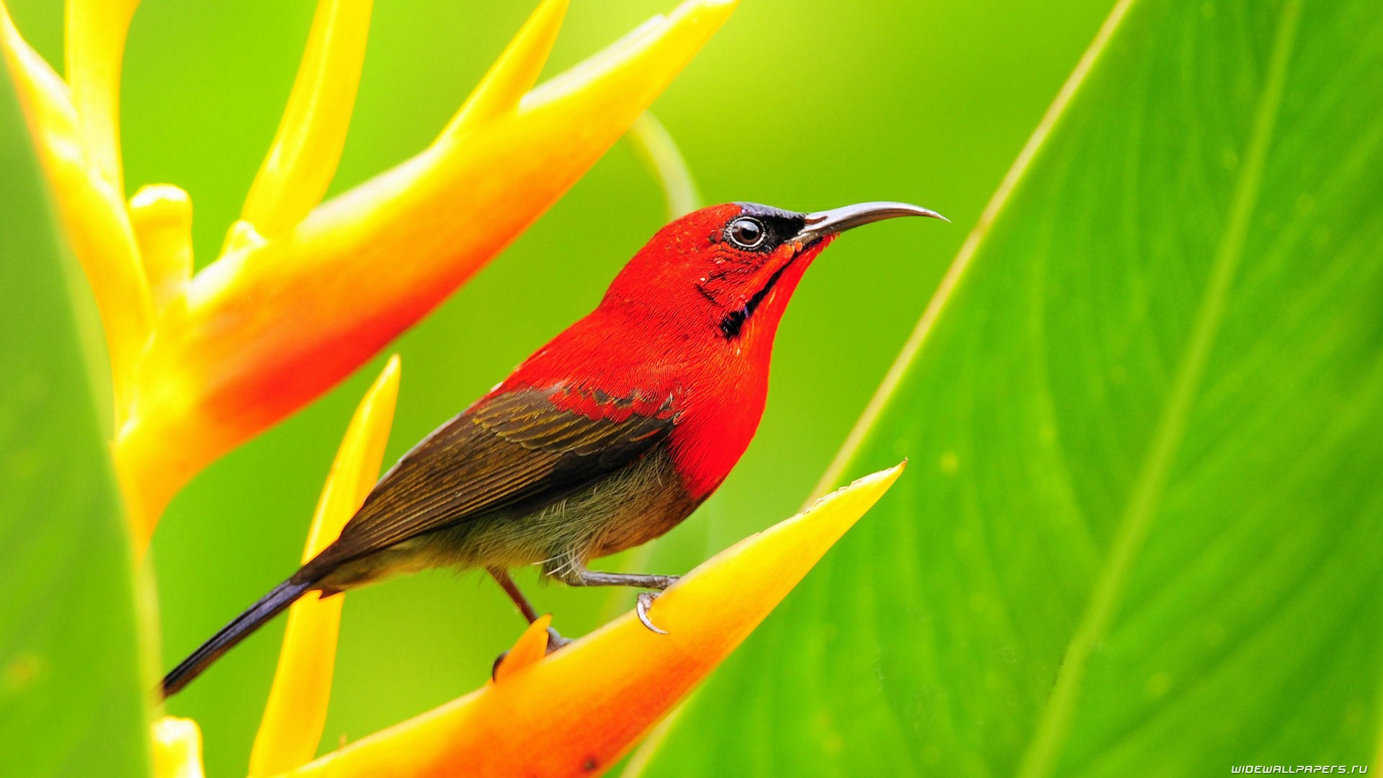
Thank you all

