Slide 1
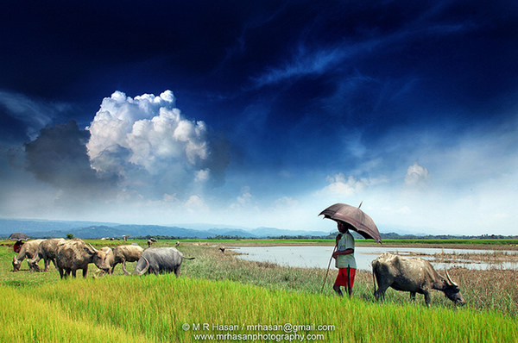
Welcome

Slide 2
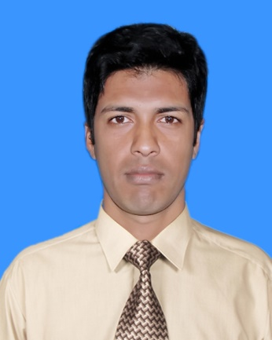
Introduction
Md. Magzumi
Assistant Teacher
Kutubpur Hat GPS
Shibchar, Madaripur.
Mob: 01720647519 Email:magzumi1985@gmail.com

Slide 3
Class : Two
Subject : English
Time : 45 minute

Slide 4
Learning Outcome
2.1.1 recognize and read cardinal numbers up to 10.
2.1.1 write cardinal numbers up to 10 in
figures.

Slide 5
Let’s we sing a song.
We shall overcome
We shall overcome
We shall overcome someday
Oh deep in my heart, I do believe,
………………………………..

Slide 6
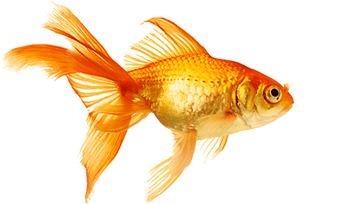
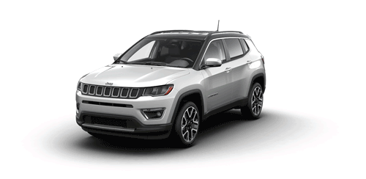
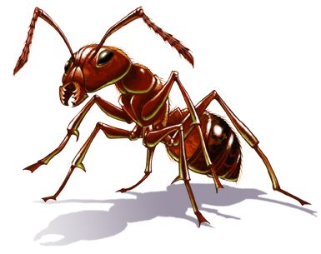
What can you see in this pictures?

Slide 7
Today’s Lesson
Counting: 1 to 1o
Unit: 26
Lesson-1 to 3
Page: 52

Slide 8
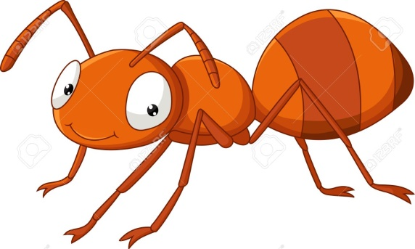
Look listen and say-
How many ant?
1

Slide 9
Look listen and say-
How many Balls?
2

Slide 10
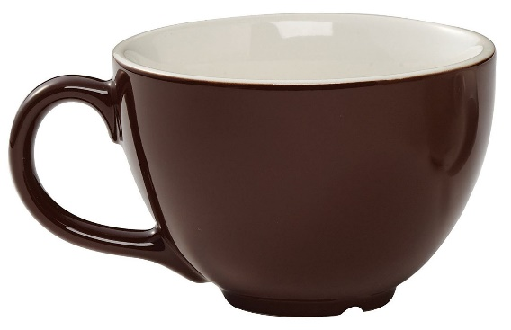
Look listen and say-
How many cups?
3

Slide 11
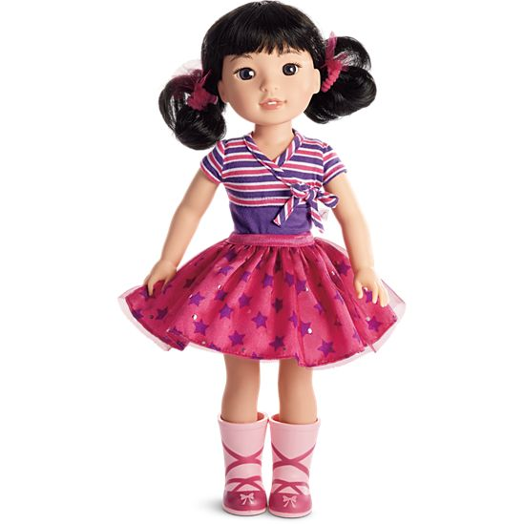
Look listen and say-
How many dolls?
4

Slide 12
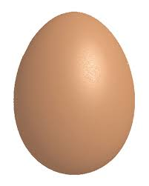
Look listen and say-
How many eggs?
5

Slide 13
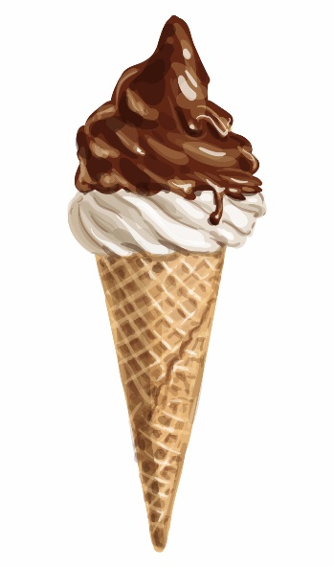
Look listen and say-
How many ice-creams?
6

Slide 14
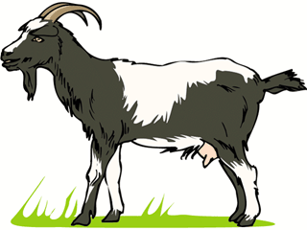
Look listen and say-
How many Goats?
7

Slide 15
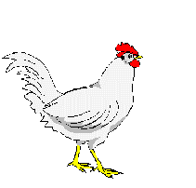
Look listen and say-
How many Hens?
8

Slide 16
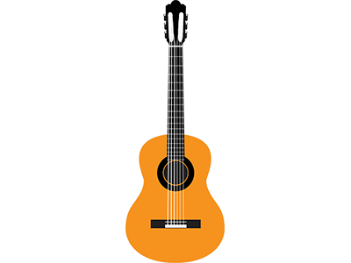
Look listen and say-
How many Guitars?
9

Slide 17
Look listen and say-
How many roses?
10

Slide 18
Trace and write-
Write down on your khata 1 to 10.
1,
2,
3,
4,
5,
6,
7,
8,
9,
10

Slide 19
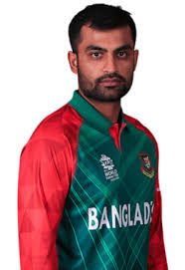
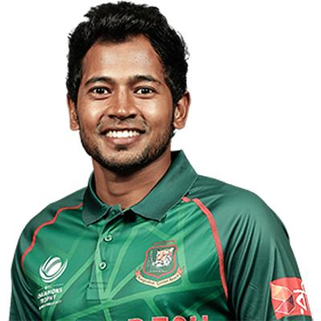
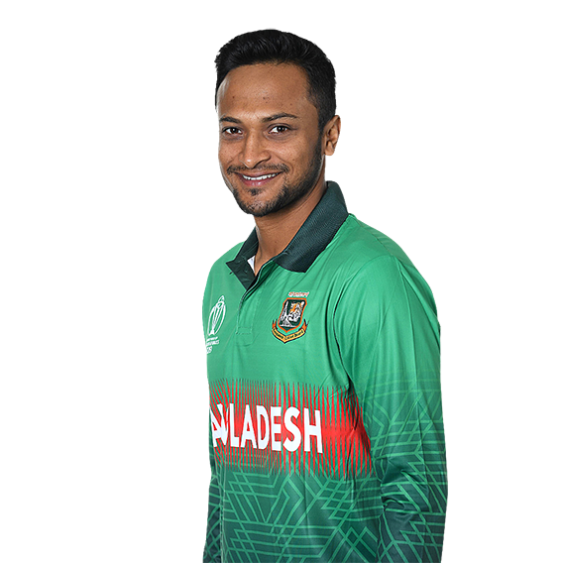
Nest lesson
Rhyme:
3 Little Tigers

Slide 20
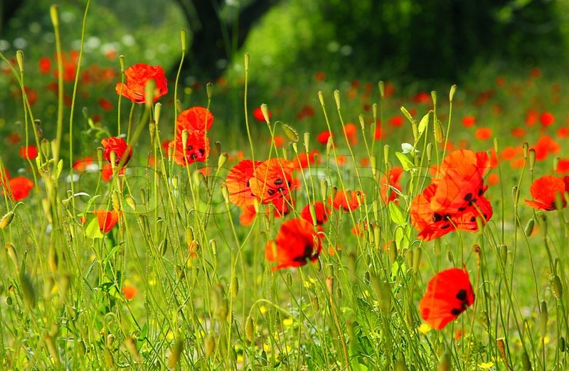
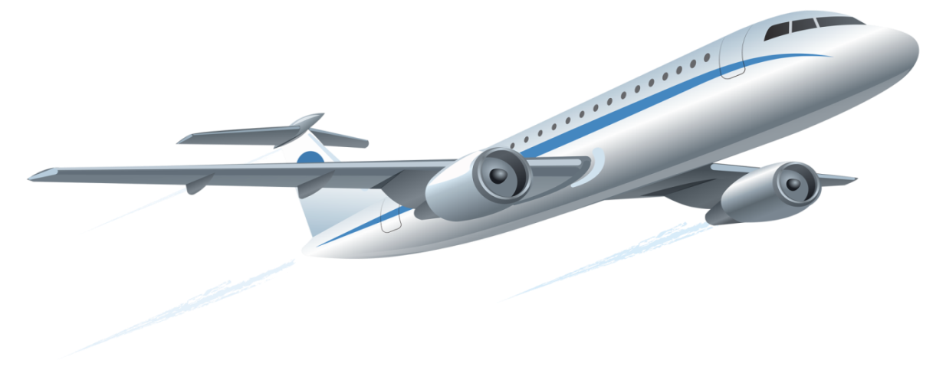
Bye bye

