Slide 1
Welcome

Slide 2
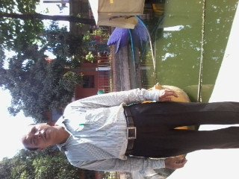
Teacher Identity
Md.Golam Mostafa
Assistant Teacher.
Madhya Mariamnagar Govt. Primary School.
Rangunia, chittagong.

Slide 3
Lessons Identity
Sub:English
Class:one
Unit:19

Slide 4
Learning outcomes:Student will
be able to
Listing:
1.1.1 become familiar with English sounds by
Listening to common English words.
Speaking:
1.1.2 say simple words and phrases.

Slide 5
Let’s See a video

Slide 6
Todays lesson:
Where do they live?

Slide 7
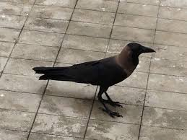
Look and listen
crow

Slide 8
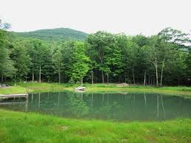
Look and Listen
pond

Slide 9
Look and Listen
Tree

Slide 10
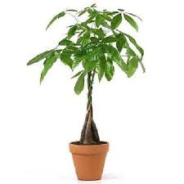
Look and listen
plant

Slide 11
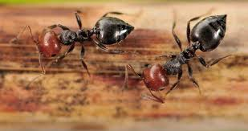
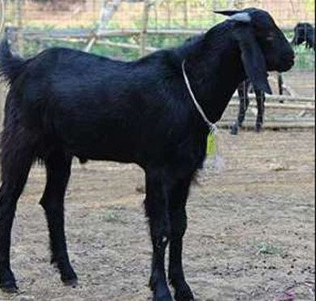
Look and listen
ants
goat

Slide 12
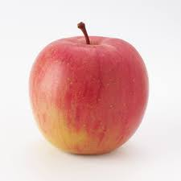
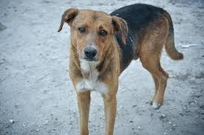
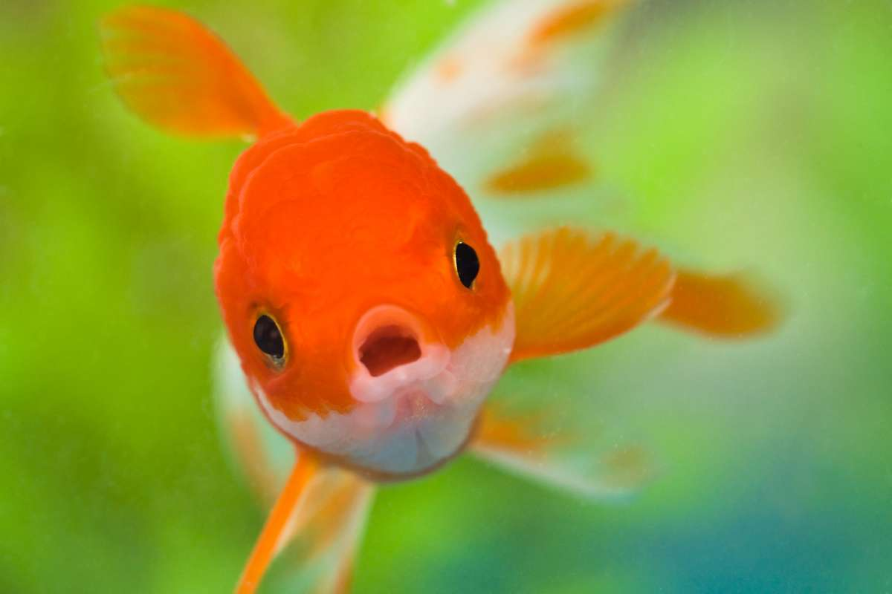
Look and Listen
dog
fish
apple

Slide 13
Look and say
crow
pond
tree
plant

Slide 14
Say,listen and point
Point to the fish

Slide 15
Say,listen and point
Point to the pond

Slide 16
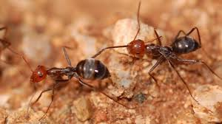
Say,listen and point
Point to the tree

Slide 17
Say,listen and point
Point to the crow

Slide 18
Look and Say

Slide 19
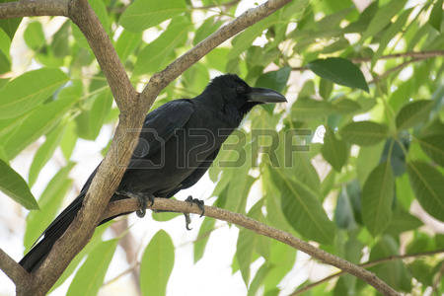
Look, Listen and say
Where does crow live?

Slide 20
Look and Say

Slide 21
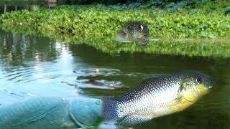
Look,Listen and say
Where does fish live?

Slide 22
Think and match

Slide 23
Thanks

