Slide 1
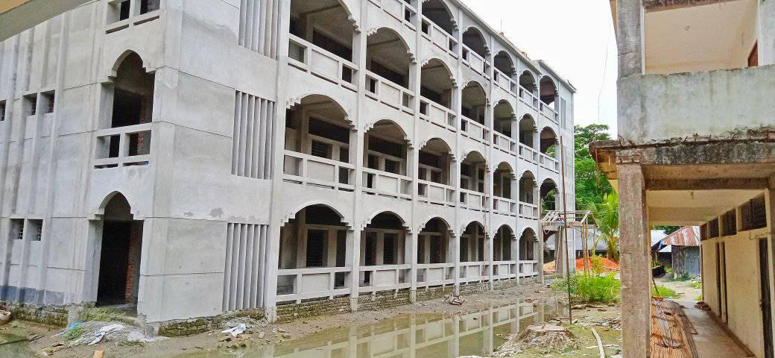
14 September,2020
18 November, 2020

Slide 2
Identity
Md. Rafi Uddin Shamim
Lecturer (English)
Mohammadpur Anowar Ali Islamia
Alim Madeasah
Mohammadpur, Chatkhil, Noakhali.
Cell: 01837526799
Email: idbshamim@gmail.com
Class : IX-X
Subject: English 2nd Paper

Slide 3
Thin
More Active
Active
Thinnest
Ugliest
Ugly
Most Active
Thinner
Uglier

Slide 4
What is our today’s topic?
Our today’s topic is…
Comparison of Adjective
Session-3

Slide 5
Review of the previous Class
January is the coldest month in Bangladesh (Positive).
2. A lion is not braver than he. (Positive).
3. He is faster than all other boys. (Positive).
4. You are older than I. (Positive)
5. The rose is the finest of all flowers. (Positive)

Slide 6
Rules of changing from Superlative to Comparative degrees
of all change to than all other
Example:
s> Akbar was the greatest of all kings in India.
C> Akbar was greater than all other kings in India.
s> Mr. Rahman is the noblest of all men.
C> Mr. Rahman is nobler than all other men.
s> Australia is the largest of all islands in the world.
C> Australia is larger than all other islands in the world.

Slide 7
Rules of changing from Superlative to Comparative degrees
2. of any change to than any other
**( of all or of any) না থাকলেও than any other বসে
Example:
s> It burns the prettiest of any wood.
C> It burns prettier than any other wood.
s> Chittagong is the biggest port in Bangladesh.
C> Chittagong is bigger than any other port in Bangladesh.
s> She was the best homemaker.
C> She was better than any other homemaker.

Slide 8
Rules of changing from Superlative to Comparative degrees
3. One of thechange to than most other
Example:
S> Suadi Arabia is one of the hottest countries in the world .
C> Suadi Arabia is hotter than most other countries in the world .
S> This is one of the greatest pictures of the world.
C> This is greater than most other pictures in the world.
S> He is one of the wisest men in the village.
C> He is wiser than most other men in the village.

Slide 9
Rules of changing Comparative to Superlative degrees
Superlative degree এর ক্ষেত্রে than উঠে যাবে
1. Any other থাকলে বা না থাকলেও adjective এর আগে the বসে
Example:
C> He is better than any other boy in the class.
S> He is the best boy in the class.
C> Iron is more useful than any other metal.
S> Iron is the most useful metal.

Slide 10
Rules of changing Comparative to Superlative degrees
Superlative degree এর ক্ষেত্রে than উঠে যাবে
2. most other/few other থাকলে adjective এর আগে one of the বসে
Example:
C> Dhaka is bigger than most other cities in Bangladesh.
S> Dhaka is one of the biggest cities in Bangladesh.
C> ‘Arabian Nights’ is better than most other story books.
S> ‘Arabian Nights’ is one of the best story books.

Slide 11
Evaluation
1. Chittagong is the biggest port in Bangladesh.(Comparative)
Chittagong is bigger than any other port in Bangladesh.
2. He is better than any other boy in the class. (Superlative)
He is the best boy in the class.
3. Australia is the largest of all islands in the world. (Comparative)
Australia is larger than all other islands in the world

Slide 12
Home Work
Beef was cheaper than any other dish on the menu.(Superlative)
2. The Everest is the highest of all peaks in the world. (Comparative).
3. She is worse than any other girl. (Superlative).
4. He is the best boy. (Comparative)
5. He was the most humorous of all men in the company. (Comparative)

Slide 13
Thank you
Nice to continue with me

