Slide 1
welcome

Slide 2
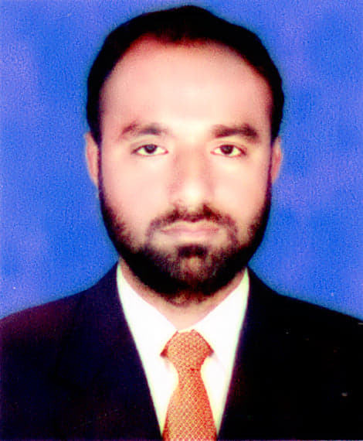
Presented by
Md Amirul Islam
Assistant Teacher
Trishal govt.primary school
Trishal,Mymensingh

Slide 3
Lesson details
Class:3
Subject: English
Unit:19,Page:38
Lesson:3-4(A)Look and say,Write.

Slide 4
Learning outcomes
By the end of the class, ss will be able to-
1.1.1:Repeat words ,phrases.
1.1.2:Say words phrases and sentences after the teacher with proper sound and stress.
6.2.1:Talk about people and objects.
3.1.2:Write words phrases and sentences using non-cursive.

Slide 5
How many people do you have in your family?
What do they do?

Slide 6
Today’s Lesson:
occupation

Slide 7
OOOooCCUPATION
Look and say
Teacher
Cobbler
Occupation
Driver
Tailor

Slide 9
Vocabulary
Cobbler-মুচি।
Tailor-দর্জি।
Driver-চালক।
Teacher-শিক্ষক।

Slide 10
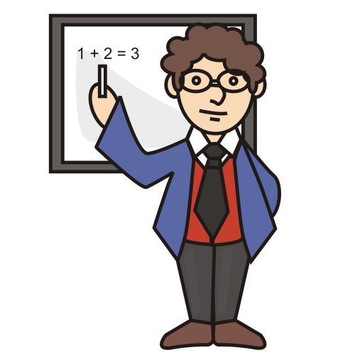
He is a teacher.

Slide 11
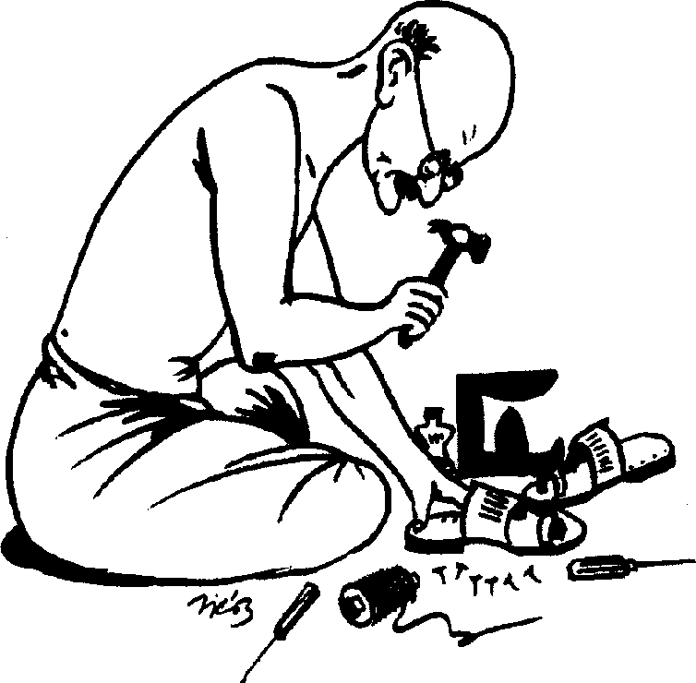
He is a cobbler.

Slide 12
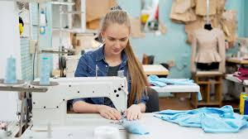
She is a tailor

Slide 13
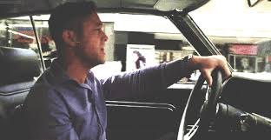
He is a driver.

Slide 14
goodbye

