Slide 1
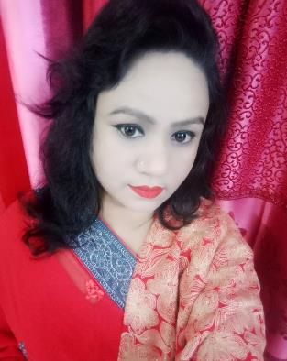
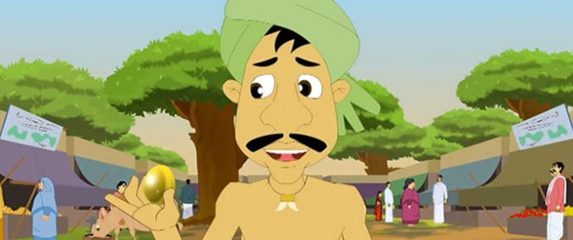
Welcome to
my online class
Nahid Akhtar parvin
Jagodishpur government
primary school.
Ekarchali,taragong,
rangpur

Slide 2
Learning outcomes
Students will be able to-
1.1.1 repeat after the teacher simple words and phrases with proper sounds and stress.
4.2.1 enjoy simple stories.

Slide 4
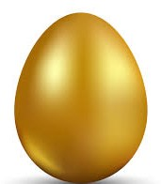
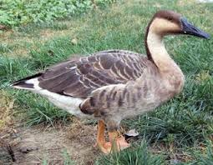
What can you see in this picture?

Slide 5
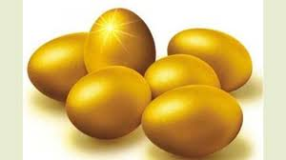
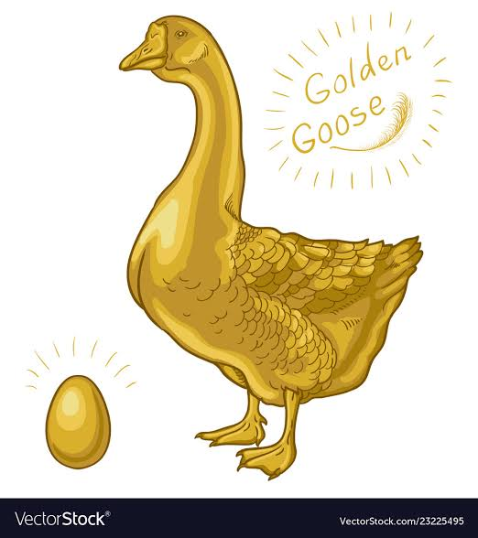
What can you see in this picture?

Slide 6
THE GOLDEN GOOSE
Unit 29
Lesson 4-6
PAGE: 59
STORY: THE GOLDEN GOOSE.

Slide 7
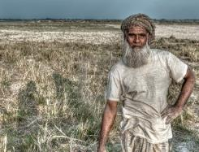
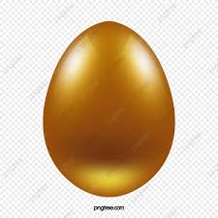
New words
Farmer
Farmer
কৃষক
Egg
Egg
ডিম

Slide 8
Story
The Golden Goose

Slide 9
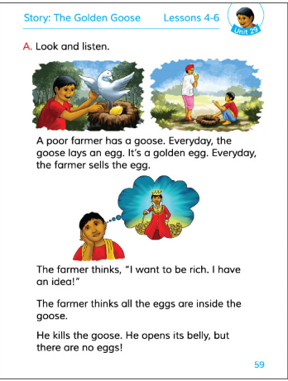
Open your Book point to the page No.59

Slide 10
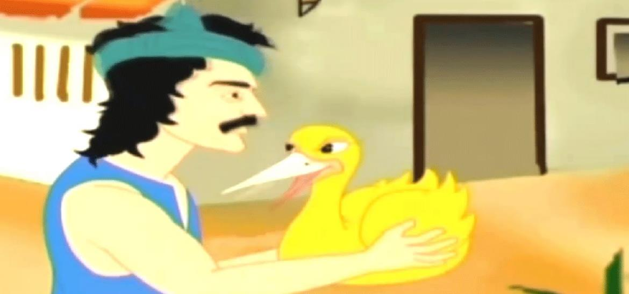
A poor farmer has a goose.

Slide 11
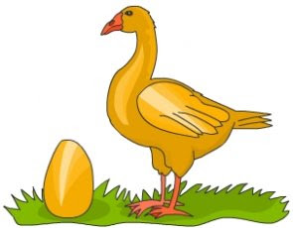
Everyday, the goose lays an egg.

Slide 12
It’s a golden egg.

Slide 13
Everyday, the farmer sells the egg.

Slide 14
The farmer thinks,’’I want to be rich.I have an idea!’’

Slide 15
The farmer thinks all the eggs are inside the goose.

Slide 16
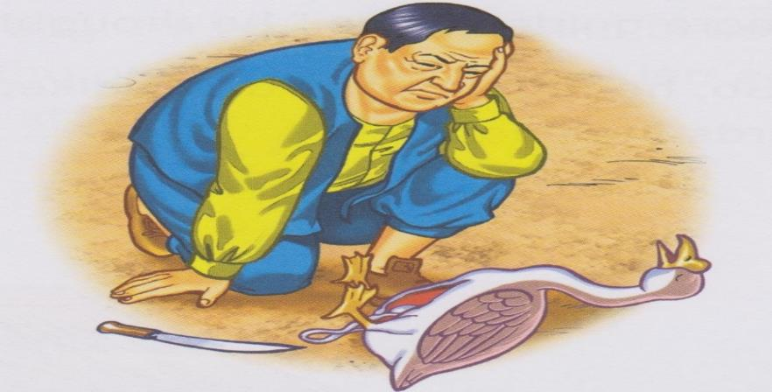
He kills the goose. He opens its belly ,
but there are no eggs.

Slide 17
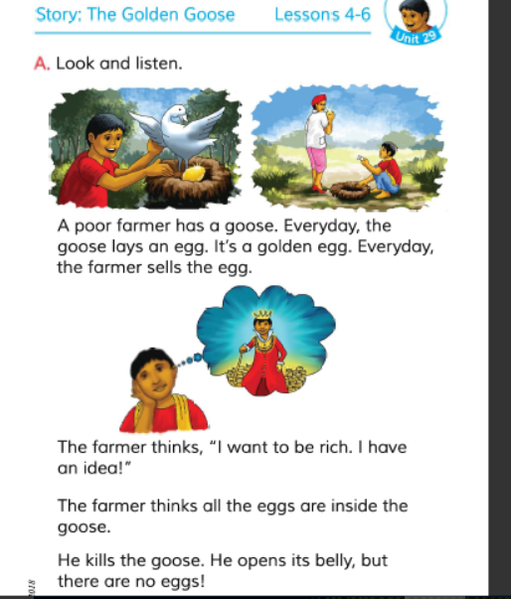

Slide 18
Pronunciation
FARMER
FAR
MER
FARMER
BELLY
BE
LLY
BELLY

Slide 19
GOLDEN
BELLY
EGG
EGG
Bingo
SELL
SELL
GOOSE
FARMER
FARMER
Lets play a bingo game

Slide 20
Fill in the blanks.
1.A poor farmer has a ------?.
2.The farmer sells the -------.
3.The farmer wants to be ------.
goose
eggs
rich

Slide 21
Evaluation
Pronunce and say the words:
Goose
Rich
রাজহাঁস
ধনী
Farmer
Egg
কৃষক
ডিম

Slide 22
Lets try to give answer
1.Who is the man ?
The man is a farmer
The goose gives the farmer
an egg everyday
3.What does the goose give the farmer ?

Slide 23
Home work.
Write 3 names of birds that you like most

Slide 24
One day one word
Think
চিন্তা করা
I think, I am so beautiful.

Slide 25
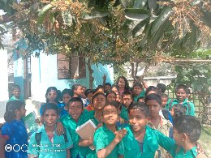
THINK
P
O
S
I
T
I
VE
BE
P
O
S
I
T
I
VE.
THANKS ALL
Thanks be with me.
See you next class.

