Slide 1
Welcome to the class Welcome to the class

Slide 2
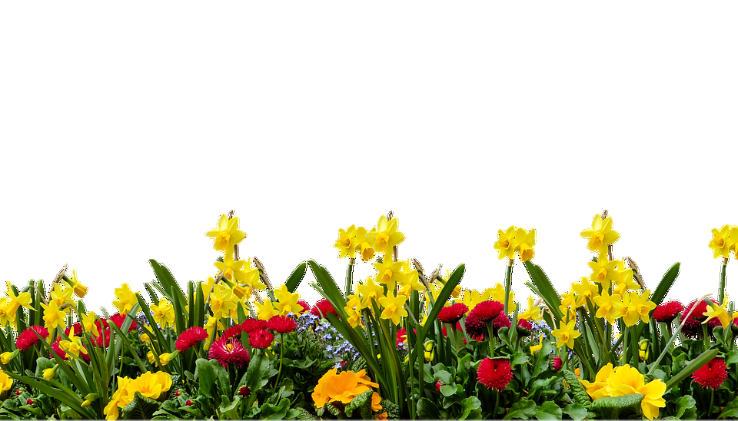
Introduction
Let’s play a bingo game
(Write any 3 words in your exercise book.)
understand
similar
energy
Shahnaz ferdushi jui
Assistant teacher
Madhobpur Govt . primary school
Chhatak , Sunamgonj .
vitamins
important

Slide 3
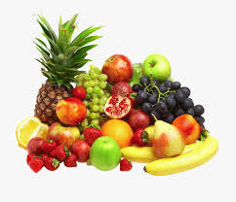
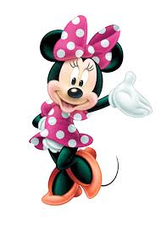
Subject Identity
English For Today
Class: five
Unit: 6, Eat healthy
Lesson: 2-3
Time: 40 minutes

Slide 4
Learning outcomes
By the end of the lesson the students will be able to…
Listening:
1.3.1. recognize which words in a sentence are stressed.
3.3.1.understand questions about objects around them.
3.4.1.understand statements made by the teacher and students.
Speaking:
1.1.1. say words,phrases and sentences with proper sounds and stress.
1.1.2. say sentences with proper intonation.
Reading:
1.5.1. recognize and read statements,commands,greetings,questions and answers.
5.1.1.read silently with understanding paragraph.

Slide 5
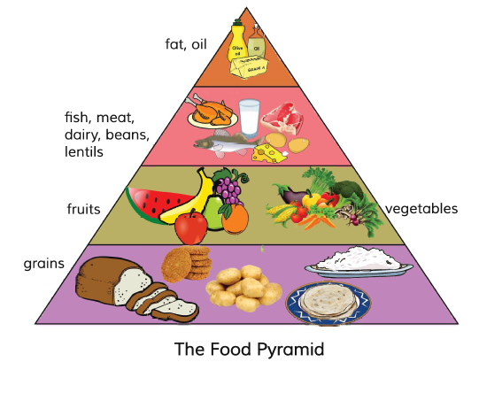
Look at the picture.
Fat
and oil.
Fish, Meat, Dairy, Beans and lentils.
Fruits and vegetables.
Grains
What do you see in the picture?

Slide 6
Lesson Declaration
students our today’s lesson is
Eat healthy.
What food…choice.

Slide 7
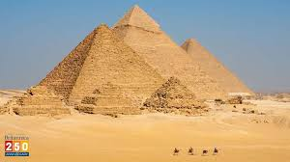
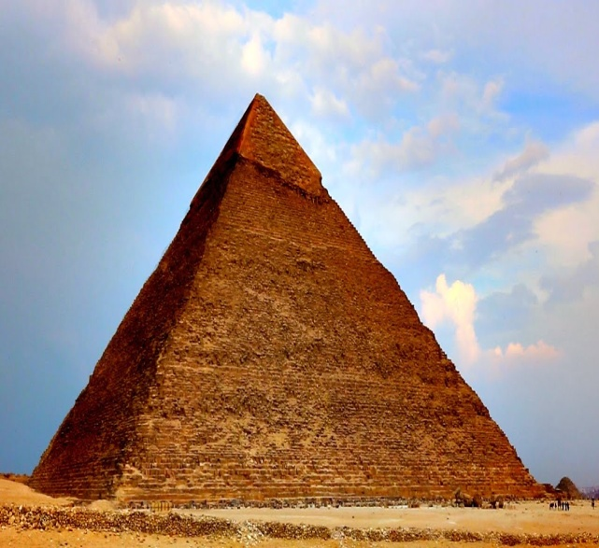
One day one word
Pyramid
স্মৃতিস্তম্ভ

Slide 8
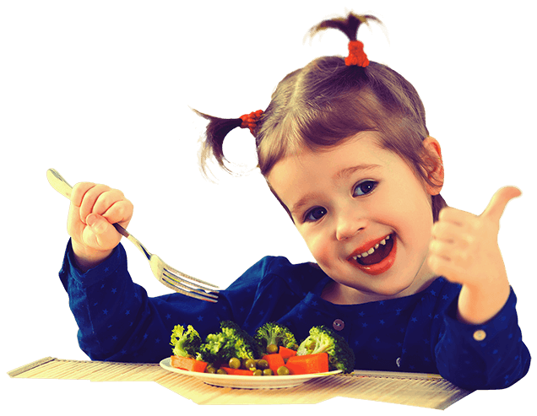
Finding out new words
Taste
Delicious
Different
Not the same

Slide 9
New words
Different
Not the same
Bottom
Under
Similar
Same
Top
Above
Delicious
Taste
Grain
Corn

Slide 10
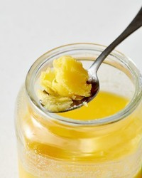
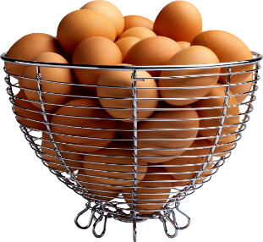
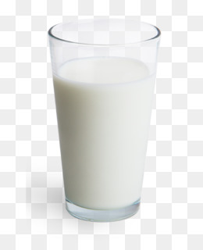
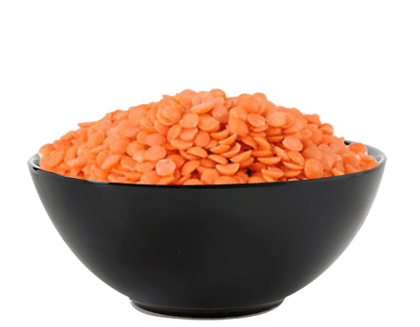
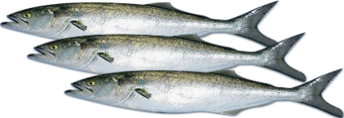
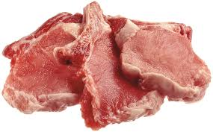
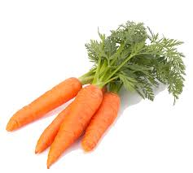
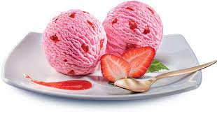
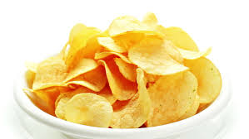
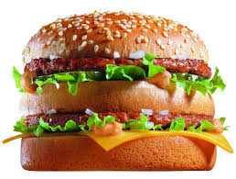
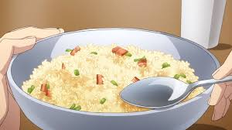
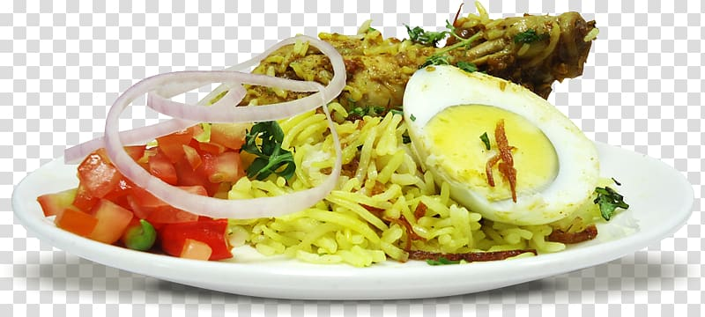
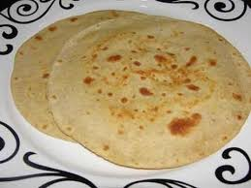
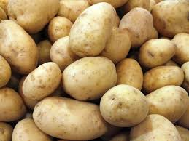
Look at the pictures carefully
What food do you like most ?
Tell the name of some unhealthy foods ?
Why do you think these are unhealthy food ?

Slide 11
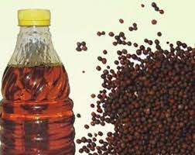
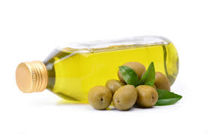
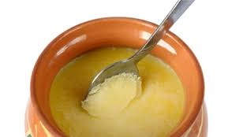
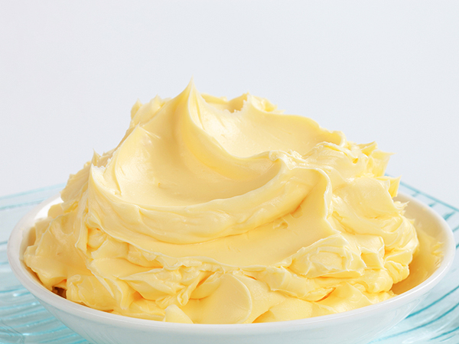
Sun-flower Oil
Olive Oil
Mustard Oil
Its Make food delicious, but our body doesn’t need very much of them.
Ghee
Butter

Slide 12
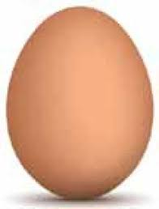
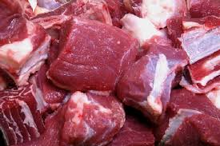
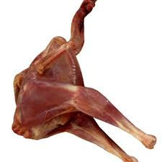
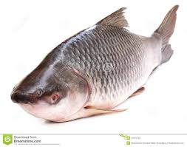
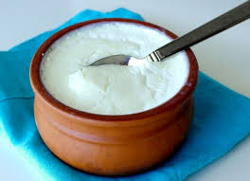
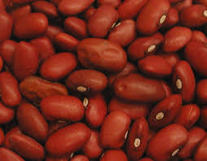
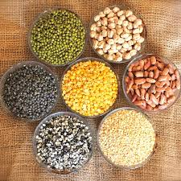
EGG
Meat
Chicken
Fish
Contain protein that keep us fit to fittest
Bean
Milk
Curd
Lentils

Slide 13
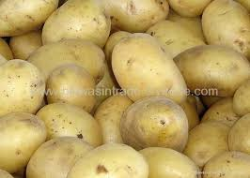
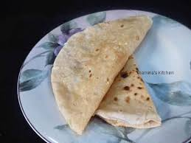
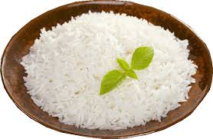
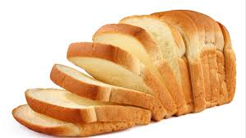
Potato
Ruti
Grains give us energy.
Bread
Rice

Slide 14
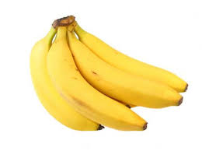
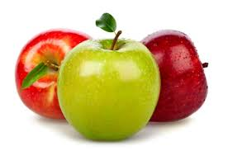
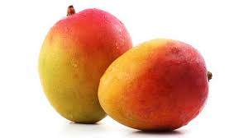
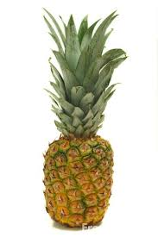
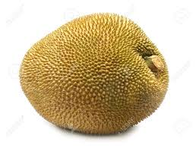
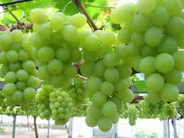
Banana
Apple
Mango
Contain vitamins that help our eyes and our health.
Pine apple
Jack fruit
Grape

Slide 15
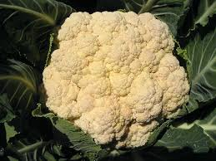
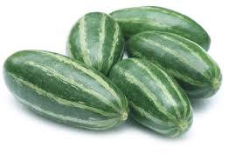
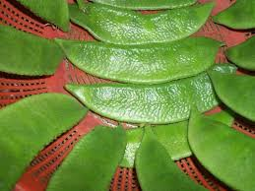
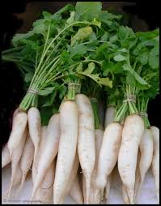
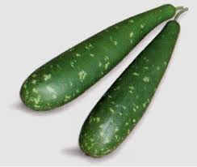
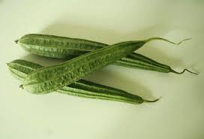
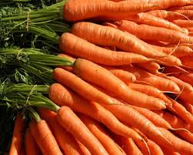
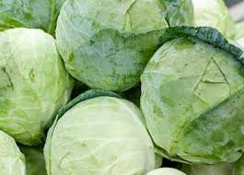
Cauliflower
Parble
Bean
Radish
Bottle-Gourd
Vegetables are also important for us having vitamins.
Jhinga
Carrot
Egg plant
Cabbage

Slide 16
Hilsha fish
Mola fish
Crub fish
Contain protein that make us strong.
Kholse fish
Jiol fish
Walking fish

Slide 17
Puri
Fries
Chips
Some unhealthy foods for us .
Ice-cream
Chocolate
Chocolate-biscuit

Slide 18
Teacher reading & ss reading.
Now open your English book at page number 24. Listen to me attentively and put your finger under the line.

Slide 19
Food Pyramid
Fat and Oil
Dairy products
Vegetables
Bread, Patatoes
Rice, Ruti
Fruits
Fish, Meat
Lentils

Slide 20
Lets play a game
Write down any five of the following words in your notebook and follow my instructions.
Meat
Fish
Fruits
Fat
Oil

Slide 21
Fill in the blanks.
energy
vitamin
good
important
similar
What food is ________ food?
2. Grain gives us__________.
3. Potatoes and grains are _________.
4. Fruits and vegetables have _________.
5. Fruits and vegetables are very _________ for us.

Slide 22
Individual Work
Answer the following questions:
What is Food Pyramid?
How many levels are there in the Food Pyramid?

Slide 23
Group Work
Banana Group
Write names of five healthy food.
Carrot Group
Write names of five unhealthy food.

Slide 24
Pair Work
Answer the following questions:
What kind of foods are potatoes?
Write two sentences about fruits and vegetables?

Slide 25
Evolation
Write a short composition on “The Food Pyramid” in at 5 sentences.

