Slide 1
Welcome to my class

Slide 2
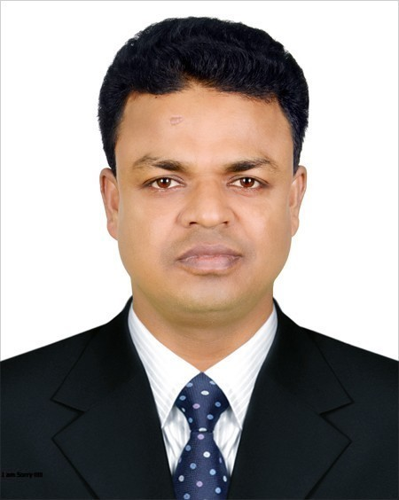
INTRODUCING
Md. Shakhawat Hossen
Assistant Teacher
Pakuria Government Primary School
Singra, Natore
E-mail: shakhawathossengps@gmail.com
Mobile: 01724025641
Class – Five
Subject: English For Today
Heading of the lesson: Completing forms
Parts of speech

Slide 3
Learning Outcomes...
Students will be able to...
1.1.1 repeat after the teacher simple words and phrases with
proper sounds and stress.
1.1.2 say simple words and phrases with proper sounds and stress.

Slide 4
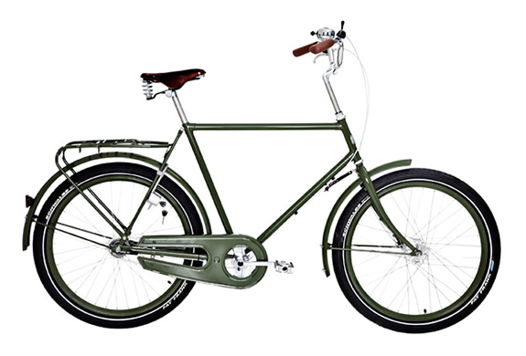
ByCycle

Slide 5
Topic
Parts of Speech

Slide 6
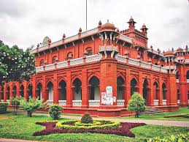
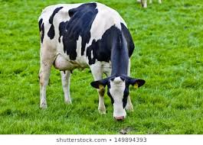
Dhaka University
The cow
Noun
Dhaka University, Bangladesh i
The cow is eating grass.

Slide 7
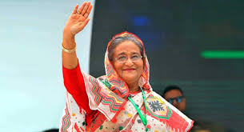
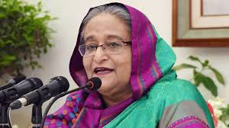
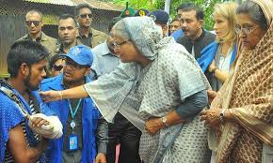
The Prime Minister Sheikh Hasina is welcoming.
Pronoun
She is delivering speech.
She is comforting a Cyclon victim.

Slide 8
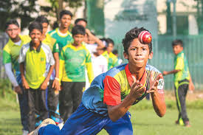
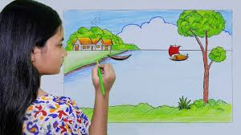
Playing
Drawing
Verb
The boys are playing cricket.
The girl is drawing picture.

Slide 9
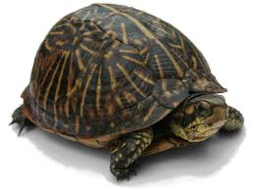
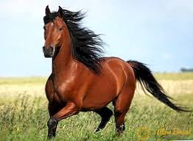
Horse
Tortoise
Adverb
The horse can run fast.
The tortoise walks slowly.

Slide 10
Parts of Speech
Noun
Pro
noun
Adjective
Verb
Ad
verb
Preposition
Conjunction
Inter
jection
Dhaka University
/
The Cow
She
/
He
Green
/
Two
Eating
/
Drawing
Fast
/
Slow
On
/
Under
And
Alas
/
Hurrah

Slide 11
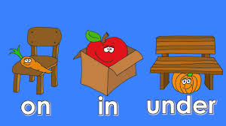
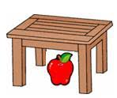
On
Preposition
Under
An apple is on the table.
An apple is under a table.

Slide 12
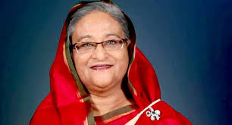
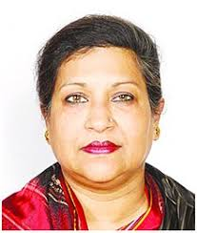
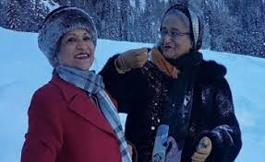
The Prime Minister Sheikh Hasina is a daughter of Bangobandhu Sheikh Muzibur Rahman.
Conjunction
Sheikh Rehana is a daughter of Bangobandhu Sheikh Muzibur Rahman.
The Prime Minister Sheikh Hasina and Sheikh Rehana are daughters of Bangobandhu Sheikh Muzibur Rahman.

Slide 13
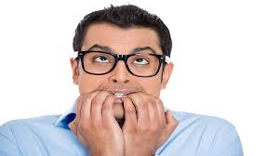
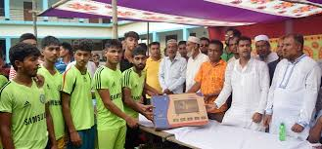
Hurrah !
Alas !
Interjection
Alas! What will I do now?
Hurrah! We have won the game.

Slide 14
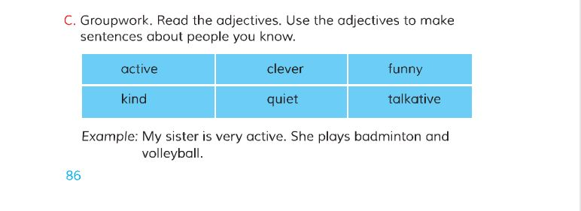
Open your book at the page no - 86

Slide 15
Group
Work
Write two examples of verb.
2. Write two examples of adjective.

Slide 16
Evaluation:
1. How many kinds of ‘Parts of Speech’?
2. Tell one examples of conjunction.
3. Tell one examples of adjective.

Slide 17
Home work
1. Write one sentence with each kind of Parts of Speech.

