Slide 1
Welcome to All

Slide 2
Introduction
Md Shahneoaz
Assistant Teacher (English)
Jalalabad B/L High School,Sylhet.
E-mail: shahneoazmd@yahoo.com
Cell: 01631712091
Class: X
English 1st paper
Unit-11, Lesson-1
Time- 45 Minutes

Slide 3
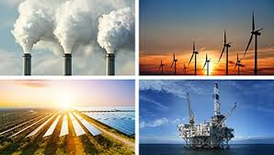
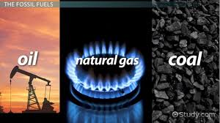
Can you say what the pictures are about?
Non-renewable Energy Sources
Renewable Energy Sources

Slide 4
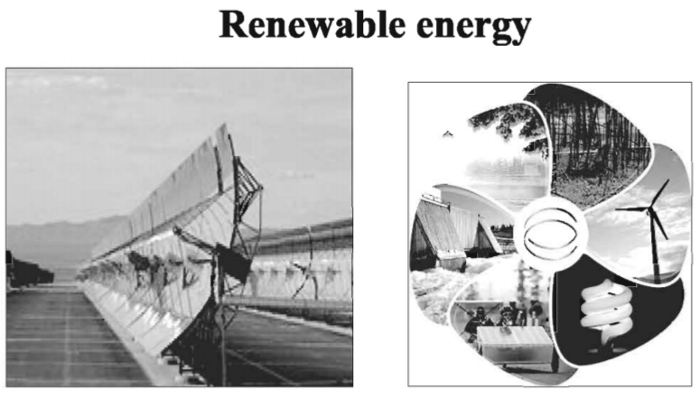
Today’s Topic
Renewable Energy Sources -1

Slide 5
Learning Outcomes:
After completing this lesson, students will be able to-
describe familiar objects.
answer the multiple choice questions.
describe the present demand and the production of power in Bangladesh.

Slide 6
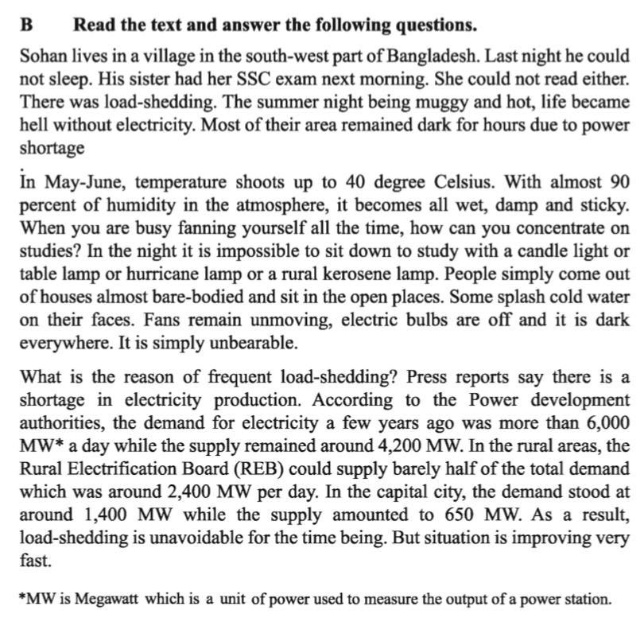
Read the passage silently in unit-11, lesson-1 (B)

Slide 7
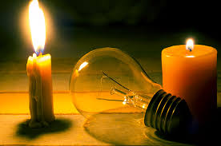
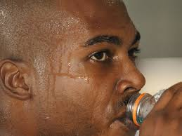
Let’s be introduced with new Words:
Load-shedding
The interruption of an electricity supply to avoid excessive load
Muggy
Humid /sultry /sticky

Slide 8
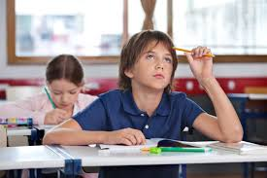
Let’s be introduced with new Words:
Concentrate
Focus / centralize
Splash
Cause (liquid) to strike or fall on something in irregular drops

Slide 9
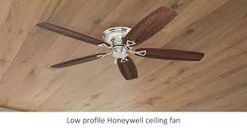
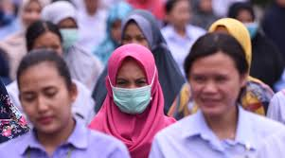
Let’s be introduced with new Words:
Unmoving
Not moving / Still
Unevoidable
Inevitable / bound/sure to happen / unpreventable

Slide 10
Group Work
Fill in each gap with an appropriate word:
Load shedding is a common phenomenon in Bangladesh. The main reason of it is the a)----------- in production of electricity. The supply is only 4200 MW b)---------- the demand is more than 6000 MW. Rural Electricity Board can c)-------- only 50% percent of the total demand of electricity for the d)--------- people. The people of Bangladesh want to e)---------- rid of the this unbearable condition immediately.
shortage
though
supply
rural
get

Slide 11
Pair work
Answer the following Questions:
1. What happened to Sohan last night?
Ans. Sohan could not sleep last night.
2. How was the summer night?
Ans. The summer night was muggy and hot.
3. How is a summer day?
Ans. A summer day is wet, damp and sticky.
4. What happens during load shedding in Sohan’s area?
Ans. During load shedding, Sohan’s area remains dark for hours.
5. What do people use at night during load shedding?
Ans. People use candle light or table lamp or hurricane lamp or kerosene lamp for lighting and hand fans for fanning.

Slide 12
Write a paragraph on Load Shedding.

Slide 13
Thanks a lot for being with me

