Slide 2
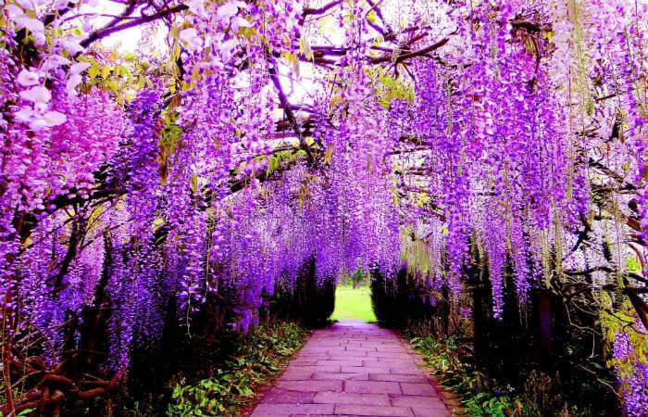

Slide 3
Salma Begum
Assistant teacher
Gokulnagar government primary school
Raipura, Narsingdi.
Subject: English
Class: One
Lesson: 1-3
Lesson unit: 15
Date: 25-07-2020

Slide 4
Learning outcomes-
By the end of the text :
Students will be able to-
R- 2.1.1- recognize and read cardinal numbers up to 10.
W-2.1.1-write cardinal numbers up to 10 in fingers.

Slide 6
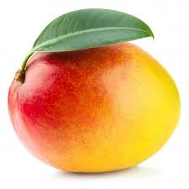
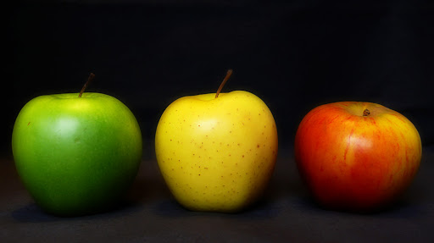
Look at the picture. How many pictures are there ?
Count and say the Number.
4
3
5

Slide 7
Our today’s lesson
Numbers

Slide 8
How many flower are there ?
1
2
3

Slide 9
4
5
6

Slide 10
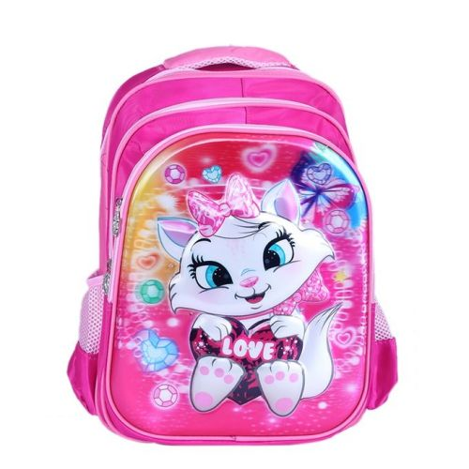
Open your book at page number 30.
1
2
3
4
5
6

Slide 11
Say and read. Trace and write.
6
6
6
6
6
6
6
6
1 2 3 4 5 6

Slide 12
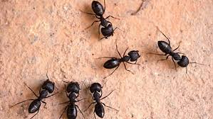
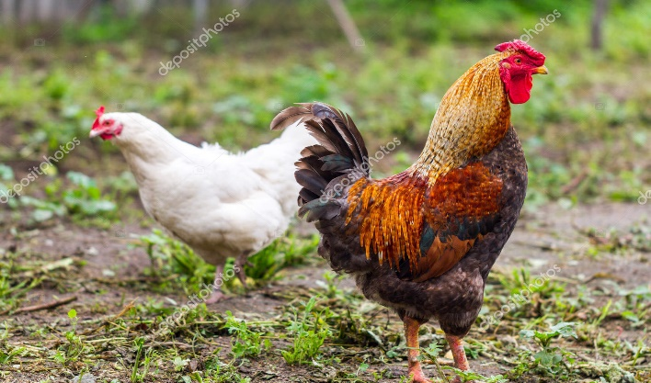
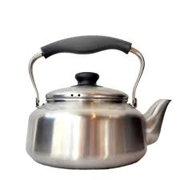
Count , trace and write .
6
2
5

Slide 13
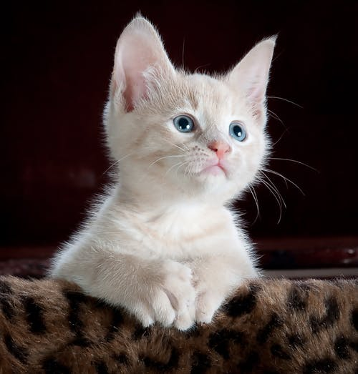
Count , trace and write .
3
4
6

Slide 14
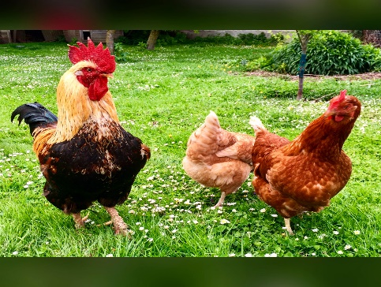
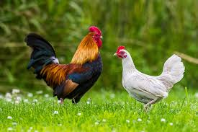
Match the numbers
4
5
2
6
3

Slide 15
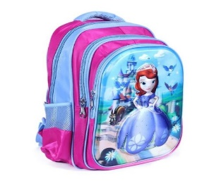
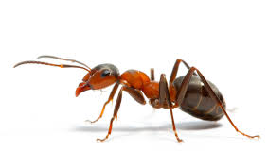
Look, count and say the numbers.
3
4
5
6

Slide 16
Write the cardinal number from 1-6

Slide 17
No more today. Thank you everyone.

