Slide 2
Teacher’s Identity
Mizanur Rahman
Assistant Teacher
25 No Zangir Government Primary School
Rupgonj , Narayangonj.

Slide 3
Lesson Identity
Class: Two
Subject: English
Unit: 1
Lesson: 4-6

Slide 4
Lets see a video

Slide 5
Today’s lesson
Alphabet
(A-E)

Slide 6
Learning Outcomes
After completing the lesson the students will be able to:
1.to become familiar with English sounds by listening to common English words.
2. to say words with proper sounds and stress. 3.to recognize and read the names of objects.

Slide 7
Aa
What is this ?
Ant

Slide 8
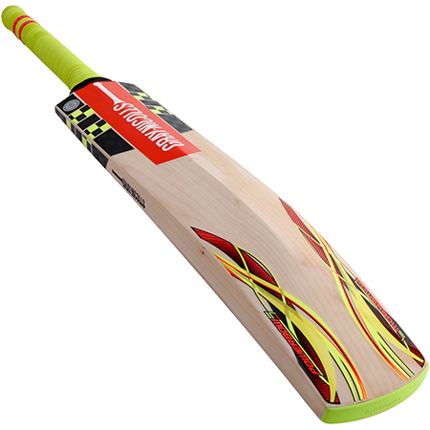
What is this ?
Bb
Bat

Slide 9
What is this ?
Cc
Cup

Slide 10
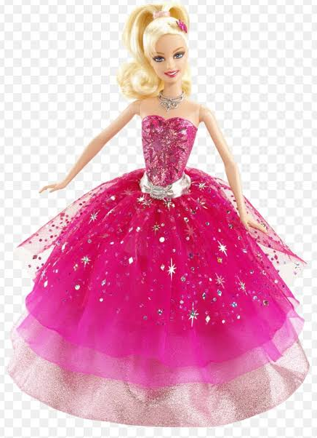
What is this ?
Dd
Doll

Slide 11
What is this ?
Ee
Egg

Slide 12
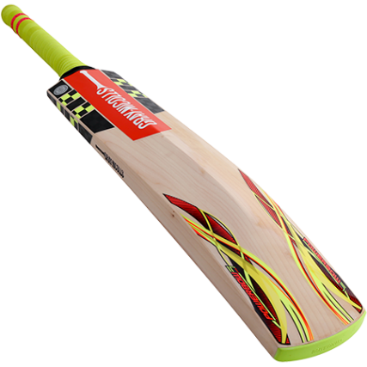
practice
Ant
Bat
Cup
Doll
Egg

Slide 13
practice
c
a
n
t
b
a
t
u
p
d
o
l
l
e
g
g

Slide 14
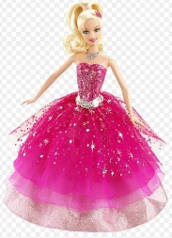
Match the first letter with the object name:
evolution
C
E
A
D
B

Slide 15
evolution
doll
cup
egg
ant
bat

Slide 16
One day one word
Alphabet
A,B,C,D,E,F,G,H,I,J,K,L,M,N,O,P,Q,R,S,T,U,V,W,X,Y,Z
বর্ণমালা

Slide 17
Goodbye…

