Slide 1


Welcome to all of you

Slide 2

Teacher and Class Identify-------
Md shafiqul islam
Assistant teacher
Sonaton darussannats dakhil madrasah
Kaunia, Rangpur.
Mail:shafiqulislam42347@gmail.com
English Gramer
Class: Eight
Date:26/11/2020
Notes:
Md shafiqul islam

Slide 3
___ honest boy is he who never tells a lie.
A or An

Slide 4
Lesson: THE SELECTION OF ‘A’ OR ‘AN’

Slide 5
Learning Outcome
By the end of the lesson you will be able to …
say when to use article “A”.
say when to use article “An”.
complete some exercises.

Slide 6
A or An?
Discrimination
Between:
A and an

Slide 7
A or An
The choice of indefinite (a/an) article is actually based upon the phonetic (sound) quality of the first letter in a word, not on the orthographic (written) representation of the letter.

Slide 8





Rules of using
“A”
A dog
A cat
A girl
A follower
All words that begin with consonant sounds.

Slide 9
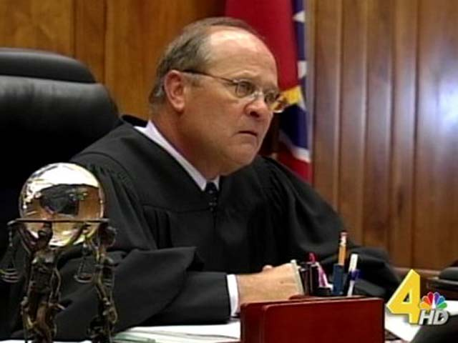
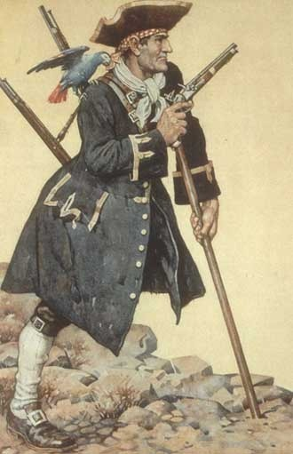


More Examples:
Rule--2
If the “O” and “u” is pronounced “wa” then a is used instead of “an”
A one man tribunal
A one leg sailor
A Useful metal
A united country

Slide 10




Rules 1 ,of using: “An”
An apple
An apricot
An egg
All words that begin with vowels.(a, e, i, ,o u)

Slide 11
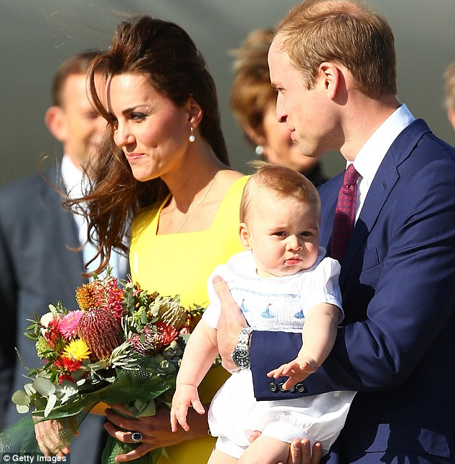



Rule-2 Using ‘’Án”
Before a word which begins with a vowel sound or a silent “h”
Example:
An hour
An hair to the throne
An honorable peace
An honest error

Slide 12
Rule-3: “An”
  Before a letter or an acronym (Abbreviation) or before numerals, choose "a" or "an" according to the way the letter or numeral is pronounced.
Example:
An MSDS (material safety data sheet) was used to record the data.
An SPCC plan (Spill Prevention Control and Countermeasures plan) will help us prepare for the worst.
An M.A
An L.L.B.
An M.P.
An M.B.B.S

Slide 13

Pair work
10. __an__ eagle
11. ___an_ chair
12. __a__ opera
13. __an__ watch
14. __a__ television
15. _an earthquake
16. __an__ intern
17. __a__ plant
18. ___an_ egg
1. __a__ shoe
2. _an___ idiot
3. _a___ good job
4. __a__ television
5. __an__ M.B.A
6. __an__ uncle
7. __a__ historian
8. _an___ apple
9. ___an_ heir

Slide 14
Evaluation
In the following passage fill in the gaps ------------
----eraser ------color --------urgency
-----orange ------work -------apricot
-----number -----picture --------shirt
------airplane ------restaurant -------umbrella
--------desk ------friend -------eye

Slide 15

Home Work
Practice these rules and find if you face any difficulties.

Slide 16

Thanks
to
all.

