Slide 1
WELCOME TO MY CLASS

Slide 2
What can you see in the picture?
A man is going to apply for a job. So, he is preparing a CV with cover letter.

Slide 3
Can you guess what we are going to learn today ?
CV
with cover letter

Slide 4
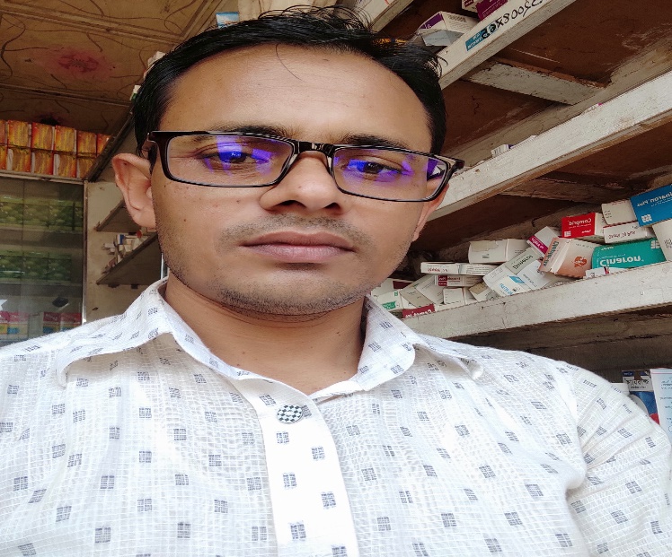
INTRODUCTION
Presenter
Lesson
English Second Paper
CV with cover letter
For class IX_X
MD. Samim Reza
Assiatant Teacher ( English)
Teghoria SESDP Model High School
Lakhai, Habiganj.

Slide 5
Learning Outcomes
By the end of the lesson, the students would be able to :
>> say the definition of CV
>> say the elements of a CV
>> say the importance of a CV
>> write a CV.

Slide 6
( চাকরি সংক্রান্ত যে কোন CV পরিক্ষায় আসলে নিচের CV টি কিছুতা edit করে লিখতে হবে)
27.11.2020
The Chairman,
‘N’ Teghoria SESDP Model High School,Lakhai,Habiganj (প্রশ্নে যে নাম থাকে তা লিখতে হবে।)
Subject: Application for the post of( প্রশ্নে যে পদের লোক চাইবে তা প্রশ্ন থেকে লিখতে হবে )
Sir,
In response to your advertisement published in ‘The Daily Star’on the 1st October,2020 for the post of ( প্রশ্নে যে পদের লোক চাইবে তা প্রশ্ন থেকে লিখতে হবে ) for your (প্রতিষ্ঠানের নাম), I want to offer myself as a candidate for the post. My CV(curriculum vitae) is given below for your kind consideration.

Slide 7
My CV
1.My name : Md. Novel
2.Father’s name : Md. Akul Talukdar.
3.Mother’s name : Tania Khatun.
4.Present address : Vill: Teghoria Post: Teghoria,Thana: Lakhai, District: Habiganj.
5.Parmanent address: Village: Do
6.Date of birth: 01.12.1995
7.Religion: Islam
8.Nationality: Bangladeshi (by birth)
9.Marital status: Unmarried
10.Contact: 01717170255
11. Email: rezasamim4@gmail.com

Slide 8
12 . Educational Qualification:
Name of degree | University/Board | Group | Result | Passing Year
M.A. | National University | English | Second class | 2015
B.A. (Hons) | National University | English | Second class | 2014
H.S.C. | Rajshahi | Humanities | 4.50 | 2009
S.S.C. | Rajshahi | Science | 5.00 | 2007

Slide 9
13. Computer Skill: Fluent both in Bengali & English
14. Experience: Five years
May I, therefore, pray and hope that you would be kind enough to consider me as a suitable candidate for the post mentioned above.
Yours Faithfully,
Md. Novel

Slide 10
Evaluation
1. What is the full form of CV?
Curriculum Vitae.
2.What is a CV?
A CV is a written description of one’s address, educational qualification, personal interests , which one sends to an employer when he/she is trying to get a job.
3. Why we need a CV?
We need a CV for applying a job.
4. Write a CV individually.

Slide 11
Home Work:
Write a cover letter with your CV from the question given below:
A Dhaka based reputed school is looking for the appointment of an English Teacher. Qualification: BA With Honors in English. Minimum five years experience in teaching. Apply by 27 November,2020 with CV and relevant papers to: The Headmaster, Motijheel High School, Road No.8,Motijheel,Dhaka-12o6.

Slide 12
See you next class , bye.

