Slide 1
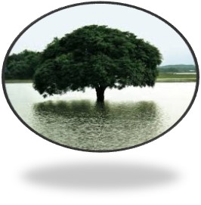
WELCOME ALL STUDENT

Slide 2
IDENTTIYi
Md shafiqul islam
Assistant teacher
Sonaton d dakhil madrasah
Kaunia,Rangpur.
Mail:shafiqulislam42347@gmail.com
ENGLISH FOR TODAY
Class : Eight
Unit: Five , Lesson: Four
Date:27/11/2020

Slide 3
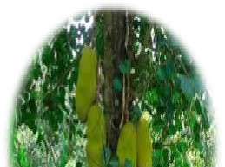
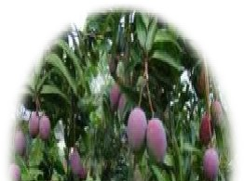
LOOK AT THE PICTURE
DO YOU LIKE TREES

Slide 4
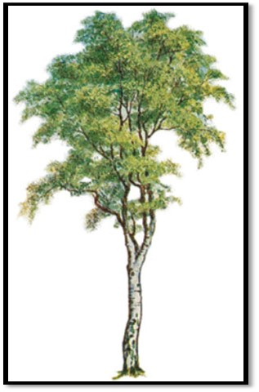
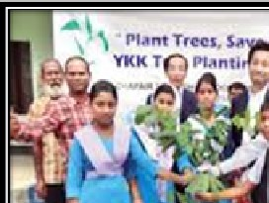
What are they doing?

Slide 5
Look at video gigantic mango tree

Slide 6
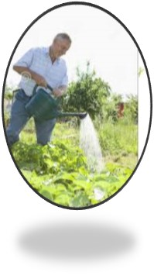
Lesson Declaration
A MAN WHO LOVES TREES

Slide 7
LESSON OUTCOME
They will able to some new words.
Choose the correct answer to each question from the alternatives of the above text.
Answer the following questions from your reading of the above text.
Fill in the gaps with appropriate words.

Slide 8
Silent reading by students:

Slide 9
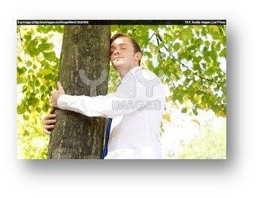
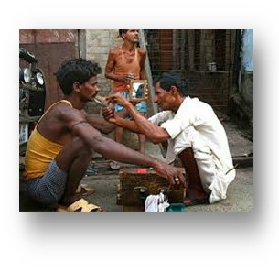
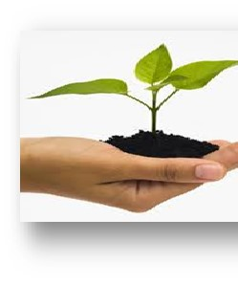
Word meaning
Gigantic tree
বড় গাছ
Nature lover
প্রকৃতি প্রেমিক
Barber
নাপিত
Sapling
চারা

Slide 10
Word Meaning
Profession------ পেশা
Sapling ------ চারাগাছ
Gigantic----- বিশাল
Job----------- কাজ
Remember------- স্মরণ
Earn--------- উপার্জন করা
Sign------- চিহ্ন

Slide 11
Individual work
1.Choose the best answer from the alternatives:
Kartik lives in----------
1. Tarapur 2.nurpur ---3. talapur 4. gobindapur
(b) Kartik was a------------
1. farmer 2. barber 3.carpenter 4. wood cutter
He loves nature---------.
Less 2. sometimes 3. hardly 4. whole heartedly
(d) He wants to make the village green by---------------------.
1.Growing paddy 2. growing grass 3. planting trees 4. colouring green
He started planting trees in his---------------.
1.Boyhood 2. teen age 3. youth 4. old age
Kartik is now----------------.
1. 35 2. 40 3. 63 4. 36

Slide 12
Group Work
How did the people of the village think of his watering the plants at night?

Slide 13
Evualation
Where did Kartik plant trees?
When did he water the plants at times?
Why should Kartik wake up early in the morning?
How did he think of their comments?
Why did he water the plants at night?

Slide 14
HOME WORK
Read the following text and fill in the gaps:
Occasionally kartik would------------early in the morning,take one or two labourers with him and set out to plant trees. He would walk -----------------to plant trees , carrying with him some dry food and water. He would pay all the ---------------- from his own pocket.

Slide 15
Good by All Student

