Slide 1
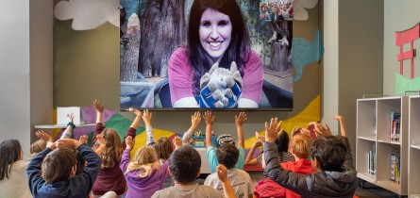
Welcome to the presentation

Slide 2
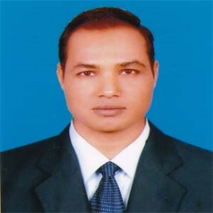
Teacher’s Identity
Md. Mizanur Rahman
B.A.(Hons.), M.A. in English, B.Ed.
Assistant Teacher
Police Lines School and College, Pabna.
E-mail: mizanplsc@gmail.com
Cell Phone :01737979719

Slide 3
Lesson’s Introduction
Class: Six
Subject: English 1st Paper
Lesson: Five
Lesson Title: Thanks for your work
Class Duration: 40 minutes
Date: 29/11/2020

Slide 4
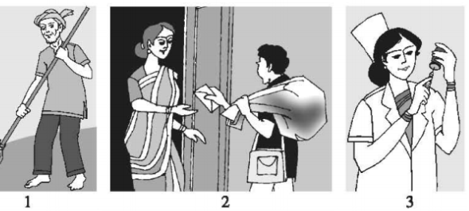
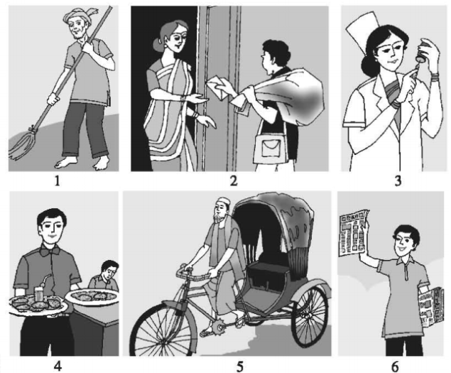
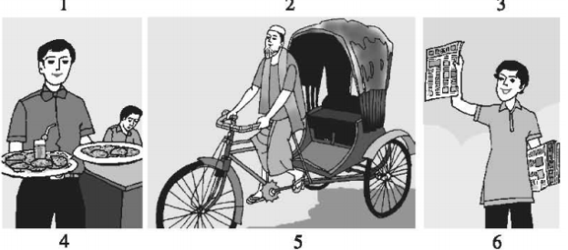
A. Look at the pictures
What do you see in the pictures?

Slide 5
Today’s Lesson
Thanks for your work

Slide 6
Learning Outcomes
At the end of the lesson, the students will be able to:
talk about, places and familiar objects in short and simple sentences.
read and understand texts.
participate in short dialogues and conversations on familiar topics.
write short paragraphs.
v. ask and answer questions.
vi. make a list of good works.

Slide 7
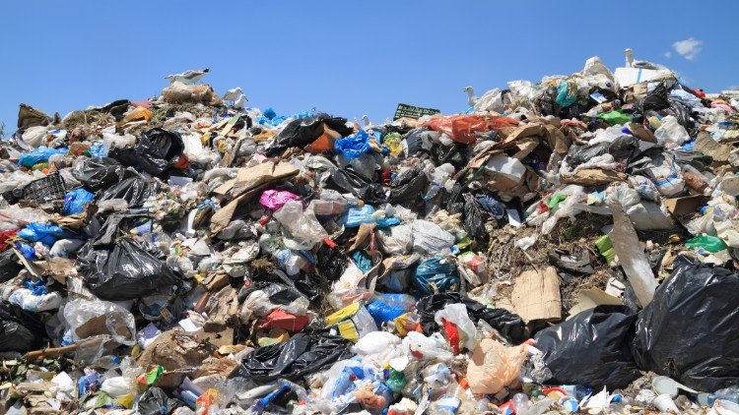
New Words Presentation
Noun
Word: rubbish
Syn. garbage
Meaning: waste material; refuse or litter
Example: Everyday Bulbul collects rubbish .

Slide 8
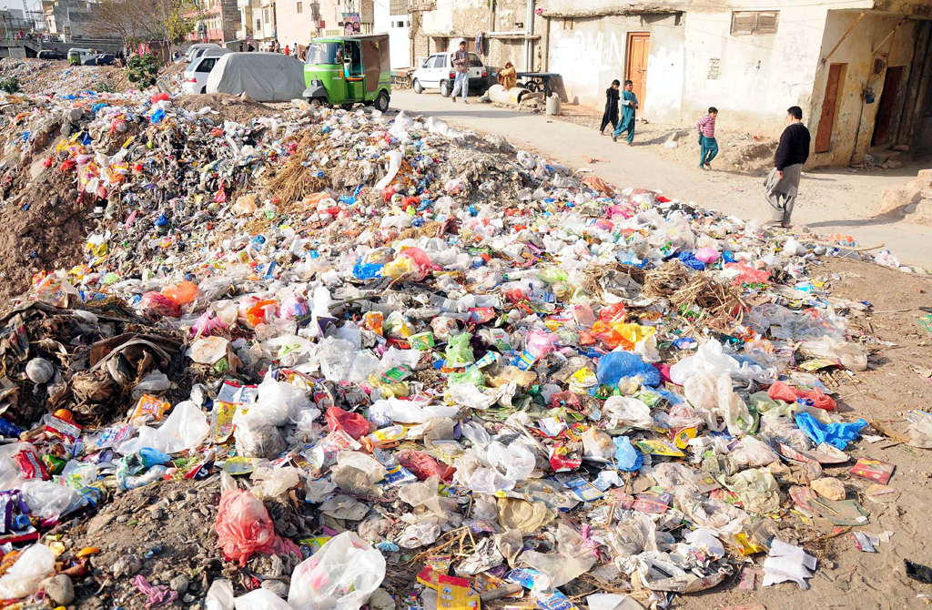
Word - Unhygienic
Adjective
Syn. - unsanitary
Ant. - hygienic
Meaning: not clean or sanitary.
Example: The environment is very unhygienic.

Slide 9
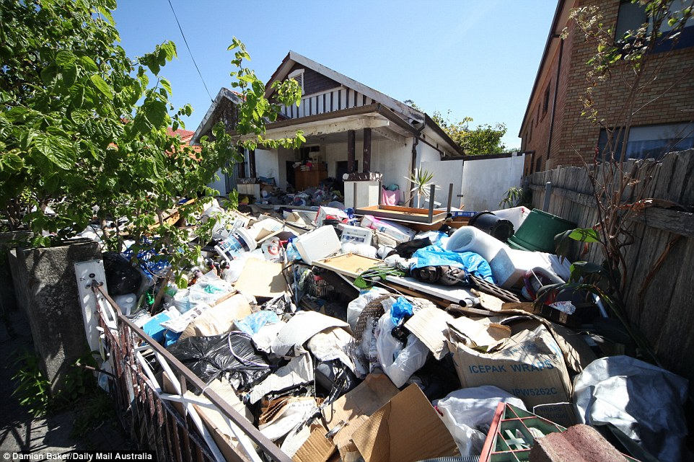
Word: Pile
Noun
Syn. - heap
Meaning: a heap of things laid or lying one on top of another
Example: Absence of Bulbul the people got piles of rubbish in front of their houses.

Slide 10
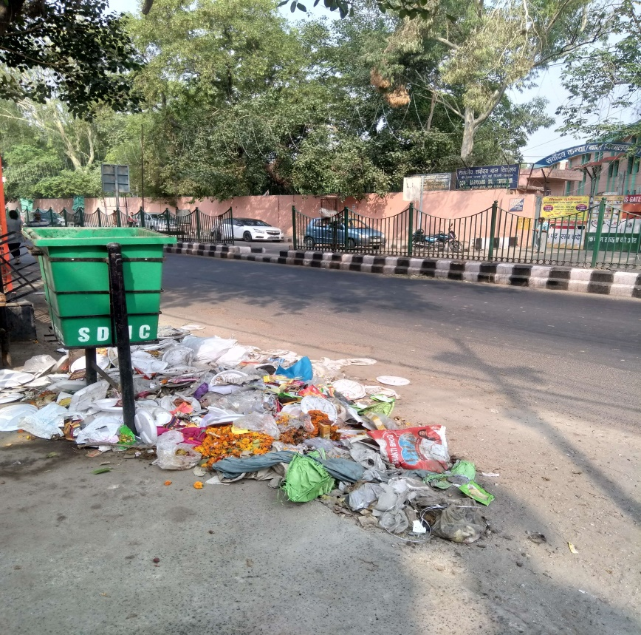
Word: Dustbin
Noun
Meaning: a large container for rubbish from a house or other building, usually made of strong plastic or metal and kept outside.
Example: If he stops working the whole area will turn into a big dustbin.

Slide 11
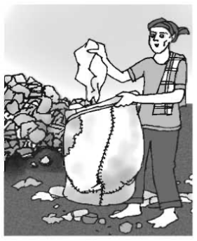
B. Read the text
Bulbul collects rubbish from the Sankar area in Dhaka. Every morning , he wakes up at 5 o’clock and walks along the streets of Sankar to collect rubbish.
People of Sanker put rubbish in plastic bins leave them in front of their houses.
Bulbul walks from door to door to collect them. Sometimes the bins are very dirty and they smell bad.

Slide 12
Last month Bulbul was sick for two days. So, he could not come to collect the rubbish. The people of Sankar were in great trouble. They got piles of rubbish waiting in front of their houses. The whole area became dirty and unhygienic. When Bulbul got well, he came to Sankar. He collected everything from all the bins. Bulbul does not want to fall sick again. He realizes, if he stops working even for a few days only, the whole area will turn into a big dustbin.
But Bulbul does not mind. He takes out everything from the bins and puts them in his van. He believes that all jobs are important. He works hard every day to keep this area clean.

Slide 13
Pair Work
A1. Choose appropriate words from the box to complete the dialogue below. Then act out the dialogue in pairs.
Letter, restaurant, streets, place, morning
A: What does a cleaner do?
B: A cleaner cleans our houses, office, etc.
A: What does a newspaper hawker do?
B: A hawker delivers would be better or distributes newspapers every
A: What does a postman do?
B: A postman delivers and other items to us.
A: What does a rickshaw – puller do?
B: A rickshaw – puller takes us from one to another.
streets
morning
letters
place

Slide 14
Group Work
B1. Think of a person who helps you live well. Write a composition on this person. Now answer the following questions.
What does he/ she do?
What time does he / she start his / her work?
How does / she do the work?
Does he / she like the job? Why or why not?
What will happen if he? She stops working?
What do you think about his/ her job?

Slide 15
Individual Work
B2. Underline all the verbs in text on Bulbul (B). Write down the past form of the verb in the present tense. Also write down the present form of the verb in the past tense.
was –
Could –
Were –
Got –
Became –
Came –
Collected –
Past Tense - Present Tense
am / is
can
are
get
become
come
collect

Slide 16
Evaluation
B3 . Now ask and answer the questions.
1 : What time does Bulbul wake up?
2: Where do the people of Sankar put their rubbish?
3: Why does Bulbul think that all jobs are important?
4: What happened when Bulbul became sick?
5. What will you say to Bulbul, if you meet him?

Slide 17
Home Work
Make a list of some good works for which you can get thanks from the members of your family and the society.

Slide 18
Thank you everybody, Have a nice day.
See you again in the next class.

