Slide 1
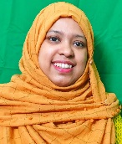
W
E
L
C
O
M
E
Mahia
Rahman
Assistant Teacher
English
Silam P.L High School
B.A Hons
M.A (English)

Slide 2
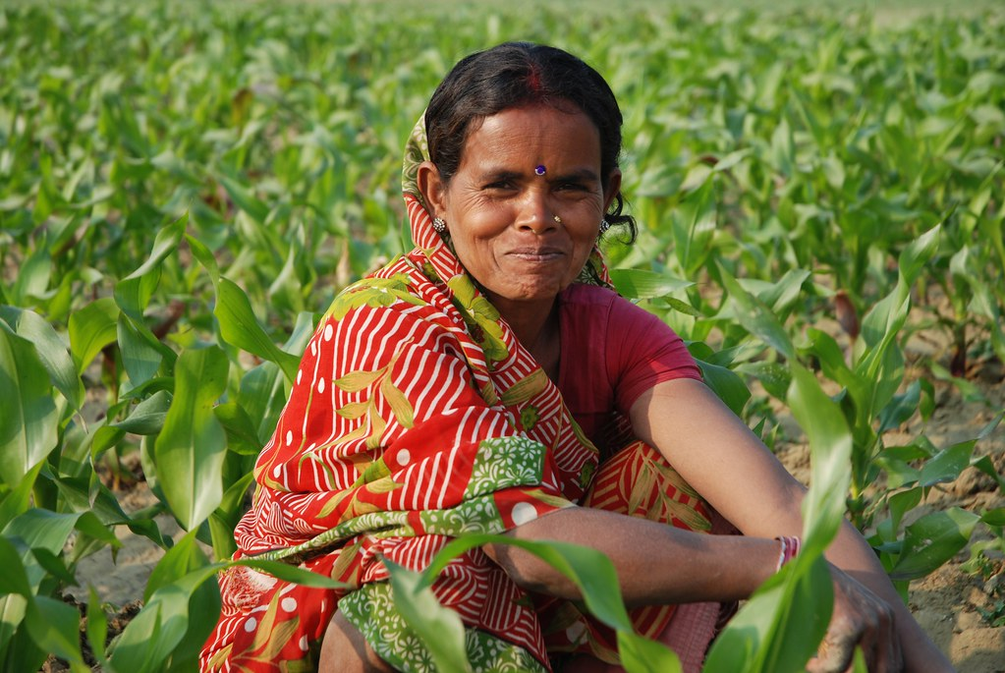
LOOK AT THE PICTURE.TALK ABOUT THE PICTURE.

Slide 3
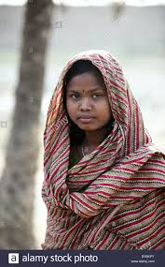

Slide 4
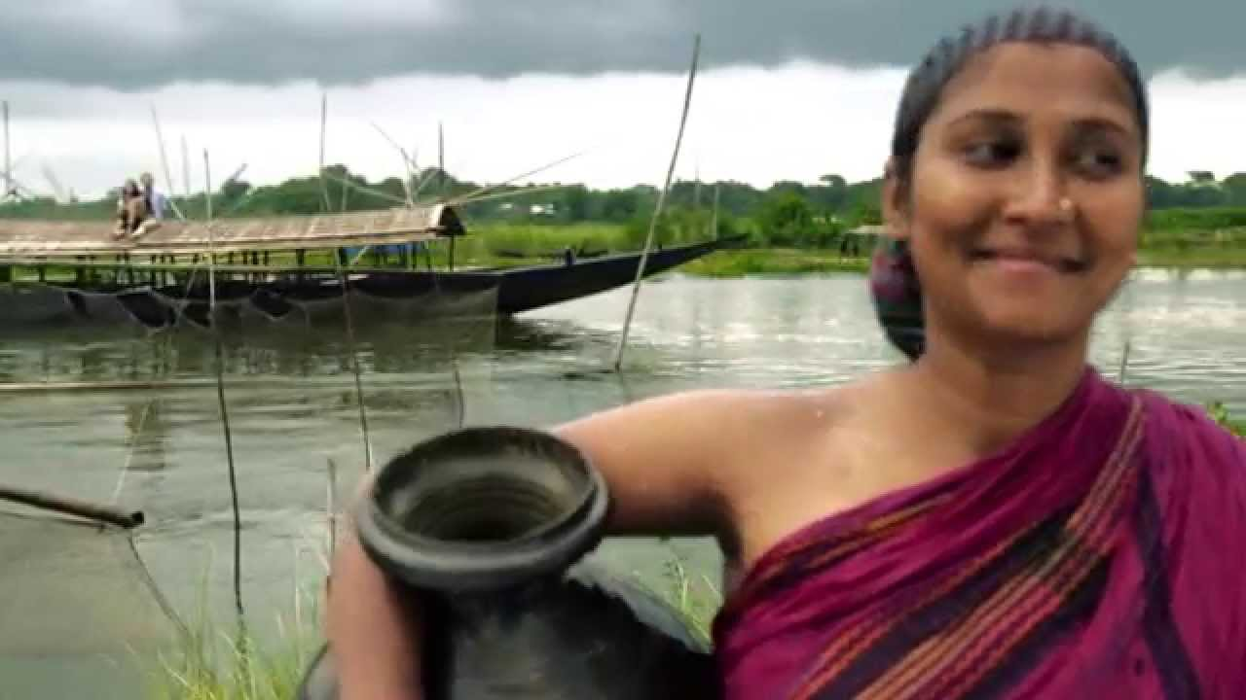

Slide 5
Ever beautiful shamima
Add a Slide
Unit -5
Lesson-3
Title-7

Slide 6
*Read and understand texts through
*Silent reading
*Listen for information
*After we have studied this unit ,we will be able to
*Ask and answer question

Slide 7
New-word
Out ward
Vow
Disabled
Product
Dignity

Slide 8
True or false. if false give correct answer.
⬥ Shamima’s husband destroyed her.
⬥ Shamima promised to stand beside the helpless women .
⬥ She has some trainers to train the women of her organization .
⬥ Shamima want’s to become a wealthy person to help others.

Slide 9
Home-work
Home-work
Find a person in your locality who has succeeded in the face of difficulties and write about her/him

