Slide 1
WELCOME

Slide 2
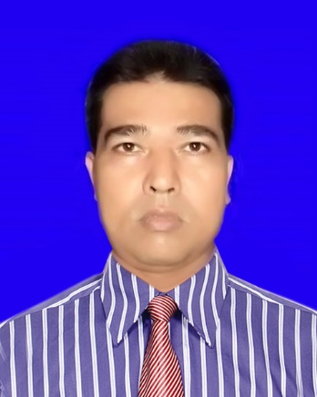
TEACHER’S IDENTITY
ASHUTOSH KUMAR BOSU
ASSISTANT HEAD TEACHER
DHULJORA CHURARGATI P,C HIGH SCHOOL
MOHAMMADPUR, MAGURA.
Email-ashutoshbosu1971@gmail.com
-01718322787

Slide 3
LESSON IDENTITY
CLASS- EIGHT
SUBJECT- ENGLISH GRAMMAR
LESSON- CHANGING SENTENCES

Slide 4
LOOK AT THE FOLLOWING SENTENCES
He is a good boy.
Isn’t he a good boy?
Is he a good boy?

Slide 5
DECLARATION OF LESSON
CHANGING SENTENCES

Slide 6
OBJECTIVES
After the end of the lesson the students will be able to
Tell the definition of Changing of Sentences
Tell the kinds of Changing of Sentences in English Grammar
Tell the definition of Conversion of Sentences
Tell the definition of Transformation of Sentences

Slide 7
LOOK AT THE FOLLOWING SENTENCES
He was absent
He was not absent
He was not present

Slide 8
WHAT IS CHANGING OF SENTENCES?
Changing of Sentences means structural changing of a sentence with the changing of meaning or without the changing of meaning

Slide 9
LOOK AT THE FOLLOWING CHANGING
Computer is a blessing to mankind
Computer is not a blessing to mankind
Computer is not a curse to mankind

Slide 10
HOW MANY KINDS OF CHANGING OF SENTENCES IN ENGLISH GRAMMAR?
There are two kinds of changing of sentences in English Grammar
Conversion
Transformation

Slide 11
LOOK AT THE FOLLOWING CONVERSION OF SENTENCES
Assertive-I went to school.
Interrogative-Did I go to school?
Affirmative-They play football.
Negative-They do not play football.
Assertive-The man is poor.
Negative-The man is not poor.

Slide 12
WHAT IS CONVERSION?
Conversion is the changing of structure of a sentence with changing the meaning of the sentence.

Slide 13
LOOK AT THE FOLLOWING TRANSFORMATION OF SENTENCES
Assertive- We are proud of our country.
Interrogative- Aren’t we proud of our country?
Affirmative- He is active.
Negative- He is not inactive.
Assertive-Bangladesh is a beautiful country.
Exclamatory-What a beautiful country Bangladesh is !

Slide 14
WHAT IS TRANSFORMATION?
Transformation is the changing of structure of a sentence without changing the meaning of the sentence.

Slide 15
THANK YOU ALL

