Slide 1
WELCOME

Slide 2
IDENTITY
Mahfuja Khatun
Head Teacher
Sujanagor Govt. Primary School
Pangsha, Rajbari.
ENGLISH FOR TODAY
Class-2
Lesson. Numbers
Lesson unit. 1o (1-3 A)
Time.35 minutes
Date. 30/11/2020

Slide 3
Learning Outcomes
Students will be able to ---
count and say numbers (14,15,16)

Slide 4
Let’s enjoy a video

Slide 5
Numbers
14,15,16

Slide 6
Let’s say the numbers that we learned
1
2
3
4
5
6
7
8
9
10
11
12
13

Slide 7
Open your book at page 20

Slide 8
Let’s Count and say the number
1
4

Slide 9
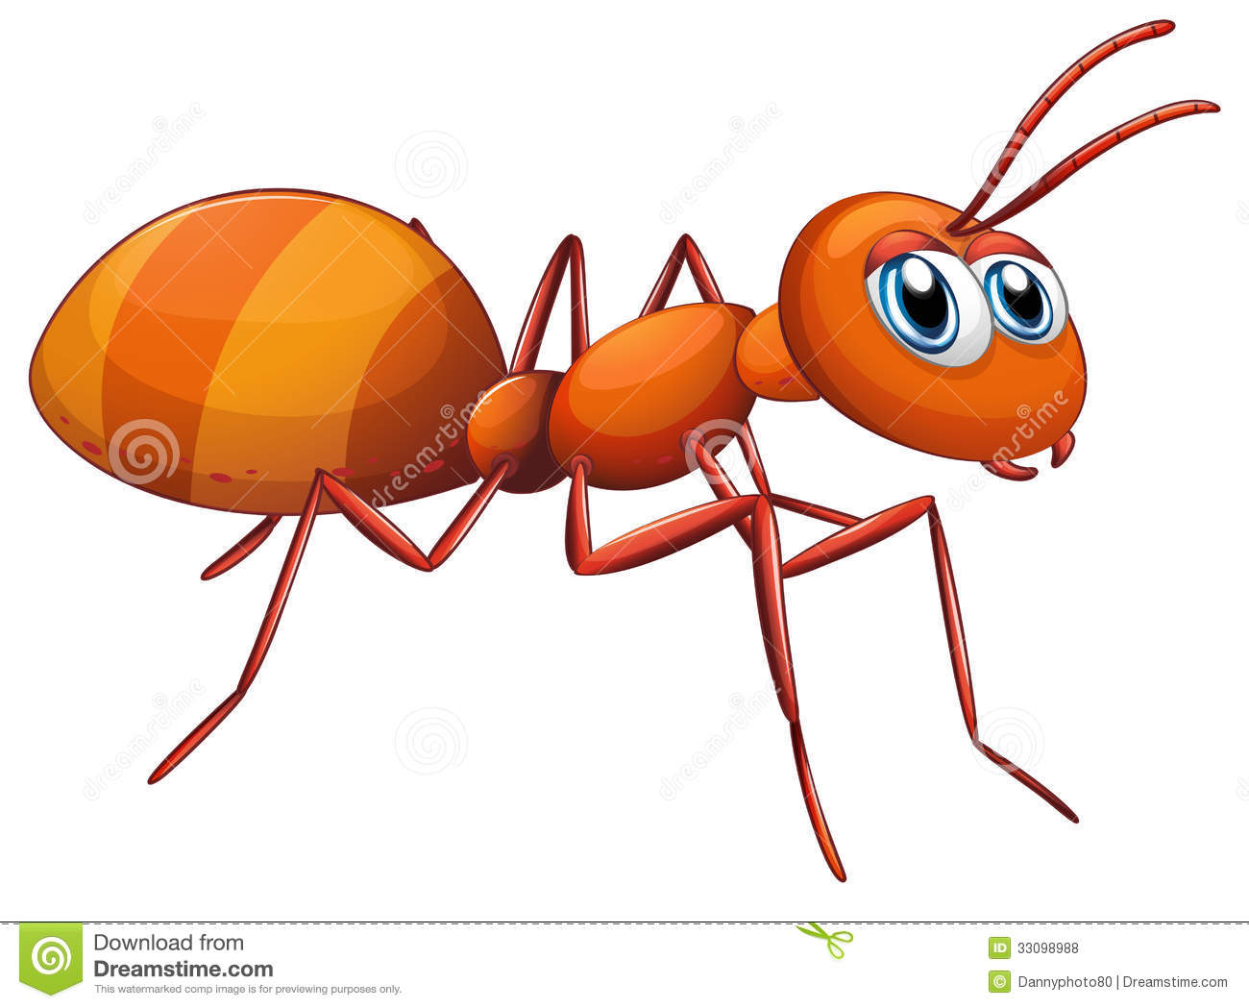
Let’s Count and say the number
1
5

Slide 10
Let’s Count and say the number
1
6

Slide 11
1
4
Listen and say

Slide 12
1
5
Listen and say

Slide 13
1
6
Listen and say

Slide 14
IW
Say the numbers 14,15 and 16

Slide 15
Group Work
Count the members of your group and say the number.

Slide 16
Home Work
Draw 16 pictures/shapes and colour them.

Slide 17
Thank you

