Slide 1
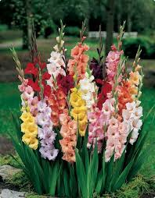
Welcome, dear students of class 7.

Slide 2
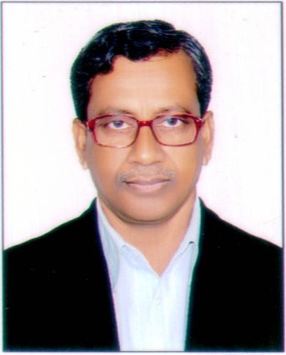
Teacher’s identification
Md. Ayub Ali
Asst. Snr. Teacher
Gouripur S. A. High School
Gouripur, Comilla.

Slide 3
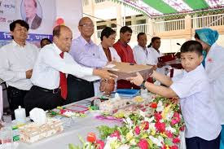
Look at the picture.
What can you see in the picture?
Answer.
In the picture I can see
a boy is receiving prize
from the chief guest.
So our today’s lesson: Prize giving day at school.

Slide 4
Lesson declaration
Unit 3
Lesson 1: Prize-giving day at school
Learning outcome: After you have studied the lesson, you will be able to learn to describe and
answer the questions.
Key words: eminent, outstanding, performance
Answer
Eminent= famous
Outstanding= extremely good
Performance= achievement

Slide 5
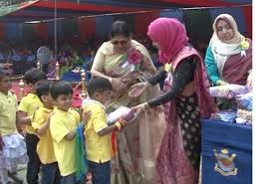
Look at the pictures and talk about discuss the following questions.
Who can you see in the picture?
What are they doing?
Answer
In the picture, I can see some boys standing in a queue.
One of the boys is receiving a prize from the chief guest.

Slide 6
B. Read the text about a prize giving ceremony.
B. Read the text about a prize-giving ceremony. Farabi is Flora’s best friend. They live in the same area. Also they are both in class 7. But they go to different schools.
It is a school holiday. Flora has come to visit Farabi. They are talking. Flora wants to know about the prize-giving ceremony of Farabi’s school.
“Yesterday was our school prize-giving day.” Farabi says. “On this occasion our scho ol auditorium and its dias were brightly decorated. Prizes were also neatly displayed on a separate table on the dais. All the students were present at the function. Among others, the guardians and some eminent persons of the locality attended the function.” Farabi continues. “The principal of PN college was the chief guest.”
“When did the function start? Flora asked.
“Oh, it started on time- just at 4 pm.” Farabi says. “Our Headmaster first read out the annual report. The Chief Guest gave a short speech. He highly praised the overall performance of the school and its excellent JSC and SSC Exam results. Then he gave away the prizes among the students for their outstanding activities.”
“Did you get any prize, Farabi?” Flora enquires.
“yes, I did,” Farabi replies. “I’ve got two prizes – one for regular attendance and the other for good results in the last year-ending exams.”

Slide 7
C. Match the words with their meanings.
Words | Meanings
visit ceremony eminent praise outstanding display | speak highly of something or somebody extremely good Go to see a person or place Put something in a place where you can see it easily Function People having lots of power and influence

Slide 8
Answer.
visit----to go to see a person or place
ceremony----function
eminent---people having lots of power and influence
praise---speak highly of something or somebody
outstanding----extremely good
display---put something in a place where you can see it easily

Slide 9
D. Ask and answer in pairs. Make questions and then choose answers from this table.
How | was did | the prize giving function held?
What |  | the auditorium decorated?
 |  | the chief guest at the function?
Who
Where |  | the Head Teacher do at the beginning of the function?

Slide 10
Answer.
1. How was the auditorium decorated?
Ans. The auditorium was decorated brightly.
2. What did the Head Teacher do at the beginning of the function?
Ans. The Head teacher read out the annual report.
3. Who was the chief guest at the function?
Ans. The Principal of PN College was the chief guest at the function.
4. Where was the prize-giving function held?
Ans. The prize giving function was held in the school auditorium.

Slide 11
E. Complete the passage with the verbs given. Write their correct forms.
sing, speak, stage, be
At the end of the prize giving function there…….
a cultural show. The students…………, danced and
………..a one act play. It was so good that everyone
…………. highly of it.

Slide 12
Answer
was,
sang,
staged,
spoke.

Slide 13
F. Do you have a sports day at your school? First tell the class about it and then write about it in your note book.
Ans. Yes, I had a sports day at our school. last 10 January was the sports day at our school. On this occasion our school playground was decorated wonderfully. The function started at 9 o’clock. The TNO of Daudkandi Upazilla was the chief guest. I was one of the winners. The chief guest gave away prizes among the winners.

Slide 14
Home task
Write a letter to your friend describing the prize-giving ceremony of your school.

Slide 15
Thank you all.

