Slide 1



Welcome

Slide 2
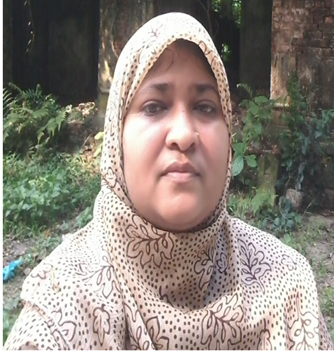
Introduction
Zannaton Nahar
Head Teacher
Teknogopara Govt. Primary School
Gazipur citycorporation, Gazipur.
Mobile-01768031223
Mail-zannatonnahar@gmail.com

Slide 3

Todays lesson:
Class: Two
Subject: English
Unit:2
lesson[1-3]
Time: 40 min

Slide 4
Learning outcomes:
Students will be able to-
2.1.1 recognize and read
cordinal numbers up to 4.
4.1.1 copy numbers up to 4 in
figures and in words.
4.1.2 write numbers up to 4 in
figures and in words.

Slide 5
Let’s see-

Slide 6


Slide 7


Slide 8
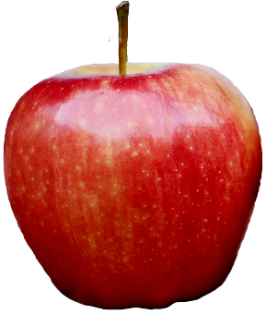

Slide 10
Lesson diclaration
Unit:2
Lesson:1-3
Topic: Number
Page no.-4

Slide 11



Look and say:
one
two
three
four

Slide 12

1
2
3
4
one
two
three
four

Slide 13
Open your EFT book and follow the teacher.
Page no.-04

Slide 14
Fill in the gaps in pair
1
1
2
3
4
2
3
4

Slide 15
Individual work
Everybody write in your exercise book.

Slide 16
1
2
3
4
four
three
one
two

Slide 17

Group work:
Count and write the number of the flowers.
Group-A
Group-B
Group-C
Group-D
1
2
3
4

Slide 18




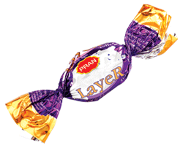
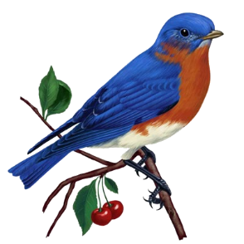
Evaluation:
Match and write the numbers.
one
two
three
four

Slide 19
Home work
Write cardial numbers[1-4].

Slide 20

THANKS
A
LOT

