Slide 2
Teacher’s Identity
Anwar Hossain
Assistant teacher in English
34th BCS non-cadre
Jaintapur Govt.High School, Jaintapur, Sylhet.
Email: hossainanwar1516@gmail.com

Slide 3
Introduction of the Topic
Class: 9-10
Unit: 11

Slide 4
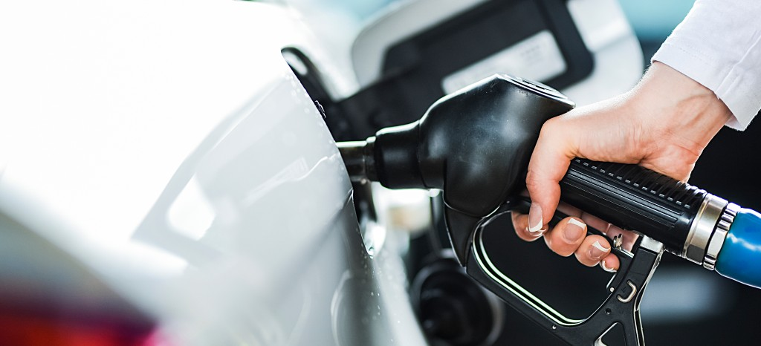
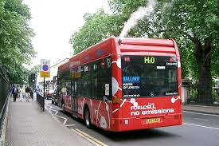
What do you see in the picture?
fuel

Slide 5
Our Today’s Class:
Unit:11
Lesson:3
( The Renewable Energy Sources)

Slide 6
Learning outcomes
After studying the lesson, the students will be able to;
say sources of renewable energy
infer new word meaning
choose the best answer from alternative.

Slide 7
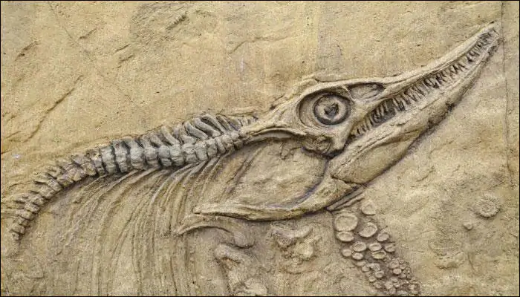
Vocabulary presentation
Fossil---
Remains of plants and animals
It takes long time to get fossil fuel.

Slide 8
Reliance----
Dependence
Self-reliance is a good quality.

Slide 9
Replenish---
Refill
I am on the way to replenish my car from a filling station.

Slide 10
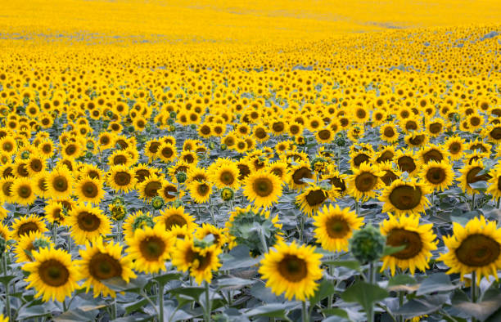
Abundant---
sufficient
There is abundant water in the lake Baikal.

Slide 11
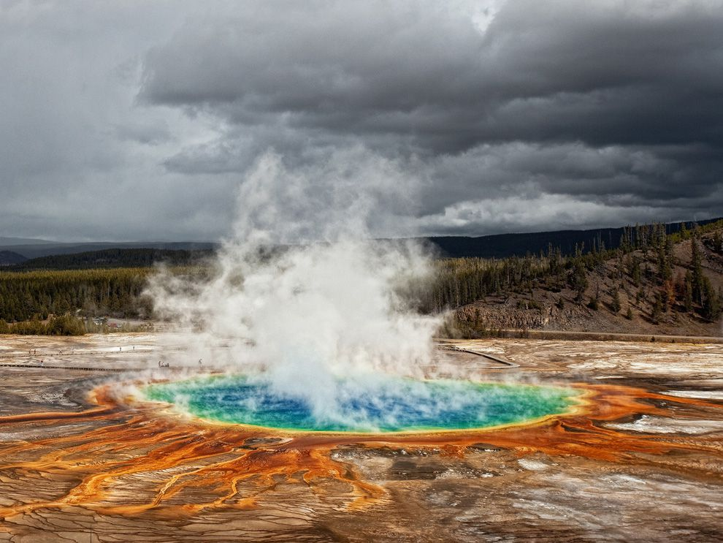
Evaporate---
Change into air/steam
Gas is used to evaporate water.

Slide 12
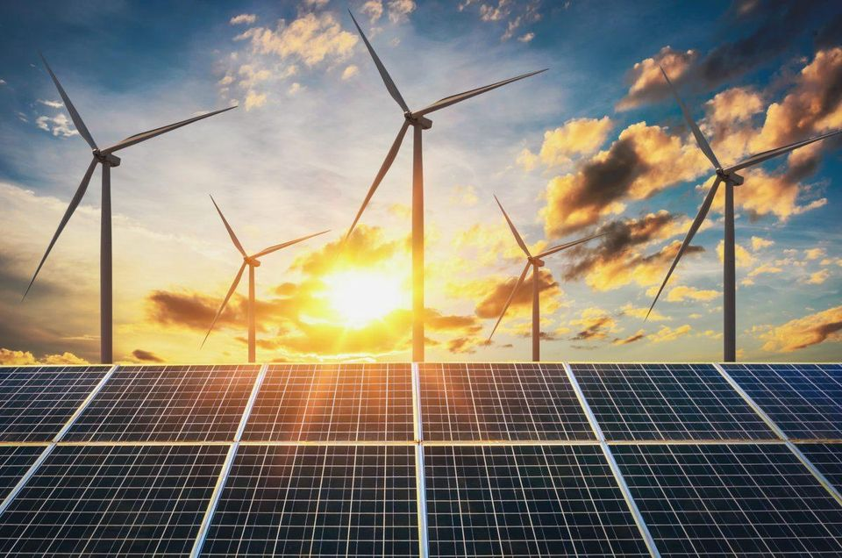
renewable---
Able to renew
Solar energy has a huge potentiality.

Slide 13
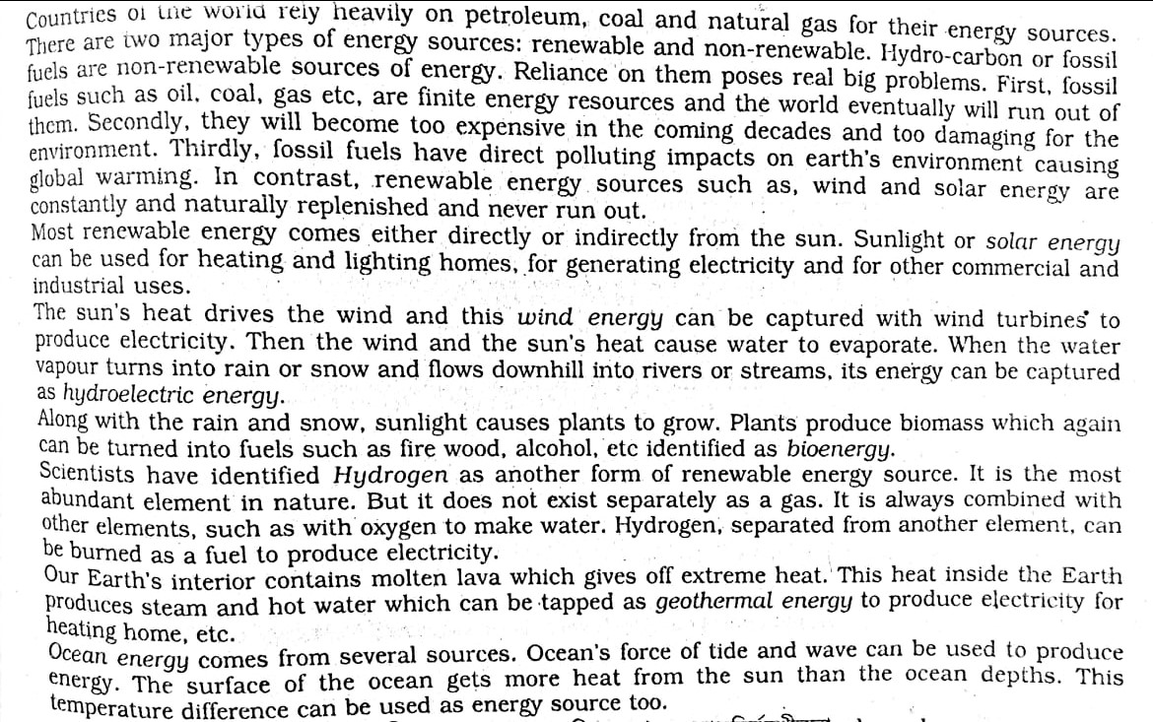
The Renewable Energy Sources

Slide 14
Choose the correct answer from the following alternatives
Which of the following describe non-renewable energy best?
a)expensive b)less costly c) environment-friendly d)less available
ii) Which of the gas can be burnt as fuel to produce electricity?
a)Hydrogen b)Oxygen c)nitrogen d) Carbon di-oxide
iii)Oil, gas and coal are called ----
a) Fossil fuels b)hydro-carbon c) solar energy d) renewable energy

Slide 15
iv) In the passage the word tremendous means---
a)medium b)extreme c)normal d)minimum
v)What is the theme of the passage?
We need both renewable and non-renewable energy b)reliance on non-renewable energy resources c)renewable energy is the alternative to non-renewable energy d)about various energy sources
vi) ------cause global warming
Green energies b) solar energies c)fossil energies d)nothing
Vii)--------never run out.
a) oil b) renewable c) gas d)petrolium

Slide 16
Thank you All

