Slide 1



Slide 2
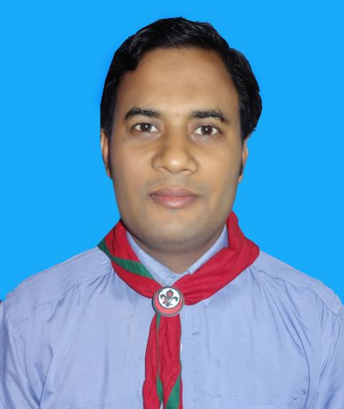


Introduction
Class: One
Subject: English
Unit:16
Lesson:1-3
Activity:A
Md. Abdur Rokib
Assistant Teacher
Chatrajitpur GPS
Shibganj, Chapainawabganj.
marokibgpst@gmail.com

Slide 3
Learning outcome
Listening 1.1.1 Become familiar with English sounds by listening to
common English word.
Speaking 1.1.1 Repeat after the teacher simple words and phrases.
1.2.1 Say simple words and phrases.

Slide 4

Watch the vedio and try to say the word

Slide 5
Student’s everybody recite the rhyme loudly
2 hands go
Clap,clap,clap.
2 feet go
ta,tap,tap.
2 eyes are open wide.
1 head goes
Side to side.

Slide 6

Look at the picture activity ‘A’
Dear student’s open at page 32

Slide 7
Student’s do the activities
Come here
Clap your hand
Tap your
feet
Open your eyes wide

Slide 8
Student’s lets know about the word
Draw
Take
Come
ছবি আকাঁ
নেওয়া
আসা

Slide 9


Listen to the audio carefuly

Slide 10

Draw
Take
Come
Teachers loud reading
Teachers loud reading

Slide 11
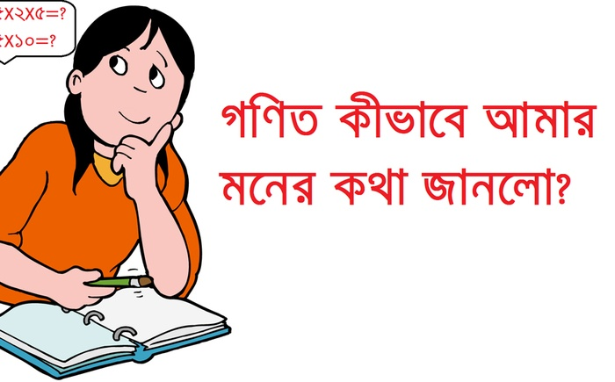
Student’s let’s play memory game
Tell me the name of missing word
Draw
Take
Come

Slide 12

Pair work
One student point and say the word other listen.in this way you do your pair work

Slide 13

Match the picture with the word
IW
Take
Come
Draw

Slide 14

Checking learning
Point the picture and say the word
Draw
Take
Come

Slide 15
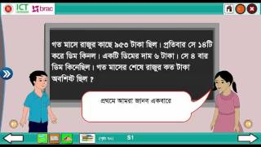
We learn today
Become familiar with English sounds by listening to common English words. Say simple words and phrases

Slide 16


