Slide 1
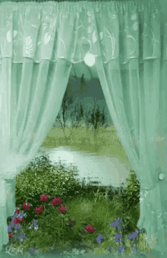

Slide 2
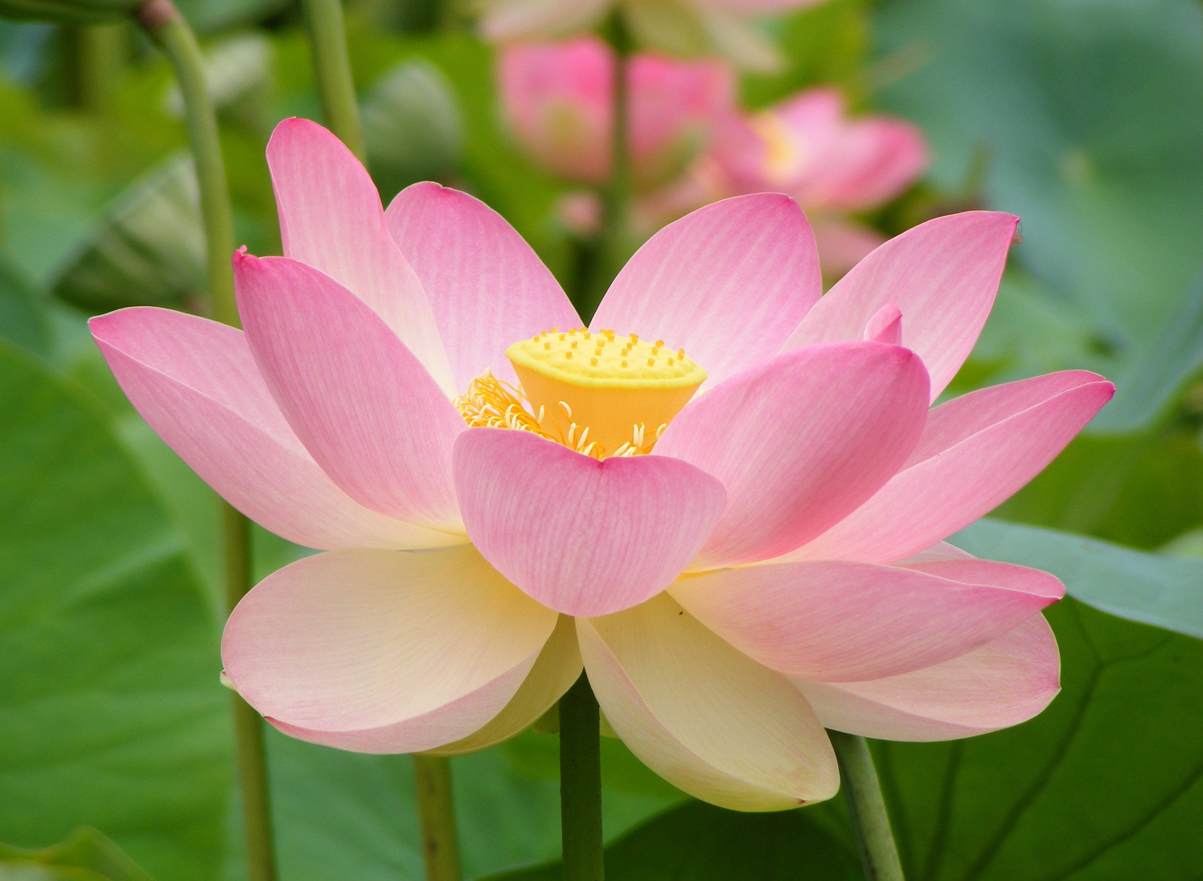
WELCOME TO ALL
This Photo by Unknown Author is licensed under CC BY-SA

Slide 3
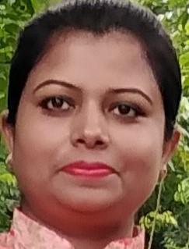
Teacher’s Identity
Nahida Akhter
Assistant Teacher
Kalikaccha North Govt. Primary School
Sarail , Brahmanbaria
Email : nahidaakhter99@gmail.com

Slide 4
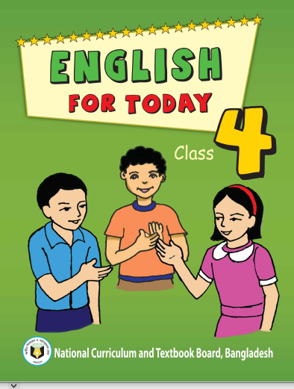
Lesson
Class:Four
Unit :35
Lessons :1-2
Lessons Tittle:My trip
Today’s Lesson:A

Slide 5
LEARNING OUTCOMES
Listening
3.2.1 understand questions about family and friends of students.
Speaking
1.1.1 Repeat after the teacher and say words, phrases and sentences with proper sounds,stress and intonation.
Reading
1.5.1 read words, phrases and sentences in the text with proper pronunciation, stress and intonation.
Writing
Write words ,phrases and sentences using non cursive capital and small letters.

Slide 6
Dear Superlearners , lets watch a video.
https://www.youtube.com/watch?v=fWuiq2tW8LQ

Slide 7
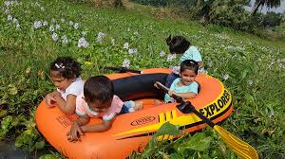
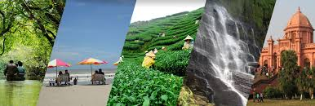
Dear learner’s what are you seeing above the pictures?
Some picture of trip.
Yes,today we’ll know about someone’s trip.

Slide 8
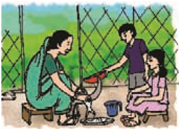
Today’s Lesson:My trip
Unit :35
Lessons :1-2
Page number : 70
Activity :A

Slide 9
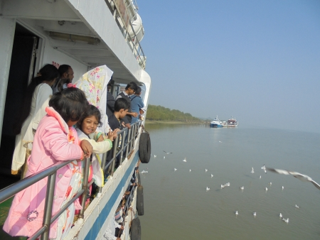
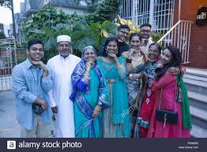
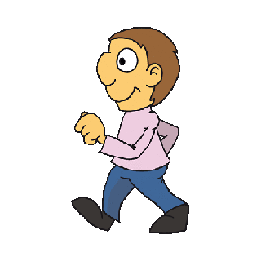
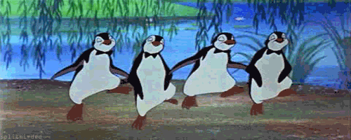
New words
A journey especially for pleasure.
Trip
A person connected by blood or marriage.
Relative
Went
Move from one place to another.
Favourite
Preferred to all others of the same kind.
Delicious
Highly pleasant to the taste.

Slide 10
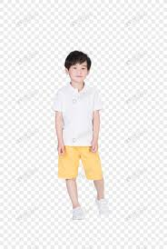
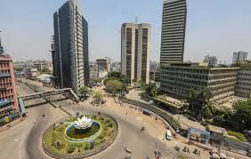
My name is Alvi.
I live in Dhaka.

Slide 11
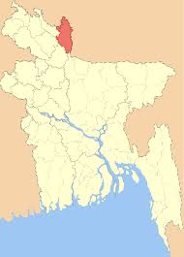
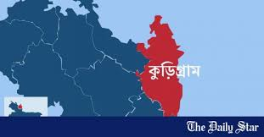
But my family is from Chilmary in Kurigram.

Slide 12
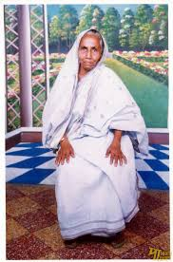
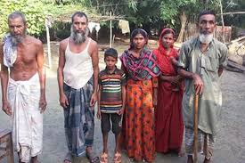
My grandmother and many of my relatives still live there. Last June, I went to visit my grandmother, my uncle and cousins in Chilmari.

Slide 13
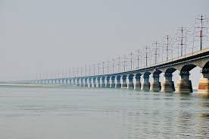
Their house is near the Jumuna river.

Slide 14
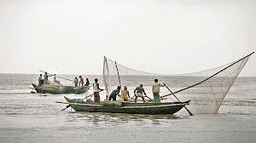
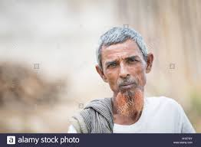
My uncle is a fisherman.My grandfather was a fisherman but he died about 10 years ago. I didn’t know him.

Slide 15
When my sister and I visited Chilmari in June, We had so much fun!

Slide 16
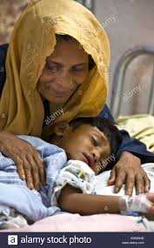
Our grandmother told us story about our family and about the history of Bangladesh.

Slide 17
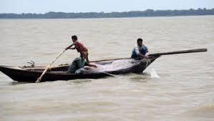
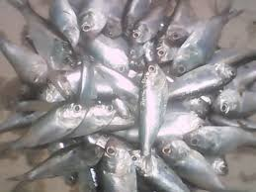
My uncle caught a lot of fish. My favourite fish is ‘‘Chapila’’.It’s a thin ,white fish.It’s delicious!

Slide 18
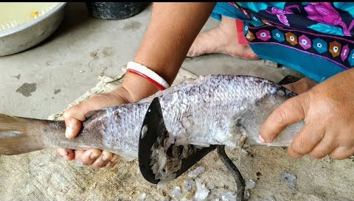
We helped our grandmother make the fish every night.

Slide 19
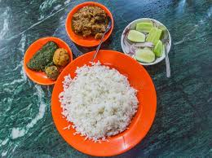
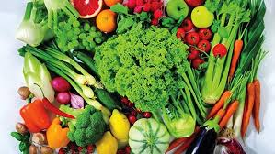
We also made rice and vegetables.

Slide 20
It was a very special trip.We with talked our relatives and learned about our family and our country .We also sang songs together.

Slide 21
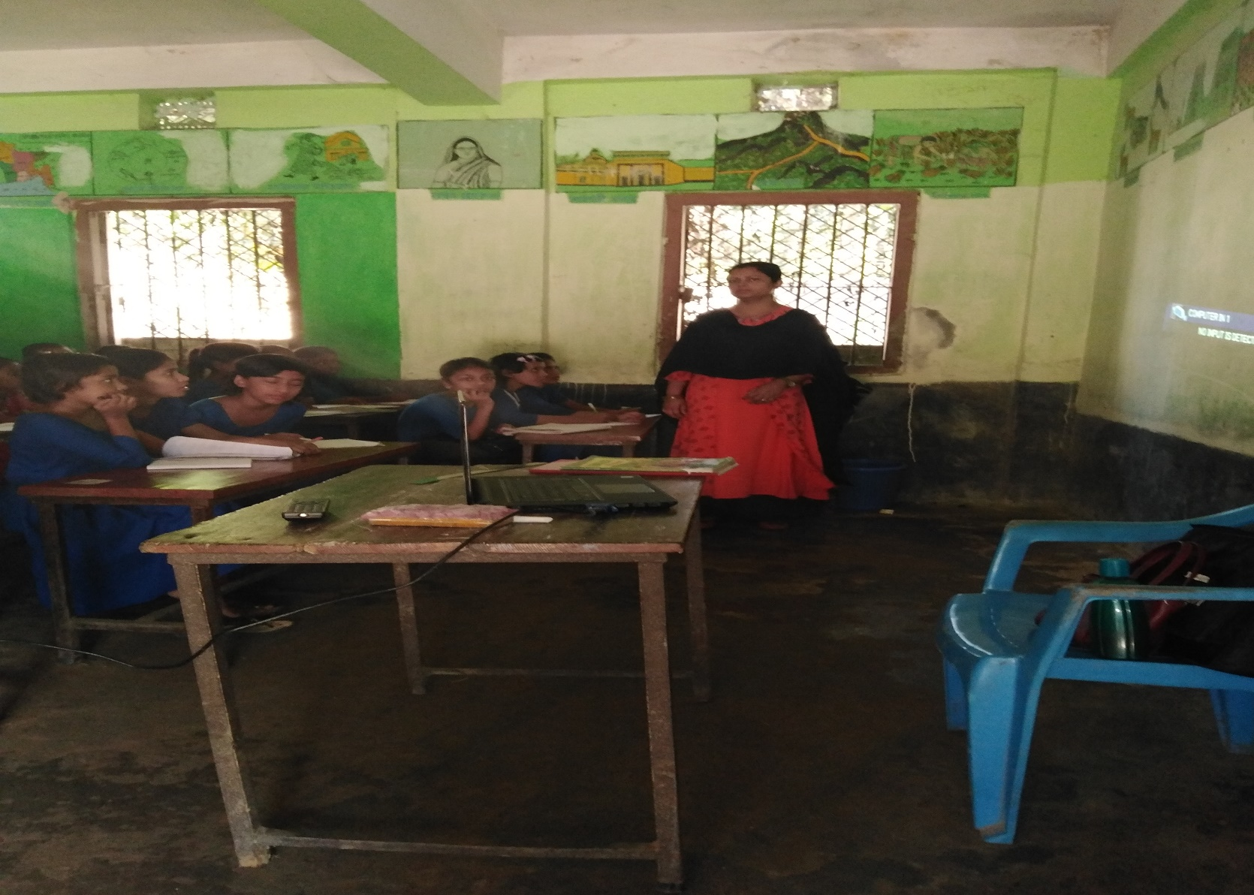
Teachers loud reading

Slide 22
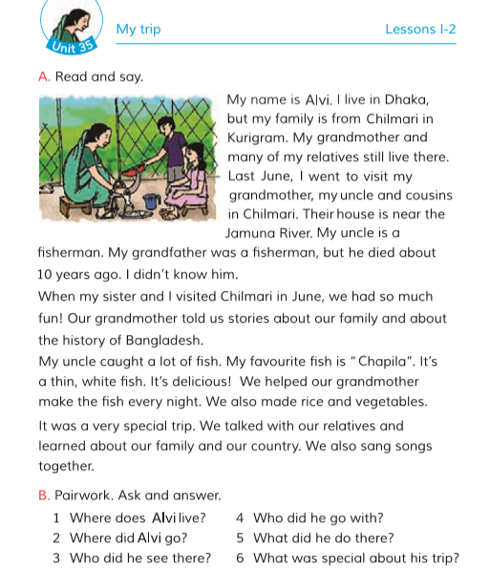
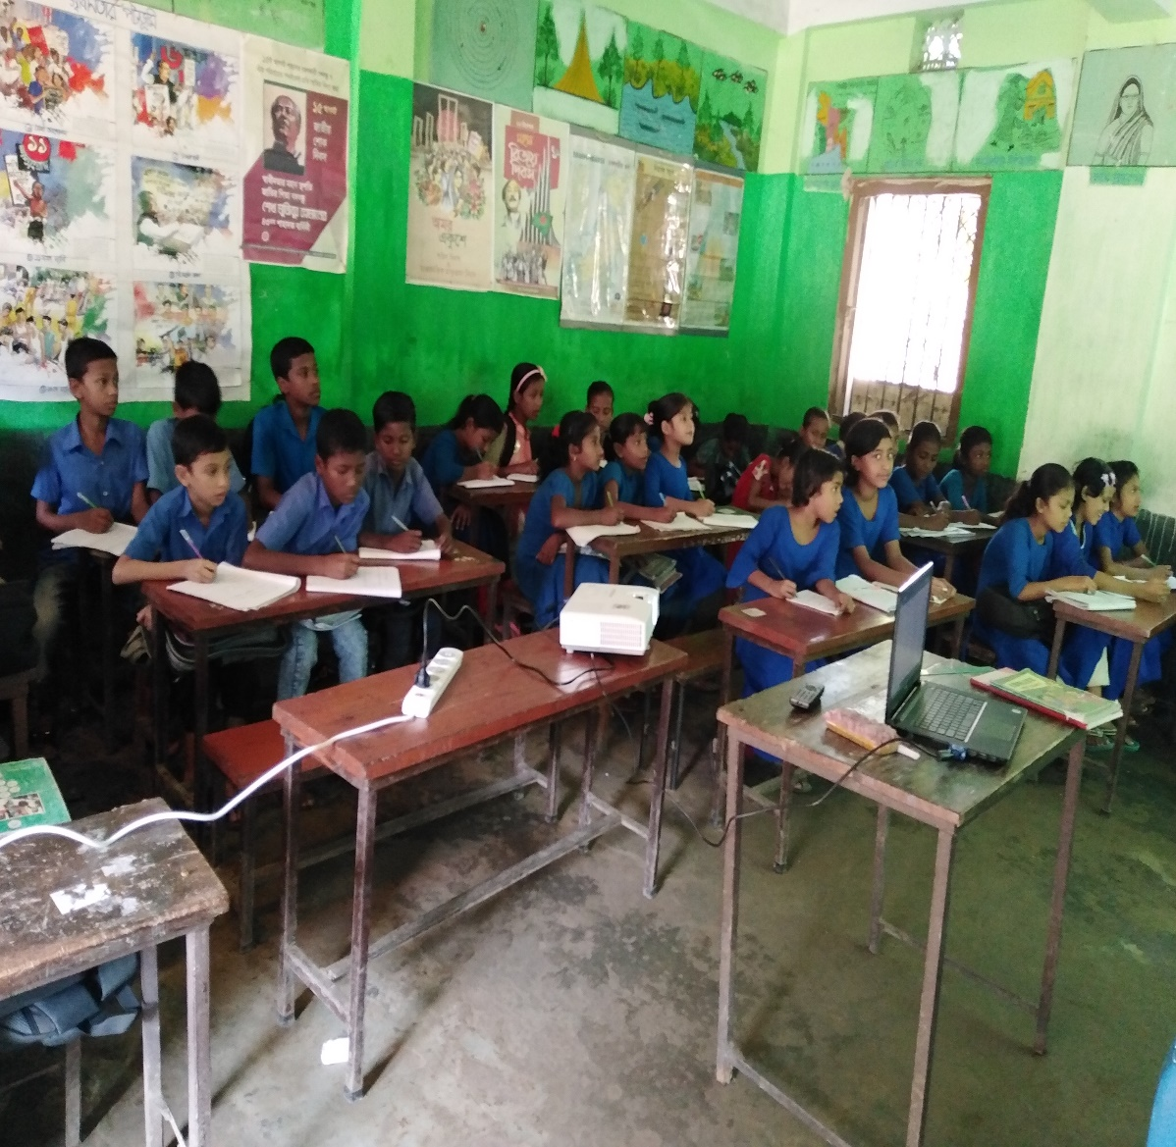
Student silent reading
Open the book ,page no-70

Slide 23
Group work
Group no 1 | Read the passage with correct pronunciation stress and intonation.
Group no 2 | Read the passage with correct pronunciation stress and intonation.
Group no 3 | Read the passage with correct pronunciation stress and intonation.
Group no 4 | Read the passage with correct pronunciation stress and intonation.
Group no 5 | Read the passage with correct pronunciation stress and intonation.

Slide 24
Match the words with it’s meaning.
Trip
Highly pleasant to the taste.
Relative
A journey especially for pleasure.
A person connected by blood or marriage.
Went
Favourite
Preferred to all others of the same kind.
Delicious
Move from one place to another.

Slide 25
Choose the correct answer.
1.Where does Alvi live?
a.Brahmanbaria
b.Dhaka
c.Sylhet
d. Hobigonj
Correct answer: b.Dhaka
2. What is his grandfather’s profession?
a. Teacher
b.Doctor
c.Fisherman
d.Businessman
Correct answer: c. Fisherman
3. What is Alvi’s favourite fish?
a. Hilsha
b.Chapila
c.Catla
d. Puti
Correct answer: d. Puti

Slide 26
Summary
Alvi lives in Dhaka .But his family is from Chilmari in Kurigram.He went to Chilmari to visit his grandmother, uncle and cousins in Chilmari. Alvi enjoyed the trip very much.

Slide 27
Homework
Suppose you are Ruhi/ Reehan, Now write five sentences about your trip.

Slide 28
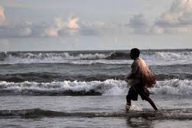
Goodby to everyone.

