Slide 1
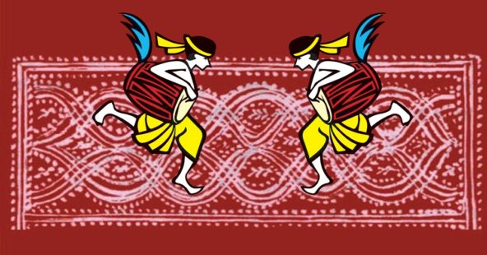
Welcome

Slide 2
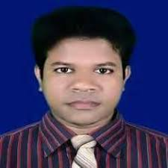
IDENTITY
Azizul F
Azizul Fakir
Assistant teacher
Dighirjan secondary school
Nazirpur, Pirojpur
Mobile: 01710745128
Email: azizul.nk@gmail.com
Azizul Fakir
Assistant teacher
Dighirjan secondary school
Nazirpur, Pirojpur
Mobile: 01710745128
Email: azizul.nk@gmail.com
Class 9
English For Today
Unit 3
Events and festivals
Time : 50 mins
23/9/2020

Slide 3
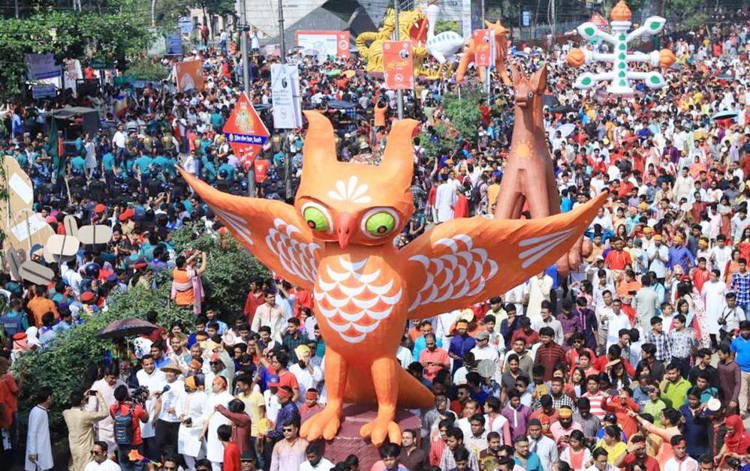
Look the picture carefully
The picture is related to our great national festival Pahela Boishakh.
What is the picture related to?

Slide 4
So our today’s topic is
“Pahela Boishakh
Unit – 3
Lesson - 4

Slide 5
Learning outcomes
After completing this lesson, we will be able to ----
infer meaning from the context
1
talk about the pictures
2
write answers to the questions
3
tick best answers from the alternatives
4
listen for information to the CD
5

Slide 6
Keywords
বাংলা অর্থ
Part of speech
English meaning
Synonyms
Special
বিশেষ
adjective
not ordinary
unique
Significance
তাৎপর্য
noun
the importance of something
importance
Irrespective
নির্বিশেষে
adjective
without considering something
impartial
Ethnic
জাতিগত
adjective
a race of people that shares a common cultural tradition
racial

Slide 7
Keywords
বাংলা অর্থ
Part of speech
English meaning
Synonyms
Identity
পরিচয়
noun
the fact of being what a person is.
individuality
Belief
বিশ্বাস
noun
a strong feeling that something exists or is true
faith
Inspire
উৎসাহিত করা
verb
to give somebody the confidence to do something well
motivate, enthuse
Renewed
নবায়নকৃত
adjective
happening against with increased
modified

Slide 8
Keywords
বাংলা অর্থ
Part of speech
English meaning
Synonyms
Carnival
আনন্দ মেলা
noun
a public festival
festival
Fascinating
আকর্ষণীয়
adjective
Extremely interesting
charming
Contemporary
সমসাময়িক
adjective
Belonging to the same time
current
Supplement
ক্রোড়পত্র
noun
a thing that is added to something else to improve
postscript

Slide 9
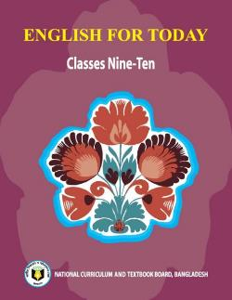
Open at page 38 and read text carefully.
‘Pohela Boishakh’ is the first day of Bangla new year. The day is a public holyday. This day has a special significance for us as it is a part of Bangalee culture and tradition. People from all walks of life, irrespective of their ethnic identity or religious beliefs, celebrate the day with traditional festivities. On this day, the whole of Bangladesh is in a festive mode. The day inspires people to start life with renewed hops and inspirations.
Every year the day is celebrated traditionally. People wake up early in the morning, have bath and wear traditional clothes. Women wear white sarees with red borders and adorn themselves with colorful churis and flowers, while men dress themselves in pajamas and panjabis. It is a day when people love eating traditional food.

Slide 10
One of the most colorful events of the day is held in Dhaka. Early in the morning, people in hundreds and thousands pour from all directions to attend the cultural function at Ramna Batamaul organized by Chayanaut. The cultural programme begins just at sunrise and the renowned artists of the country take part in the programme that starts with the famous Tagore-song Esho-he-Boishakh, Esho Esho ….Artists also sing traditional folk songs, and perform classical dances to the rhythm of musical instruments.
People also come to join the colorful processions, the biggest carnival of the country, organized by the Fine Arts students of Dhaka University. The procession usually displays the traditional practices of Bangalee culture. The masks and wreaths worn by the people are so fascinating! Often they symbolize contemporary worries or happiness in the national life. It attracts an increasing number of foreign tourists every year.

Slide 11
The day is also observed all over the country. Different social and cultural organizations and educational institutions celebrate the day with their won cultural programmes.
On this day, news papers bring out special supplements. There are also special programmes on the radio and television.
The celebration of Pahela Boishakh marks a day of cultural unity for the whole nation.

Slide 12
Time 5mins
12
1
11
10
2
9
3
Individual works
8
4
7
5
6
Complete the passage with suitable words.
The word Pahela means the first and Boishakh is the ------ month of Bangla calendar. The day is observed not ------ in Bangladesh but ------ in some other parts of the world. It is celebrated in west Bengal, Assam and Tripura. It is also ----- in Australia and the UK. In Australia, the largest ------- for Bangla new year is the Sydney Boishakhi Mela held ------ Sydney Olympic Park. In England, the Bangalees -------celebrate the day with a street ------- in London. It is the ------Asian festival in Europe, -------- Bangladesh and West Bangal.

Slide 13
Now check your answers
The word Pahela means the first and Boishakh is the first month of Bangla calendar. The day is observed not only in Bangladesh but also in some other parts of the world. It is celebrated in west Bengal, Assam and Tripura. It is also observed in Australia and the UK. In Australia, the largest festival for Bangla new year is the Sydney Boishakhi Mela held in Sydney Olympic Park. In England, the Bangalees also celebrate the day with a street procession in London. It is the traditional Asian festival in Europe, upholding Bangladesh and West Bangal.

Slide 14
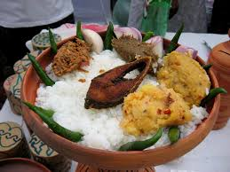
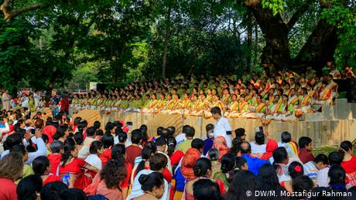
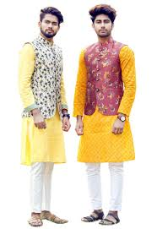
Look the pictures carefully
Describe about the pictures.
Usually at Pohela Boishakh, we eat ‘Panta Bhat’ and ‘Hilsha fish’. Early in the morning, people in hundreds and thousands pour from all directions to attend the cultural function at Ramna Batamaul organized by Chayanaut. The cultural programme begins just at sunrise and the renowned artists of the country take part in the programme that starts with the famous Tagore-song Esho-he-Boishakh, Esho Esho ….Artists also sing traditional folk songs, and perform classical dances to the rhythm of musical instruments. Women wear white sarees with red borders and adorn themselves with colorful churis and flowers, while men dress themselves in pajamas and panjabis. It is a day when people love eating traditional food.

Slide 15
12
1
Pair works
11
10
2
5mins
9
3
8
4
7
Answer the following questions
6
5
Q1: Do you go out in the morning of Pahela Boishakh? If you do, where do you go? If not, what do you do?
Q2: What kind of food do you eat in the morning of Pahela Boishakh?
Q3: Do you wear any special clothes on this occasion?

Slide 16
You may check your answers.
Ans 1: Yes, I have planned to go to the Ramna Batamul very early in the morning.
Ans 2: Usually, we eat ‘Panta Bhat’ and ‘Hilsha fish’.
Ans 3: I wear ‘Pajama’ and ‘Panjabi’ on this occasion.

Slide 17
Read the passage carefully
The biggest carnival of the country is the colorful processions arranged by the Fine Arts students of Dhaka University. Their parade usually exhibits the conventional practices of our Bengalee culture. They wear masks and wreaths which depict the current happiness or vexations of our national life.By this sentence I mean that Pahela Boishakh is a day when people want to decept their tradition. They like to eat traditional food which consists of ‘panta bhat’, ‘ilish machh’ and various types of ‘bharta’. They relish every bit of their food. Chyyanata arranges the cultural programmes at Ramna Batamul

Slide 18
Time: 6mins
12
1
Group works
11
10
2
9
3
8
4
7
5
6
Answer these questions.
Q1: What is the biggest carnival of the country?
Q2: “It is a day when people love eating traditional food.” What do you mean by this sentence?
Q3: Which organization arranges the cultural programs at Ramna Batamul?

Slide 19
Check your answers
Ans1: The biggest carnival of the country is the colorful processions arranged by the Fine
Arts students of Dhaka University. Their parade usually exhibits the conventional
practices of our Bengalee culture. They wear masks and wreaths which depict the
current happiness or vexations of our national life.
Ans2: By this sentence I mean that Pahela Boishakh is a day when people want to decept
their tradition. They like to eat traditional food which consists of ‘panta bhat’, ‘ilish
machh’ and various types of ‘bharta’. They relish every bit of their food.
Ans3: Chyyanata arranges the cultural programmes at Ramna Batamul.

Slide 20
Choose the best answer from the alternatives
a) The closest meaning of the word ‘significant’ is:
(i)
point
(ii)
importance
(iii)
situation
(iv)
agitation
b) The dresses worn by men and women on the occasion of
Pahela
Boishakh
are:
kamiz
.
(i) Men wear shirt and pants and women wear
salowers
and
-
-
(ii) Women wear ordinary
colored saree and men wear Jeans and T
shirt.
.
(iii) Women wear white sarees with red borders and men wear pajamas and
panjabis
(iv) Men and women both wear modern shirt and pants.
c) The celebration of Pahela Boishakh is described by the word
(i) pensive
(ii) contemplative
(ii) dreary
(iv) festive

Slide 21
d) ‘Often they symbolize contemporary worries or happiness?” It means that:
(i) The mask entertain people with expressions of happiness or worries.
(ii) They put on masks to scare people.
(iii) The masks represents the current joy or prevalent worry.
(iv) They put on masks on faces of sorrow or joy
e) In paragraph 3, it is said, “Artists also sing traditional folk songs, and display classical
dances with the rhythm of musical instruments.” It means that:
(i) Artists at first sing and then dance
(ii) Artists at first dance and then sing
(iii) Artists do not perform their dance with singing
(iv) Artists perform dance and singing together
f) What is the purpose of the author of this passage?
(i) To highlight the celebration of ‘Pahela Boishakh’
(ii) To heighten the celebration of Eid-ul-Fitre
(iii) To state how chhyanata celebrates ‘Pahela Boishakh’
(iv) To sketch how the Fine Arts students celebrate ‘Pahela Boishakh’

Slide 22
Listen to the CD
Evaluation
Time: 6 mins
Now fill the gap
‘Pohela Boishakh’ is the first day of Bangla new year. The day is a (a)----holyday. This day has a (b) ---- significance for us as it is a part of Bangalee culture and (c) ----. People from all walks of life, irrespective of their ethnic identity or (d) ---- beliefs, celebrate the day with traditional festivities. On this day, the whole of Bangladesh is in a festive mode. The day (e) ---- people to start life with renewed hops and inspirations.

Slide 23
You may check your answers.
‘Pahela Boishakh’ is the first day of Bangla new year. The day is a (a)public holyday. This day has a (b) special significance for us as it is a part of Bengalee culture and (c) tradition. People from all walks of life, irrespective of their ethnic identity or (d) religious beliefs, celebrate the day with traditional festivities. On this day, the whole of Bangladesh is in a festive mode. The day (e) inspires people to start life with renewed hopes and inspirations.

Slide 24
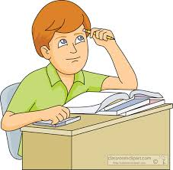
Home work
Write briefly how you observed this year’s Pahela Boishakh ?

Slide 25
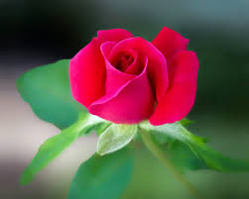
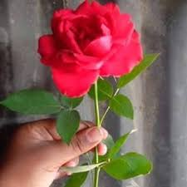
Thank you

