Slide 1
WELCOME

Slide 2
Md. Mizanru Rahman
Assistant Teacher
Kartala Govt. Primary school
Chandina, Cumilla.
01723316682

Slide 3
Subject:English
Class:Three
Lesson:Unit- 37
Time:40min

Slide 4
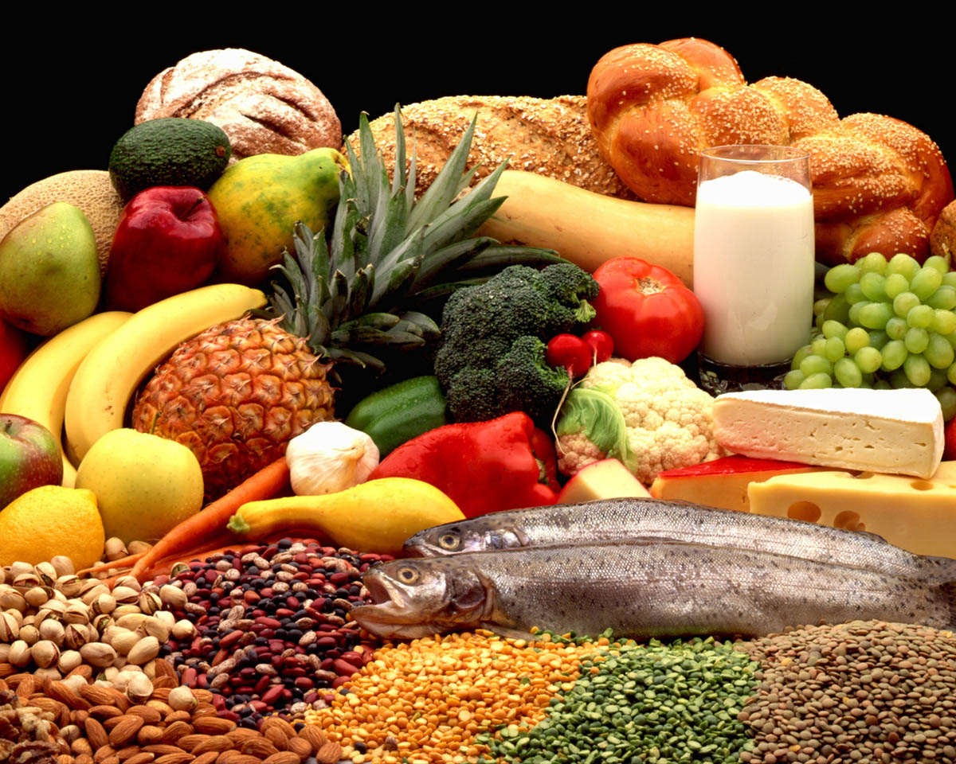

Slide 5
What food should we eat?
Page no-37

Slide 6
Learning Outcomes
1.1 able to read the lesson appropriately.
1.2 able to say about heaithy & unhealthy foods.
1.3 able to write about healthy & unhealthy foods.

Slide 7
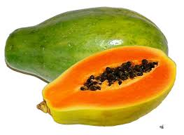
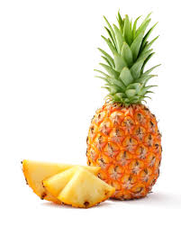
FRUITS
PAPAYA
PINEAPPLE
HEALTHY FOODS

Slide 8
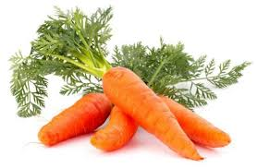
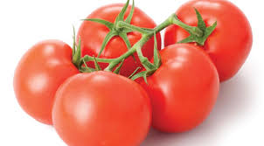
VEGETABLES
CARROTS
TOMATOES
Healthy Foods

Slide 9
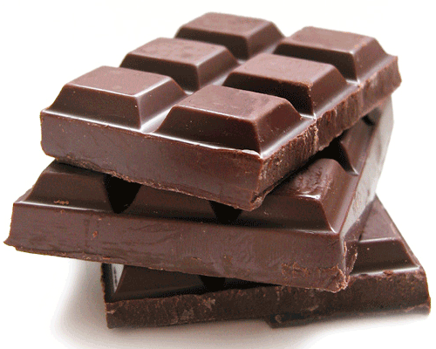
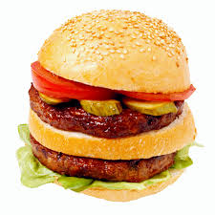
FOODS
CHOCOLATE
BURGER
Unhealty Foods

Slide 10
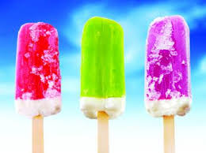
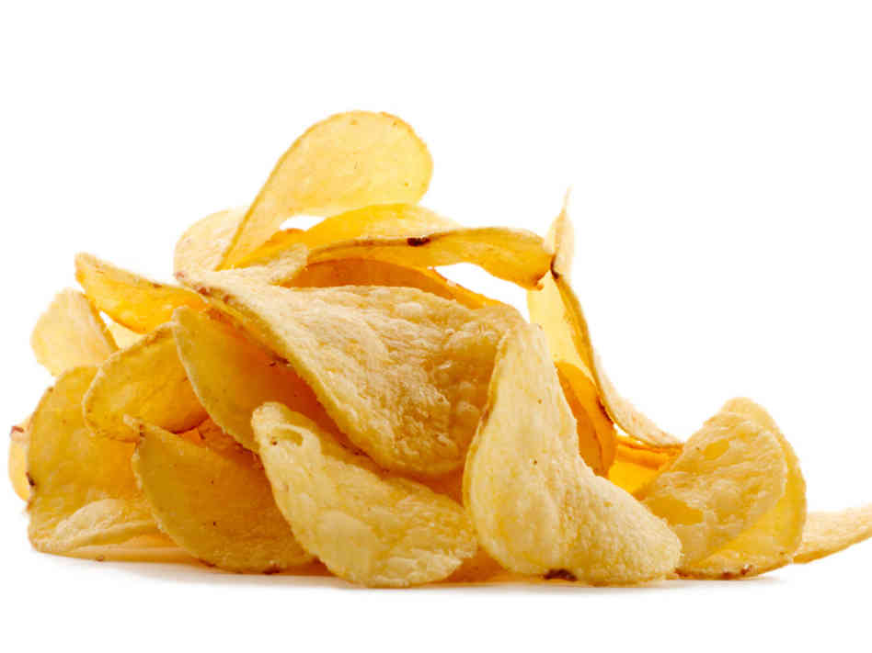
ICE-CREAM
CHIPS
Unhealthy Foods

Slide 11
Healthy food

Slide 12
Unhealthy Foods

Slide 13
GROUP WORK
A
Write down 4 healthy food.
B
Write down 4 unhealthy food.

Slide 14
Which food should we eat?
A
B
C

Slide 15
See you tomorrow

