Slide 1
Welcome to My class.

Slide 2
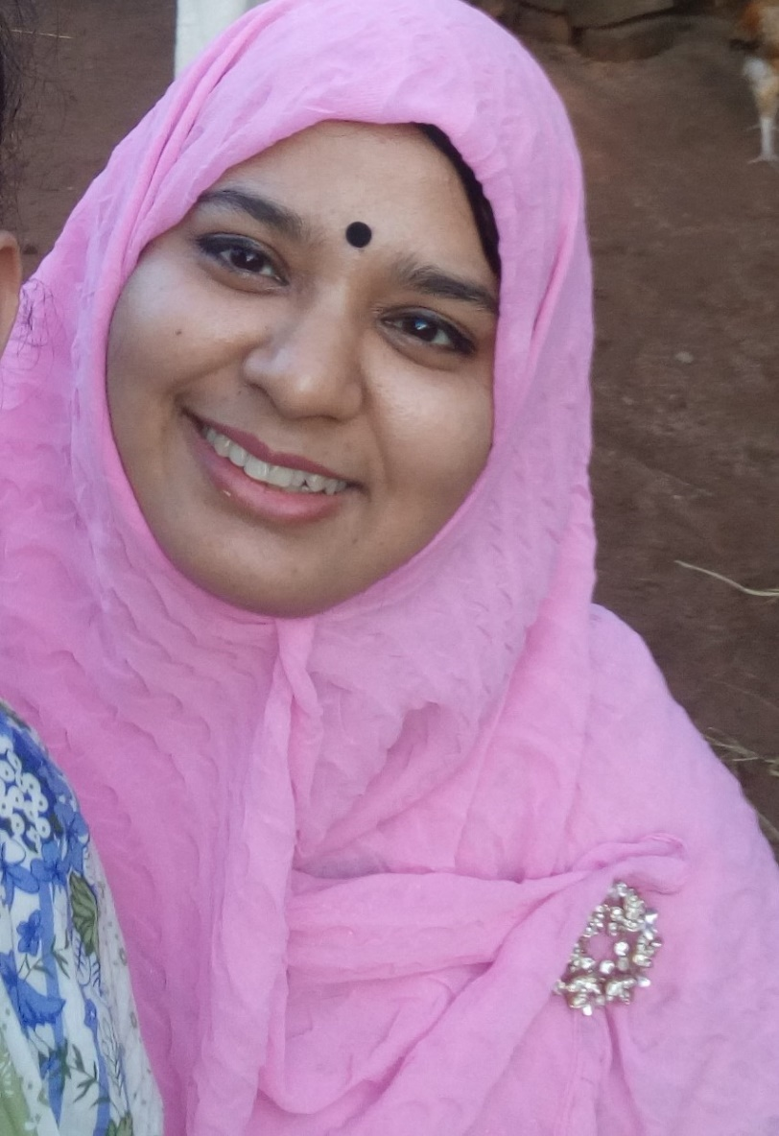
Teacher’s introduction
Syeda Nusrat Sarmin
Assistant Teacher
Ayjuddin GPS
Faridpur Sadar, Faridpur

Slide 3
Introduction of the lesson.
Class: Five
Subject: English
Unit:14, Lesson: 1
Activity: A,B,C,E,F&G,
Page: 55

Slide 4
LEARNING OUTCOMES
By the end of the lesson the students will be able to :
Listening: 1.3.1 recognize which words in a sentence are stressed.
4.2.1 understand and enjoy simple stories.
Speaking: 1.1.1 say words, phrases and sentences with proper sounds and stress.
1.1.2 say sentences with proper intonation.
6.1.2 say what others are doing.
6.2.1 talk about people, objects, events etc.
Reading: 1.5.1 read words, phrases and sentences in the text with proper pronunciation, stress and intonation.
1.7.1 read paragraphs, dialogues, stories, letters and other text.
7.1.1 recognize punctuation marks and read accordingly.

Slide 5
Teaching aids :
Pictures of seed, tub, sun, plant,
Poster paper
Slide

Slide 6
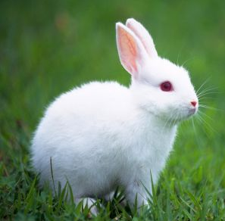
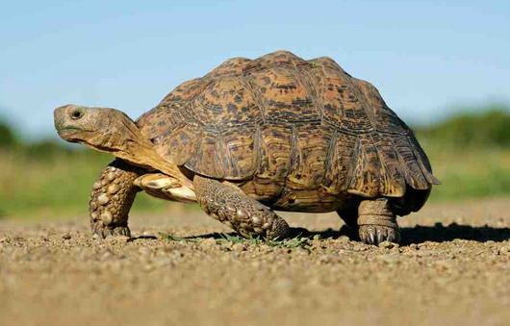
Look at the pictures.
Do you know them?
Hare
Tortoise

Slide 7
Our today’s lesson is
Story: The hare and the tortoise
Unit: 14, Lesson: 1, Activity A,B,C,E,F&G;
Page: 55

Slide 8
New Words
Asleep (adj)
Asleep
Asleep – ঘুমন্ত/ নিদ্রিত

Slide 9
New Words
Competition (n)
Competition
Competition – প্রতিযোগিতা

Slide 10
New Words
Furious (adj)
Furious
Furious – উগ্র/ ক্ষিপ্ত/ উন্মত্ত

Slide 11
New Words
Nap (n)
Nap
Nap – হালকা নিদ্রা

Slide 12
New Words
Steadily (adv)
Steadily
Steadily – ধীরস্থিরভাবে

Slide 15
The hare ran quickly and in a few minutes the hare was out of sight. The hare said to himself, “ The tortoise is very far behind. I can see the finish line. I have time for a nap!” Soon the hare was asleep under a tree next to the path.
The hare ran quickly and in a few minutes the hare was out of sight. The hare said to himself, “ The tortoise is very far behind. I can see the finish line. I have time for a nap!” Soon the hare was asleep under a tree next to the path.
The hare ran quickly and in a few minutes the hare was out of sight. The hare said to himself, “ The tortoise is very far behind. I can see the finish line. I have time for a nap!” Soon the hare was asleep under a tree next to the path.
The tortoise walked steadily, on and on. He didn’t stop. Soon, he passed the sleeping hare.
The tortoise walked steadily, on and on. He didn’t stop. Soon, he passed the sleeping hare.
The tortoise walked steadily, on and on. He didn’t stop. Soon, he passed the sleeping hare.

Slide 17
The hare slept for an hour. When he finally wake up, he looked at the finish line. He couldn’t believe his eyes! Tortoise was almost at the finish line! The hare ran as fast as he could, but it was too late. The tortoise crossed the finish line and won the competition! The hare was furious!
The tortoise looked back at the hare and smiled. Then he said, “Slow but steady wins the race!”
The hare slept for an hour. When he finally wake up, he looked at the finish line. He couldn’t believe his eyes! Tortoise was almost at the finish line! The hare ran as fast as he could, but it was too late. The tortoise crossed the finish line and won the competition! The hare was furious!
The tortoise looked back at the hare and smiled. Then he said, “Slow but steady wins the race!”
The hare slept for an hour. When he finally wake up, he looked at the finish line. He couldn’t believe his eyes! Tortoise was almost at the finish line! The hare ran as fast as he could, but it was too late. The tortoise crossed the finish line and won the competition! The hare was furious!
The tortoise looked back at the hare and smiled. Then he said, “Slow but steady wins the race!”

Slide 18
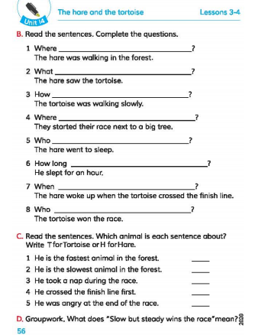

Slide 19
B. Read the sentences. Complete the questions.
Who ___________________________ ?
The hare went to sleep.
How long ________________________ ?
He slept for an hour.
When ____________________________ ?
The hare wake up when the tortoise crossed the finish line.
Who __________________________ ?
The tortoise won the race.
5.
went to sleep
6.
did he sleep
7.
did the hare wake up
Won the race
8.

Slide 21
C. Read the sentences. Which animal is each sentence about? Write T for Tortoise or H for Hare.
He is the faster animal in the forest.
He is the slowest animal in the forest.
He took a nap during the race.
He laughed and laughed.
He crossed the finish line first.
He was angry at the end of the race.
H
T
H
H
T
H

Slide 22
E. Fill in the blanks with the correct word from the box.
faster | passed | raced | slowest | steadily | took | won
The hare was the ______ animal, but the tortoise
was the _______. One day, the tortoise and the hare _______. The hare ran very quickly, but then he _______ a nap. The tortoise walked on ____________
While the hare was sleeping, the tortoise ______ him. The tortoise crossed the finish line first and ______ the race!
faster
slowest
raced
took
steadily
passed
won

Slide 23
F. Match the words in column A with the words with similar meaning in column B.
A B
angry begin
fast beside
nap furious
next to quick
start sleep

Slide 24
Language focus
G. Quotation marks(“ ”).
We use quotation marks to show someone said. We put quotation marks at the beginning and the end of the person’s words. Use a comma before or after quotation marks. Start the first word inside the quotation marks with a capital letter.
The hare said, “I am the fastest animal.”
“I am the slowest animal,” said the tortoise.

Slide 25
Evaluation
Write ‘True’ for correct statement or ‘False’ for incorrect statement.
True
The hare was the fastest animal.
The tortoise felt angry with the hare.
The hare wanted to have a race first.
Their friends came to participate
in the race.
The hare took rest during the race.
Slow but steady wins the race.
True
False
False
True
True

Slide 26
Home work
Underline the sentences with quotation marks on pages 54 and 55.

Slide 27
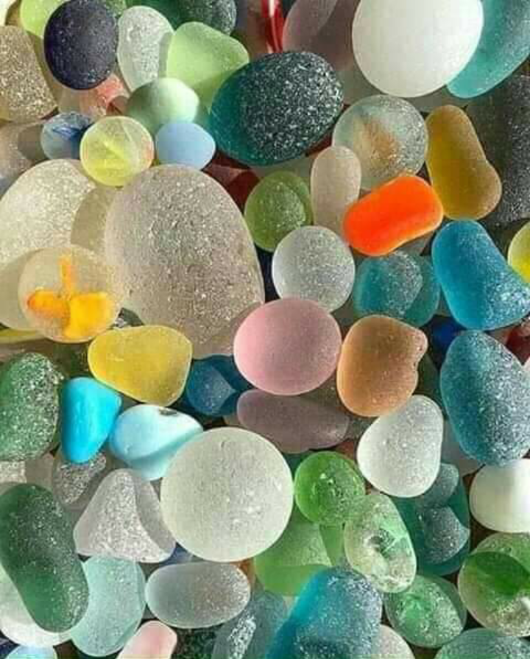
As you sow, so you reap.
যেমন কর্ম তেমন ফল।
Goodbye
dear students.

